Slide 1
Global Rotavirus Surveillance Network (GRSN) &
Global Pediatric diarrhoea Surveillance (GPDS) update
December 2025
Global Immunization Monitoring and Surveillance Team

Slide 2
Introduction
Dear Colleagues,
We are pleased to share the latest update from the World Health Organization (WHO)-coordinated Global Rotavirus Surveillance Network (GRSN) and Global Pediatric Diarrhoea Surveillance (GPDS).
This slide deck reports the most up-to-date global surveillance data reported to WHO HQ as of November 2025, which includes GRSN data from recent years with a focus on 2022-2024, as well as the most recent GPDS data available from 2017-2023.
Thank you to everyone from staff at the sentinel surveillance hospitals and Member States, concerned WHO regional and country offices, and to the country, regional and global partners who make this surveillance possible. We look forward to continuing to work together to strengthen these surveillance networks!
We hope you enjoy the update! Please feel free to forward to other interested parties.
WHO HQ – Global Immunization Monitoring and Surveillance Team
Copyright © 2025 World Health Organization, All rights reserved.

Slide 3
Disclaimers
Please note that all data contained within is provisional. If any numbers from this provisional data are quoted, they should be properly sourced with a date (i.e., "provisional data based on data reported to WHO (Geneva) as of November 2025").
All presented data is based upon data reported to WHO (Geneva); it is possible that additional data exists but has not yet been reported to all levels.
These data come from children aged <5 years hospitalized with diarrhoea at sentinel surveillance hospitals, and may not be representative of non-hospitalized diarrhoea or geographies beyond the catchment areas of the surveillance hospitals

Slide 4
GRSN & GPDS update: contents
Topic | Slide number
GRSN & GPDS surveillance objectives | 5
Global GRSN & GPDS surveillance meeting – Nov 2024 and Dec 2023 | 6
Global Rotavirus Surveillance Network (GRSN) | 11
Surveillance and laboratory performance | 16
Rotavirus positivity | 22
Genotype data | 36
Laboratory updates | 40
Global Pediatric Diarrhoea Surveillance (GPDS) | 52
GRSN and GPDS case definitions and procedures | 63
Recent GRSN/GPDS publications | 65
Additional information | 73

Slide 5
Surveillance objectives
GRSN GPDS
In countries that have not yet introduced rotavirus vaccine –
  Generate data to advocate for vaccine introduction
In countries that have introduced rotavirus vaccine –
  Evaluate vaccine effectiveness & impact
  Monitor changes in disease and/or genotypes to inform changes to vaccine product or schedule
Globally –
  Monitor rotavirus burden & circulating rotavirus genotypes
Evaluate pathogens associated with hospitalized pediatric diarrhoea
Monitor changing burden of pathogens over time
Monitor circulating strains
Inform global, regional, & country disease burden estimates
Inform new enteric vaccine development
Provide a platform for future vaccine evaluation

Slide 6
Global Rotavirus and Pediatric Diarrhoea Surveillance Meeting – November 2024

Slide 7
2024 Global Rotavirus and Pediatric Diarrhoea and Surveillance Meeting
Held at the Fairmount Hotel in Cairo, Egypt, 11-14 November 2024
The meeting brought together >60 colleagues from WHO HQ, Regional Offices, Country Offices, Ministries of Health, Regional Reference Laboratories and partners (U.S. CDC, University of Virginia, Gates Foundation)
Meeting conclusions:
  Recent data showed that the Global Rotavirus and Pediatric Diarrhoea Surveillance networks have recovered from COVID-19 pandemic impact on surveillance performance, and have improved on the intended timeline of specimen testing and data reporting
  The meeting highlighted rotavirus surveillance in the Eastern Mediterranean region
  We collectively discussed priorities and future activities for rotavirus and pediatric diarrhoea surveillance, as well as priorities and activities specific to each WHO Region, the reimagining of the GPDS network and the publication of manuscripts describing results from the network.

Slide 8
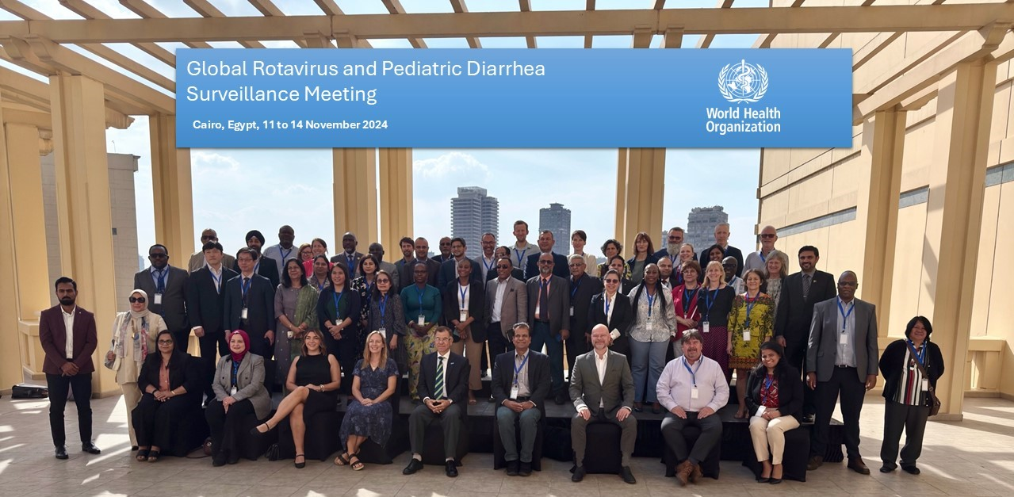
2024 Global Rotavirus and Pediatric Diarrhoea Surveillance Meeting

Slide 9
2023 Global Rotavirus and Pediatric Diarrhoea and Surveillance Meeting
Held at the Western Pacific Regional Office (WPRO) campus in Manila, Philippines, 11-13 December 2023
The meeting brought together >60 colleagues from WHO HQ, Regional Offices, Country Offices, Ministries of Health, Regional Reference Laboratories and partners (U.S. CDC, University of Virginia, Bill & Melinda Gates Foundation)
Meeting conclusions:
  Recent data showed that the Global Rotavirus and Pediatric Diarrhoea Surveillance networks continue to recover from COVID-19 pandemic impact on surveillance performance, and to get back on the intended schedule of specimen testing and data reporting
  The meeting highlighted the most recent country to join Global Pediatric Diarrhoea Surveillance (Philippines) as well as other Western Pacific Region countries participating in the surveillance networks
  We collectively discussed priorities and future activities for rotavirus and pediatric diarrhoea surveillance, as well as priorities and activities specific to each WHO Region
The final meeting report is available online: Global rotavirus and pediatric diarrhoea surveillance: meeting report, WHO Regional Office for the Western Pacific, Manila, Philippines, 11-13 December 2023

Slide 10
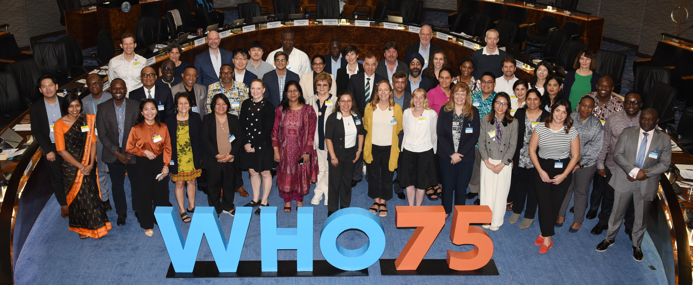
2023 Global Rotavirus and Pediatric Diarrhoea Surveillance Meeting

Slide 11
Global Rotavirus Surveillance Network
(GRSN)

Slide 12
Over a decade of rotavirus surveillance
Pre-2010 Rotavirus surveillance networks began in some regions
2010 WHO-coordinated Global Rotavirus Surveillance Network (GRSN) established: aggregate and unlinked but standardized
2013 Strategic review of GRSN and SAGE endorsement: Transition to case-based, laboratory-linked data
2014-today GRSN conducted in all 6 WHO Regions

Slide 13
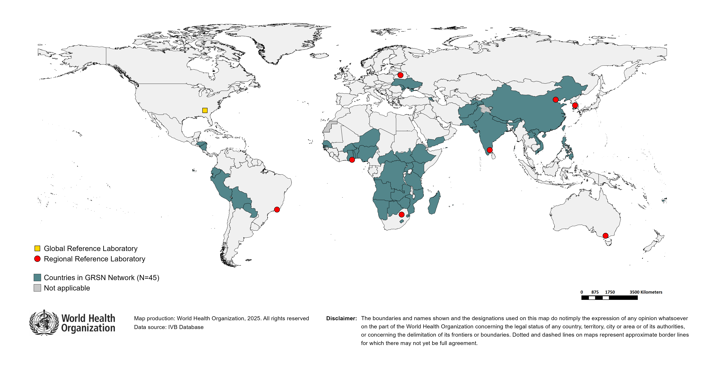
Countries reporting data to the Global Rotavirus Surveillance Network, 2022
Countries participating: AFG, AGO, ARM, BEN, BFA, BOL, BWA, CAF, CHN, COD, ECU, ETH, FJI, GHA, HND, IND, KEN, LAO, LSO, MDA, MDG, MOZ, MUS, NAM, NER, NGA, NIC, NPL, PAK, PER, PHL, PRY, SEN, SSD, SWZ, SYC, TGO, TJK, TZA, UGA, UKR, VNM, YEM, ZMB, ZWE

Slide 14
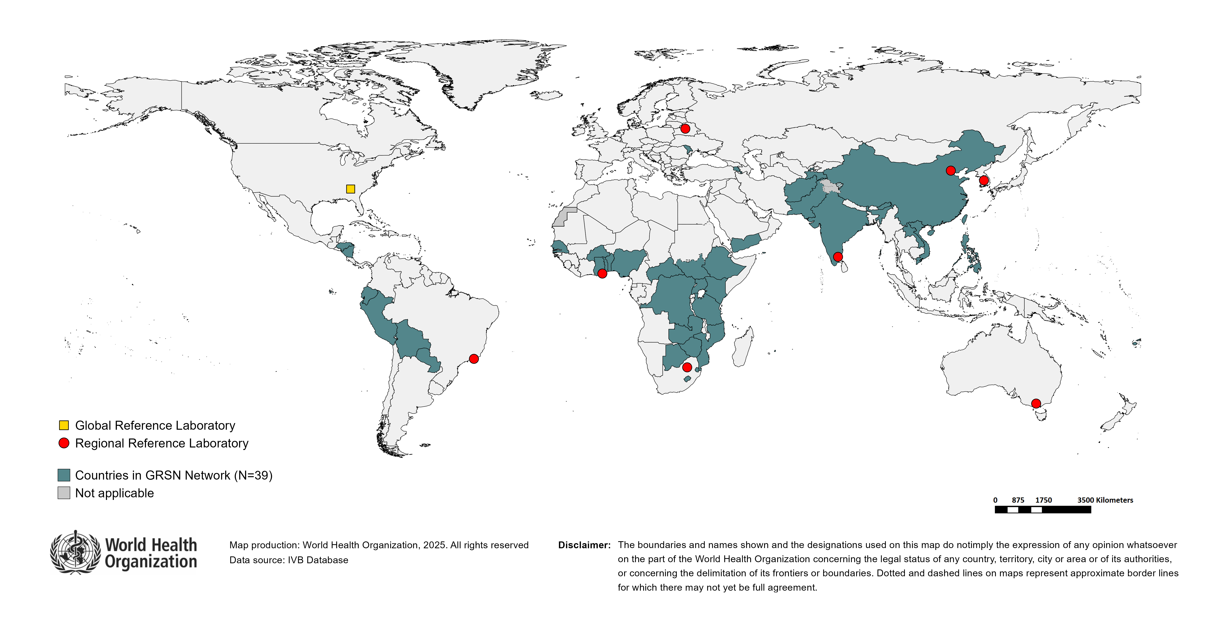
Countries reporting data to the Global Rotavirus Surveillance Network, 2023
Countries participating: AFG, ARM, BEN, BFA, BOL, BWA, CAF, CHN, COD, ECU, ETH, FJI, GHA, HND, IND, KEN, LAO, LSO, MDA, MOZ, MUS, NGA, NIC, PAK, PER, PHL, PRY, SEN, SSD, SWZ, SYC, TGO, TJK, TZA, UGA, VNM, YEM, ZMB, ZWE

Slide 15
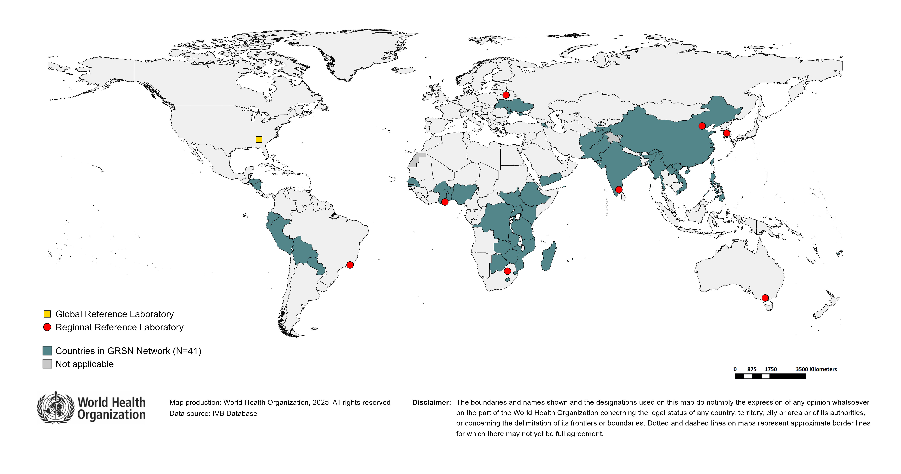
Countries reporting data to the Global Rotavirus Surveillance Network, 2024
Countries participating: AFG, ARM, BEN, BFA, BOL, BWA, CHN, COD, ECU, ETH, FJI, GHA, HND, IND, KEN, LAO, LSO, MDA, MDG, MMR, MOZ, MUS, NGA, NIC, PAK, PER, PHL, PRY, SEN, SSD, SWZ, SYC, TGO, TJK, TZA, UGA, UKR, VNM, YEM, ZMB, ZWE

Slide 16
GRSN surveillance and laboratory performance

Slide 17
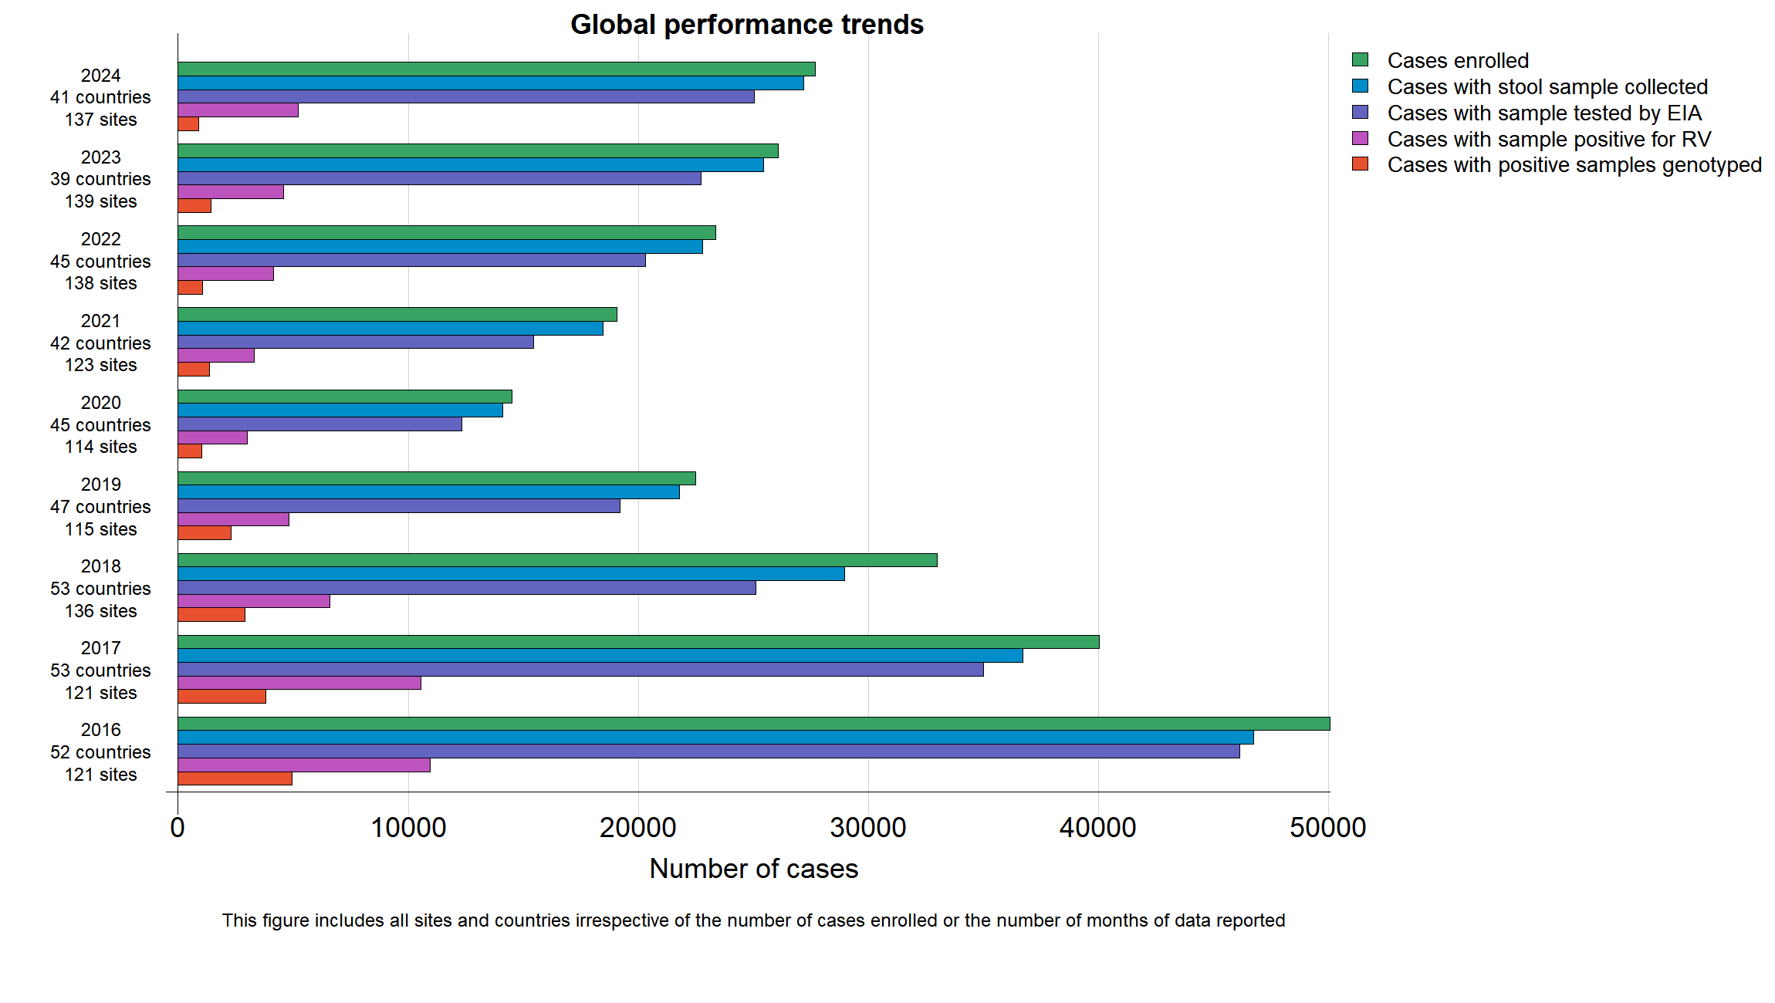
Global GRSN surveillance performance trends, 2016-2024

Slide 18
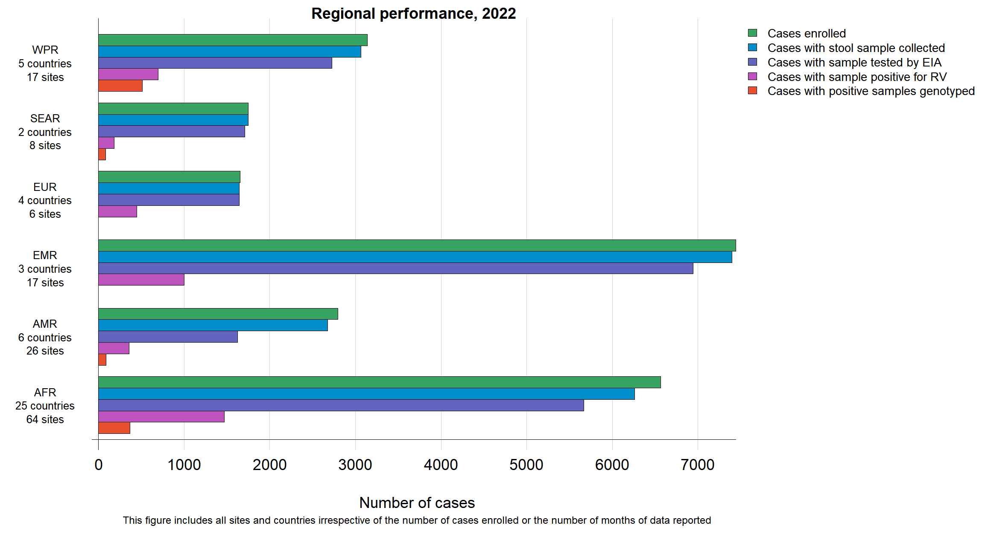
Regional GRSN surveillance performance, 2022

Slide 19
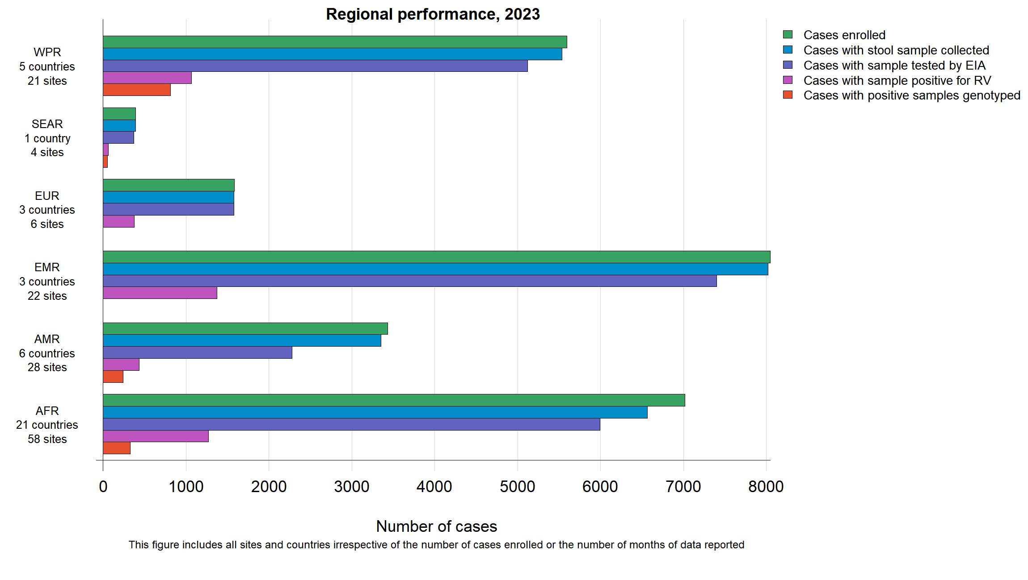
Regional GRSN surveillance performance, 2023

Slide 20
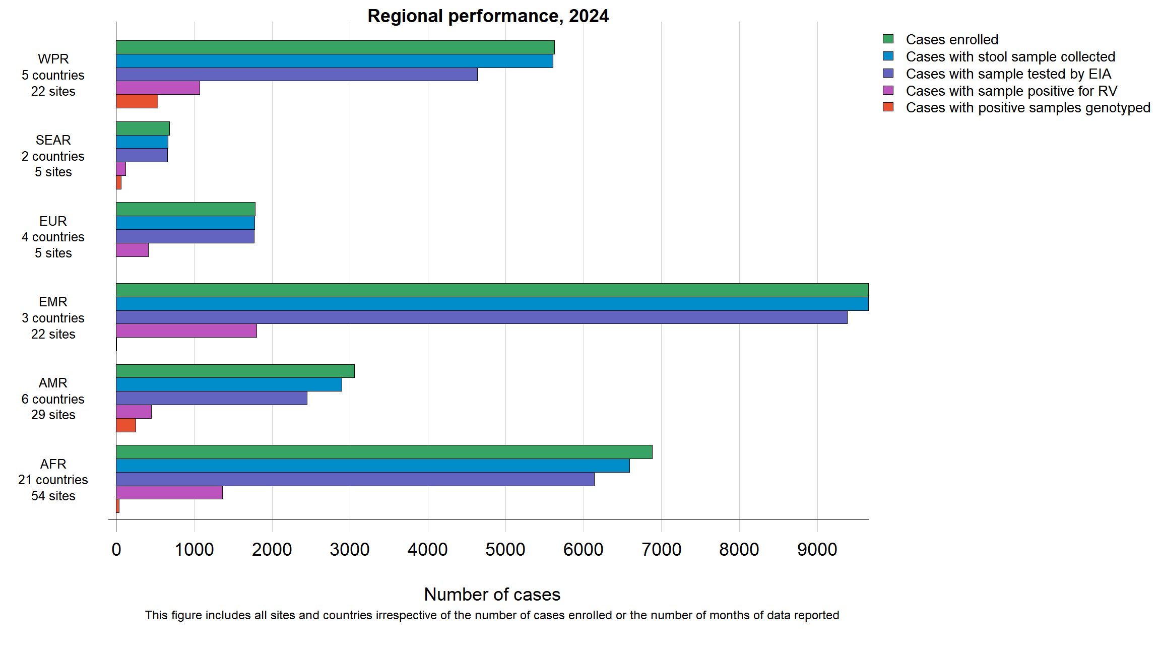
Regional GRSN surveillance performance, 2024

Slide 21
GRSN surveillance performance conclusions
Overall, surveillance performance and case enrolment has recovered from COVID-19 pandemic impact
  By 2022, the number of enrolled pediatric diarrhoea cases rebounded above pre-pandemic levels in 2019, with this trend continuing in 2023 and 2024
Work remains to improve the proportion of collected specimens tested by ELISA, and to increase the proportion of rotavirus-positive specimens with a genotype tested and reported

Slide 22
GRSN rotavirus positivity

Slide 23
The proportion of countries participating in GRSN that have introduced rotavirus vaccine has increased in recent years
2016
2024
n= 60 countries
n= 41 countries
Not yet
introduced
rotavirus
Not yet
vaccine
introduced
17%
(n=7)
rotavirus
vaccine
Introduced
40%
rotavirus
(n=24)
vaccine
60%
Introduced
(n=36)
rotavirus
vaccine
82%
(n=34)
Country vaccine introduction status data from: https://immunizationdata.who.int/global/wiise-detail-page/introduction-of-rotavirus-vaccine?ISO_3_CODE=&YEAR=

Slide 24
Rotavirus positivity was significantly lower in GRSN countries with rotavirus vaccine, 2016-2024

Slide 25
Rotavirus positivity was consistently lower in GRSN countries with rotavirus vaccine

Slide 26
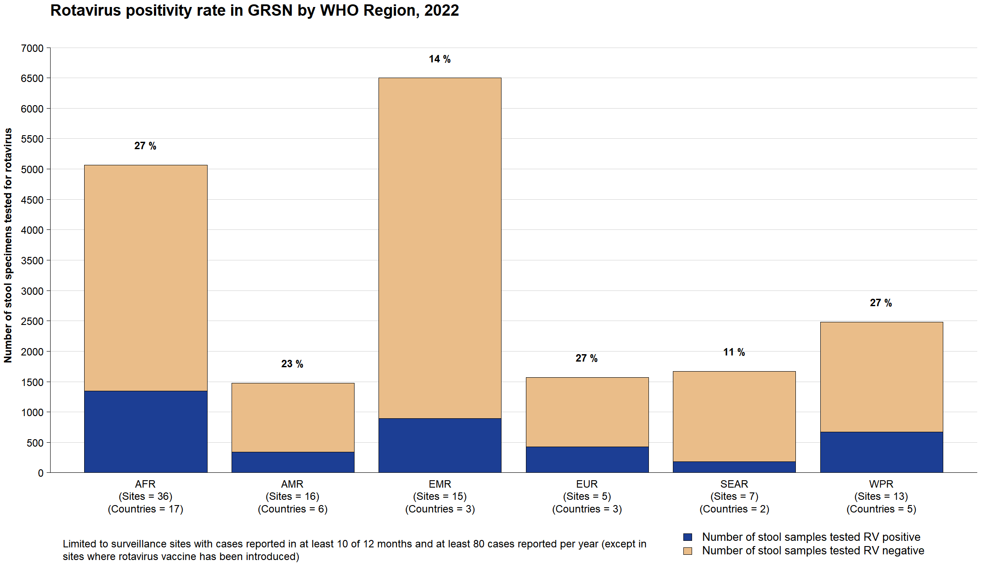
Based on data received as of 10 November 2025

Slide 27
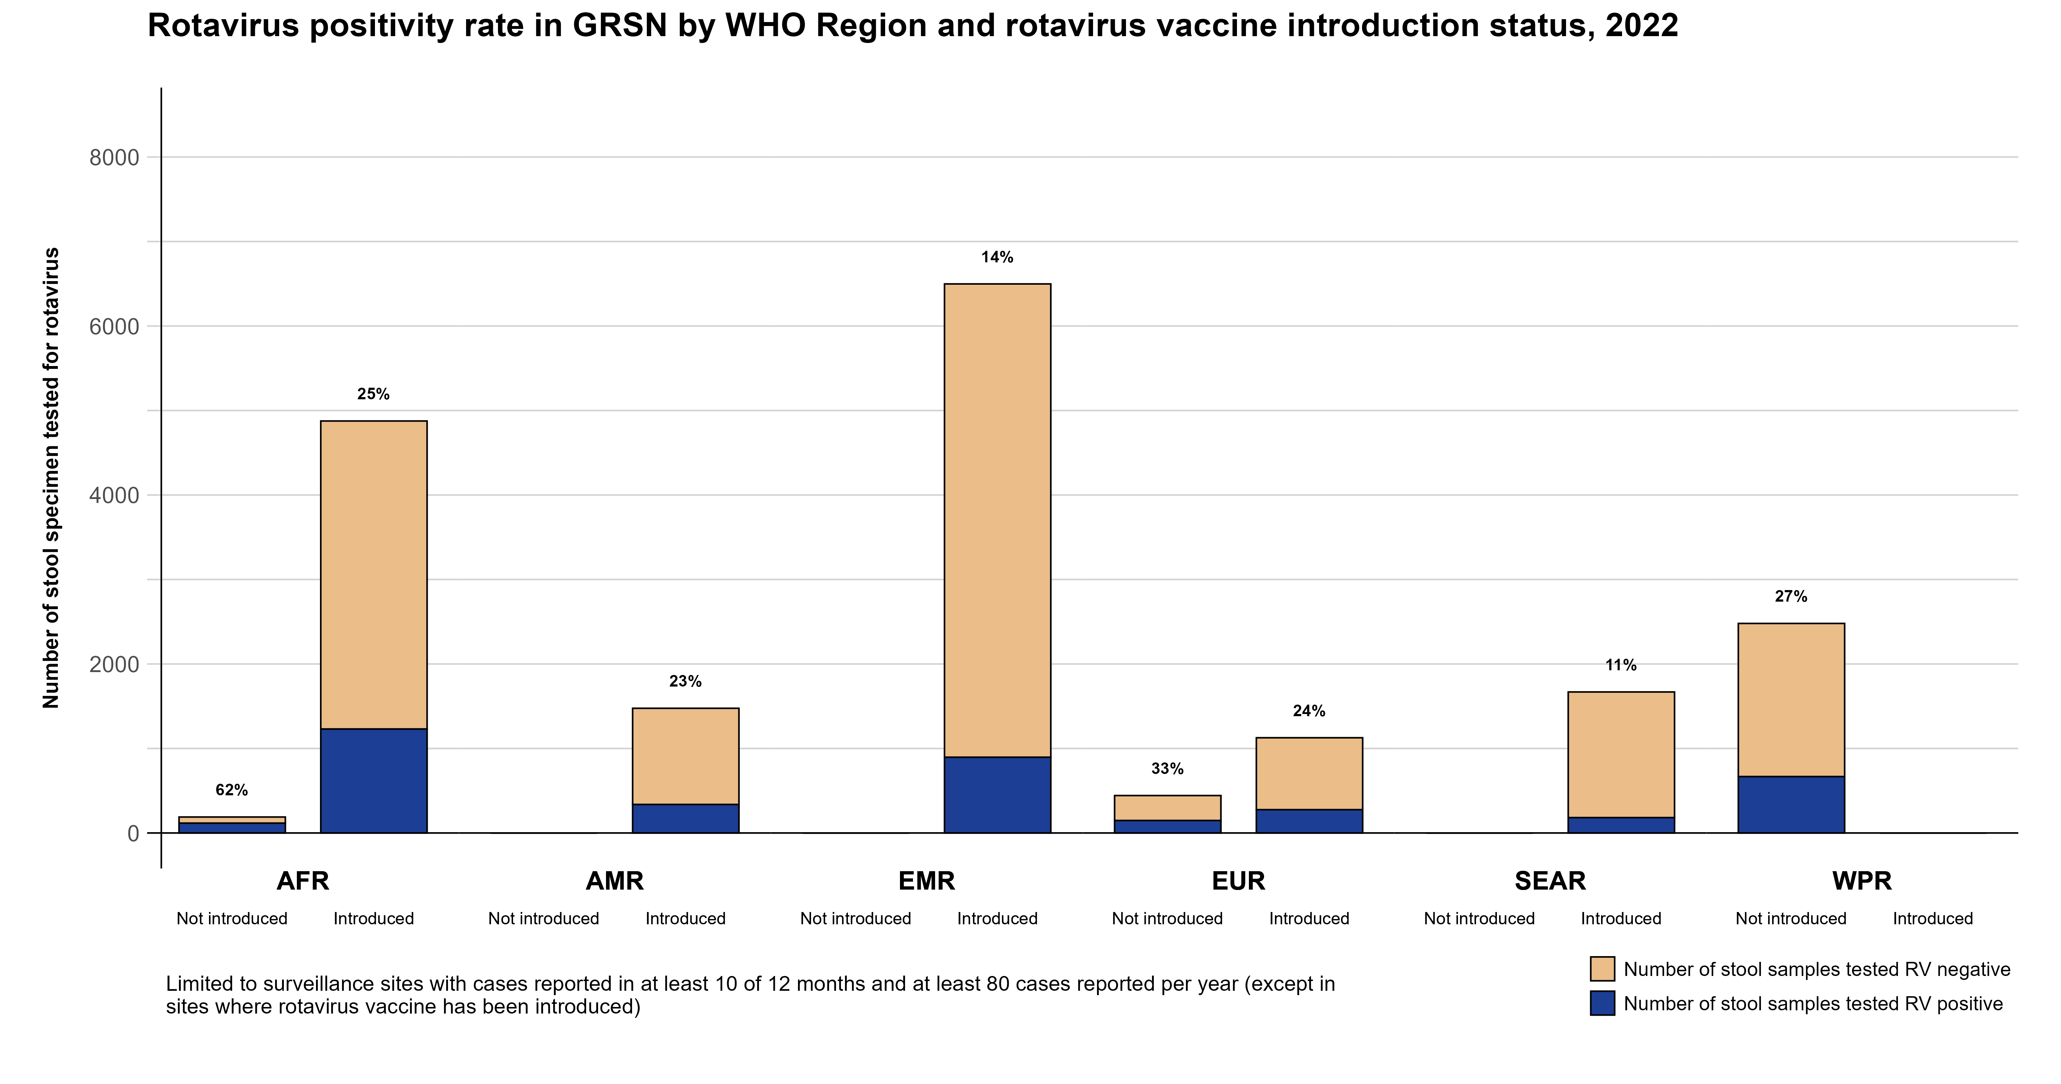
Based on data received as of 10 November 2025

Slide 28
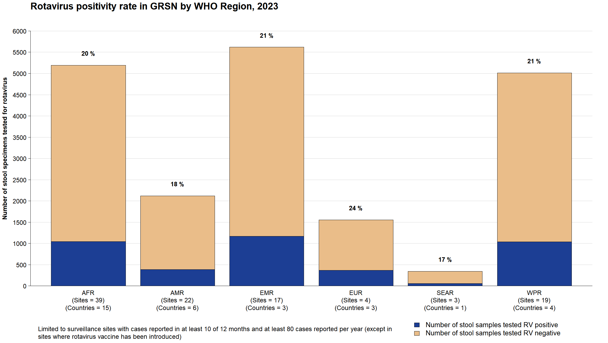
Based on data received as of 10 November 2025
Notes:
WPRO: 30%

Slide 29
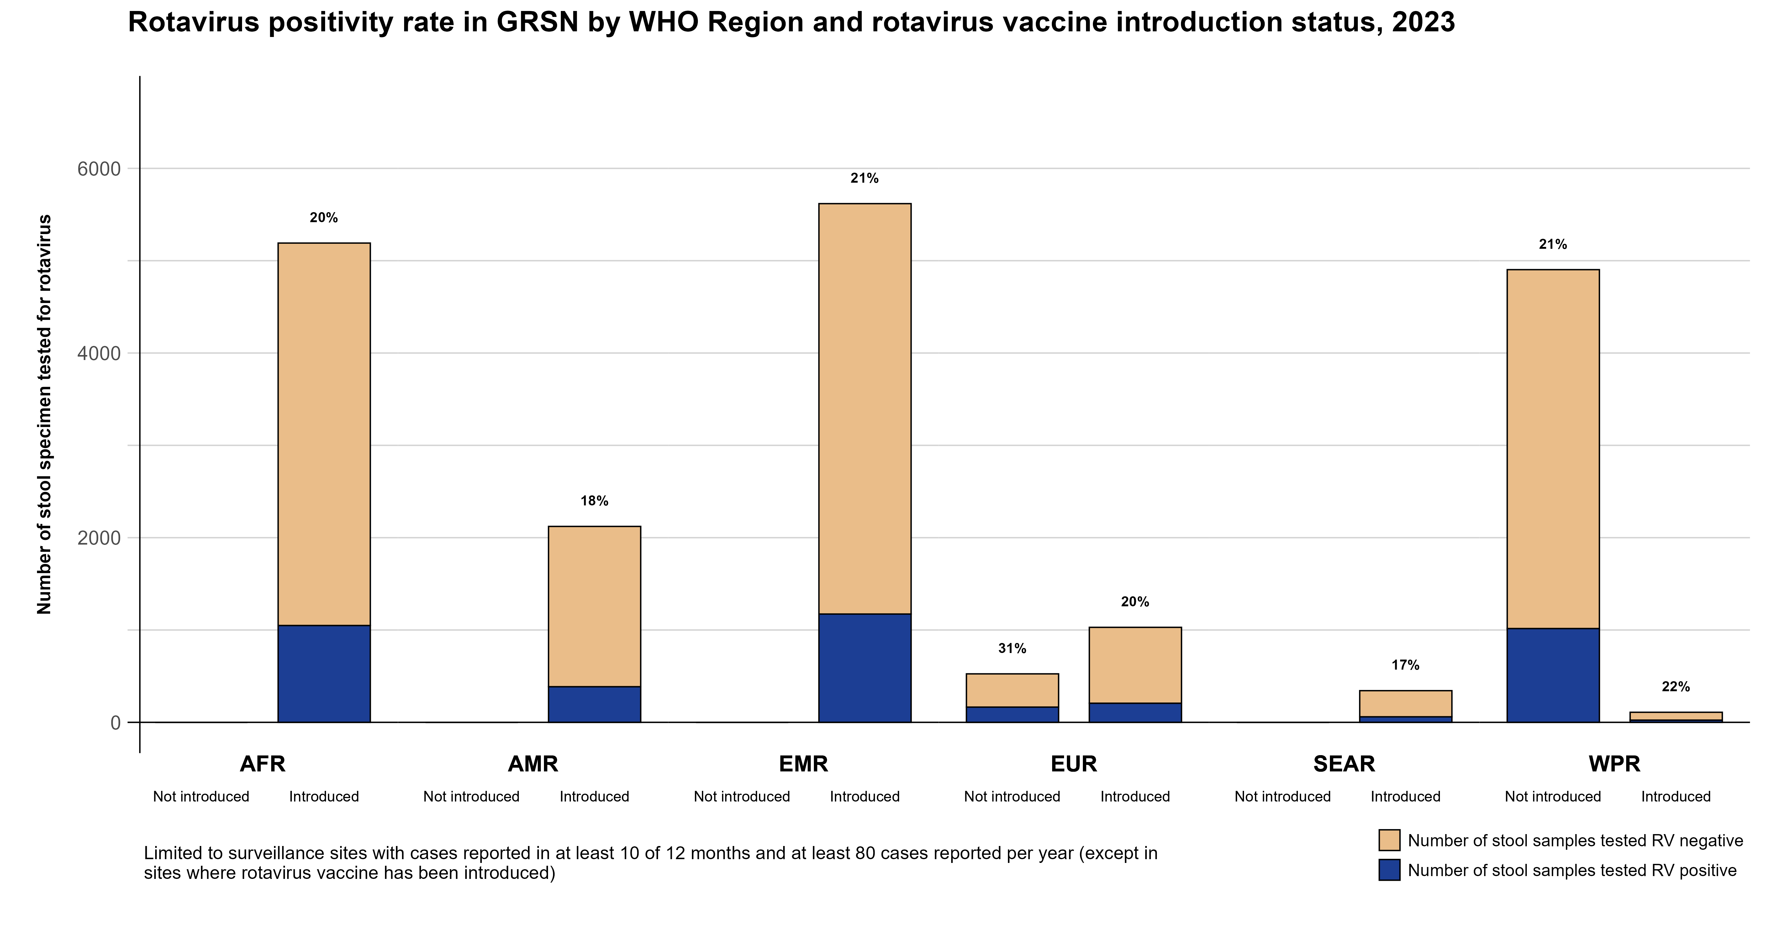
Based on data received as of 10 November 2025

Slide 30
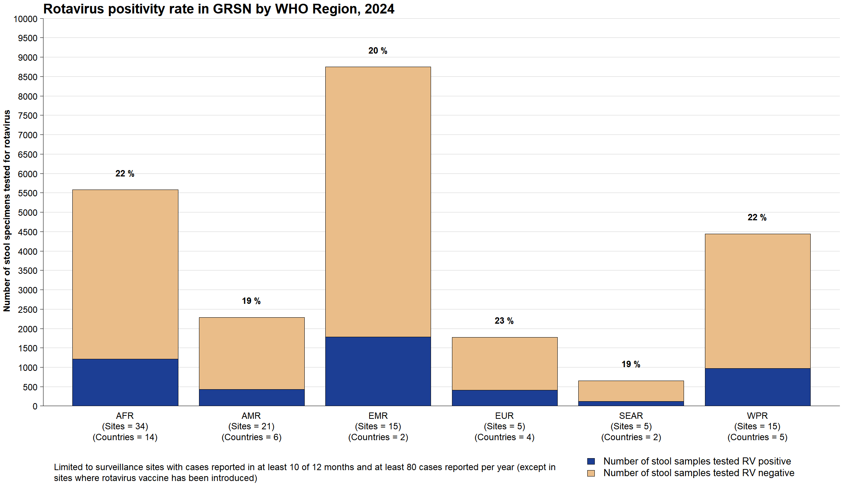
Based on data received as of 10 November 2025

Slide 31
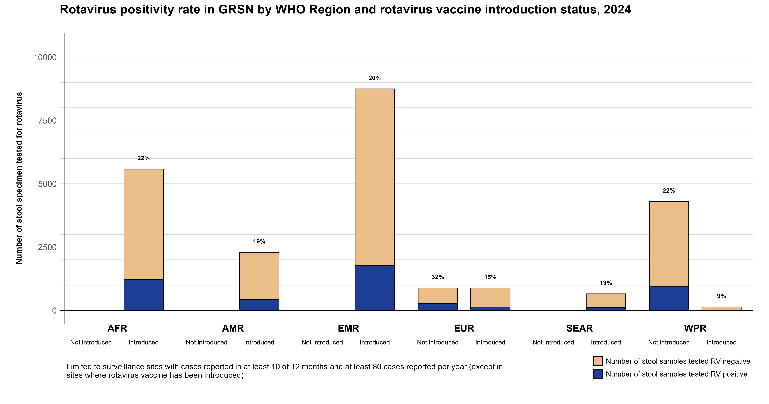
Based on data received as of 10 November 2025

Slide 32
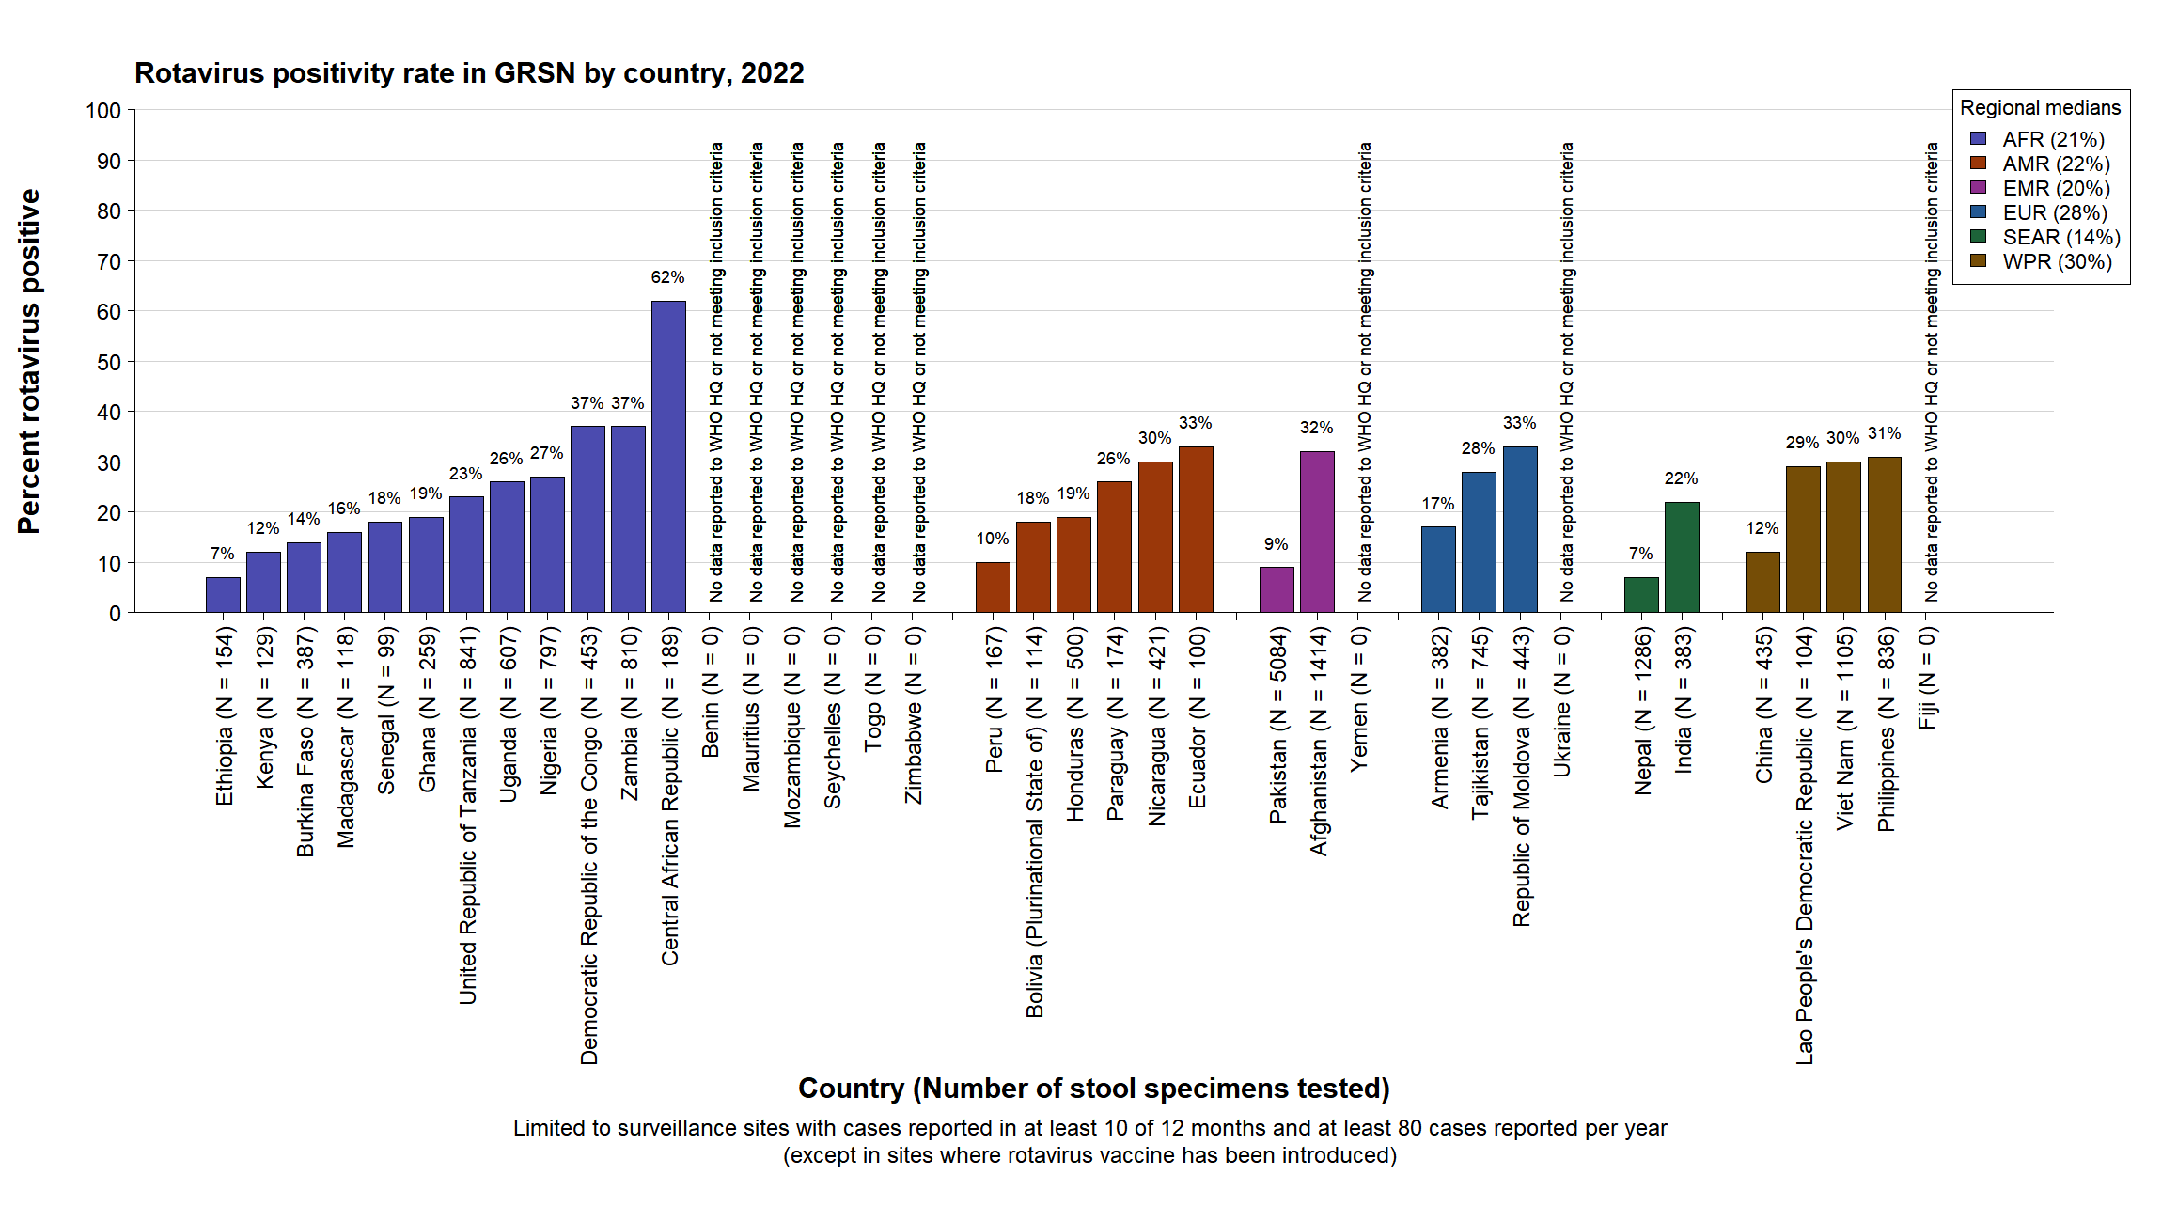
Based on data received as of 10 November 2025

Slide 33
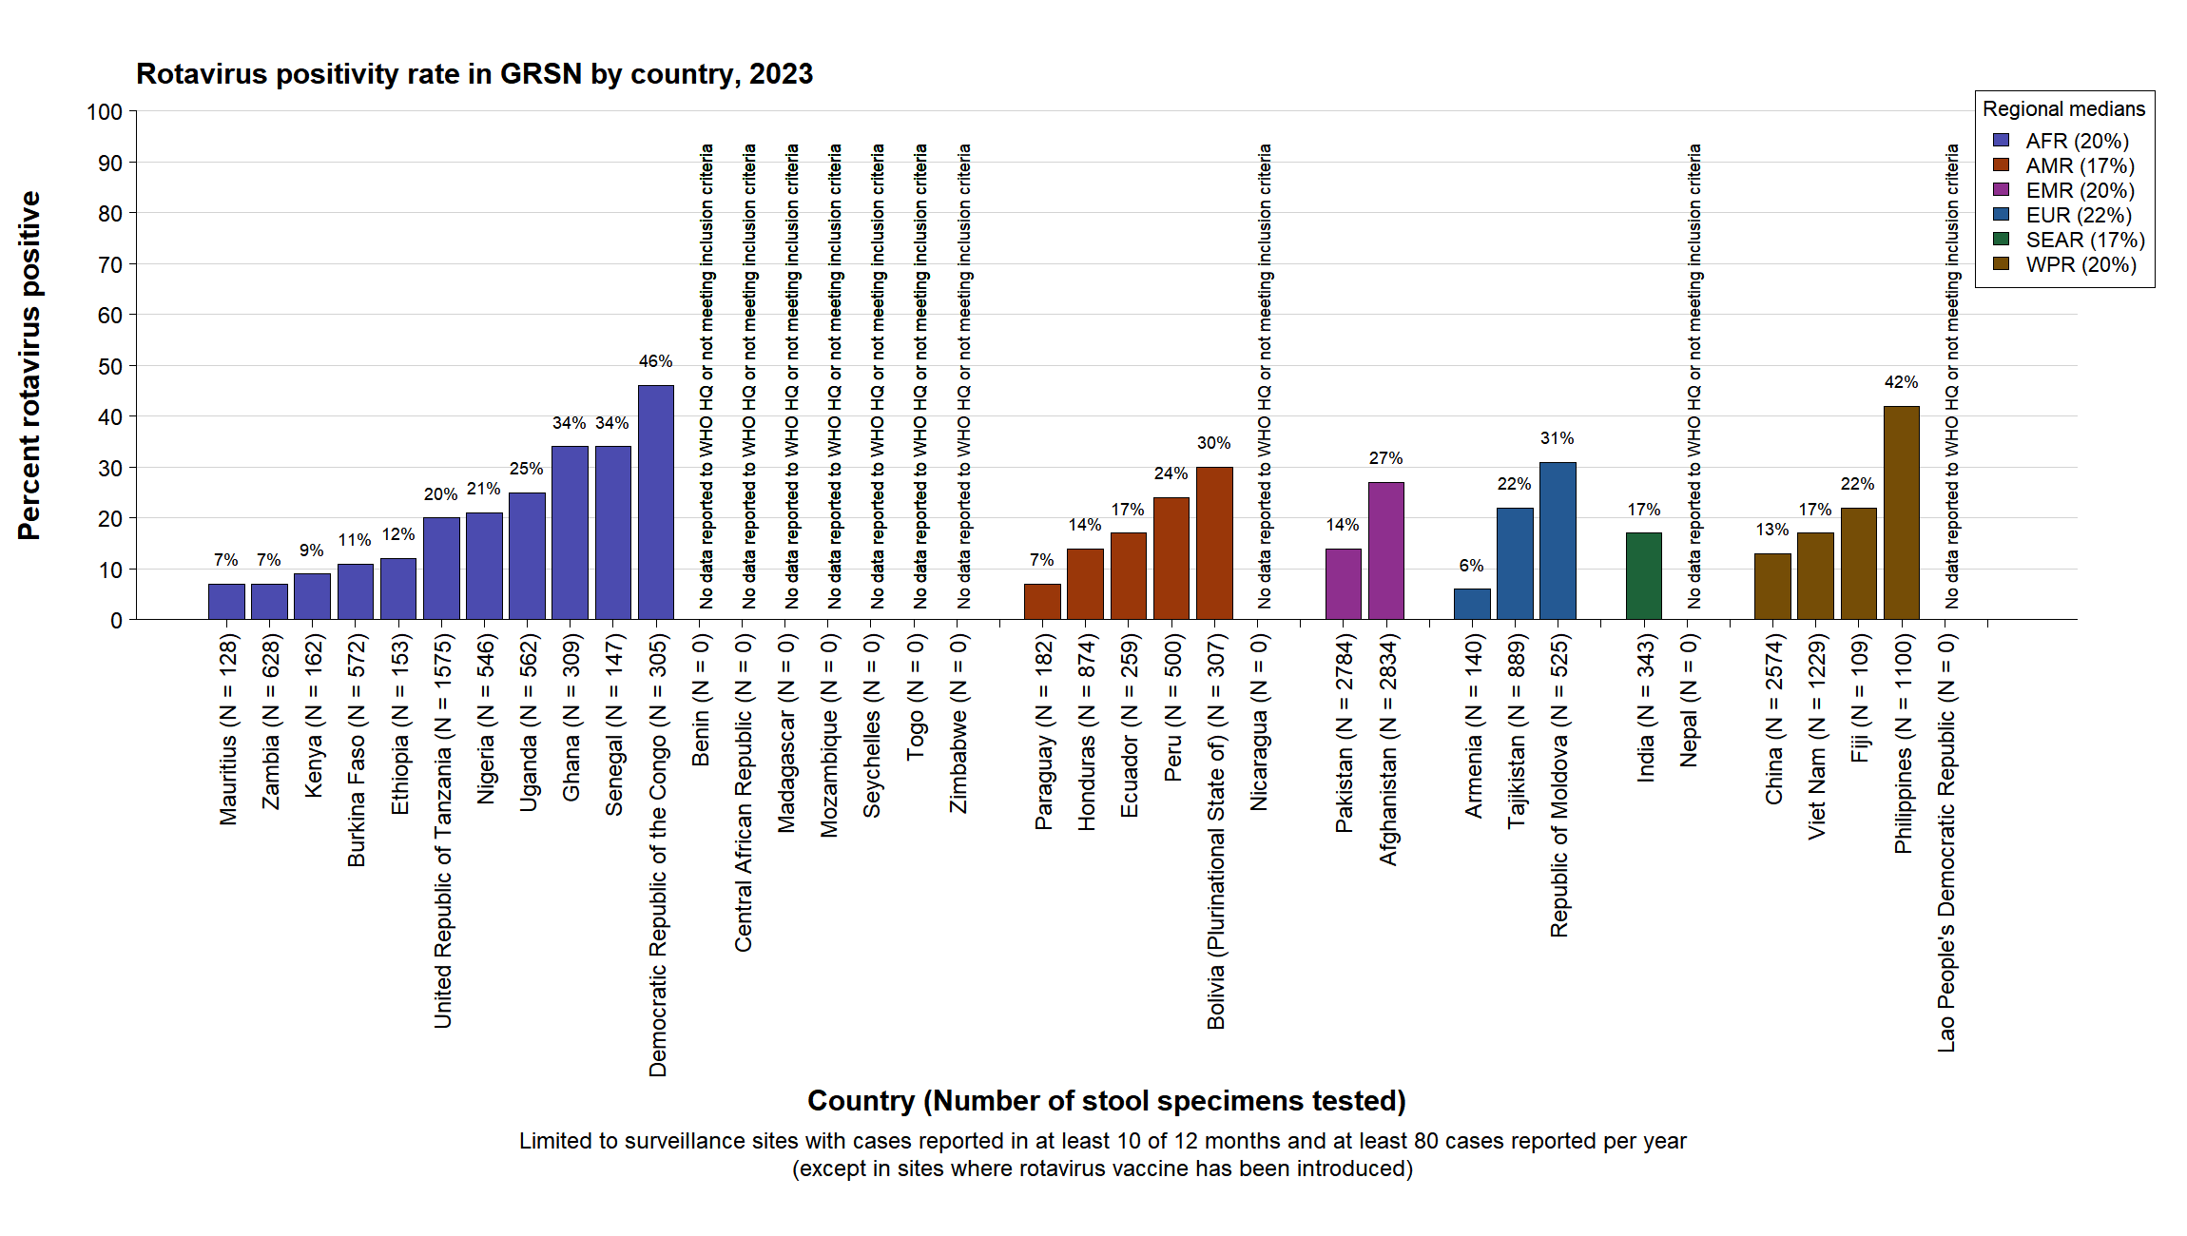
Based on data received as of 10 November 2025

Slide 34
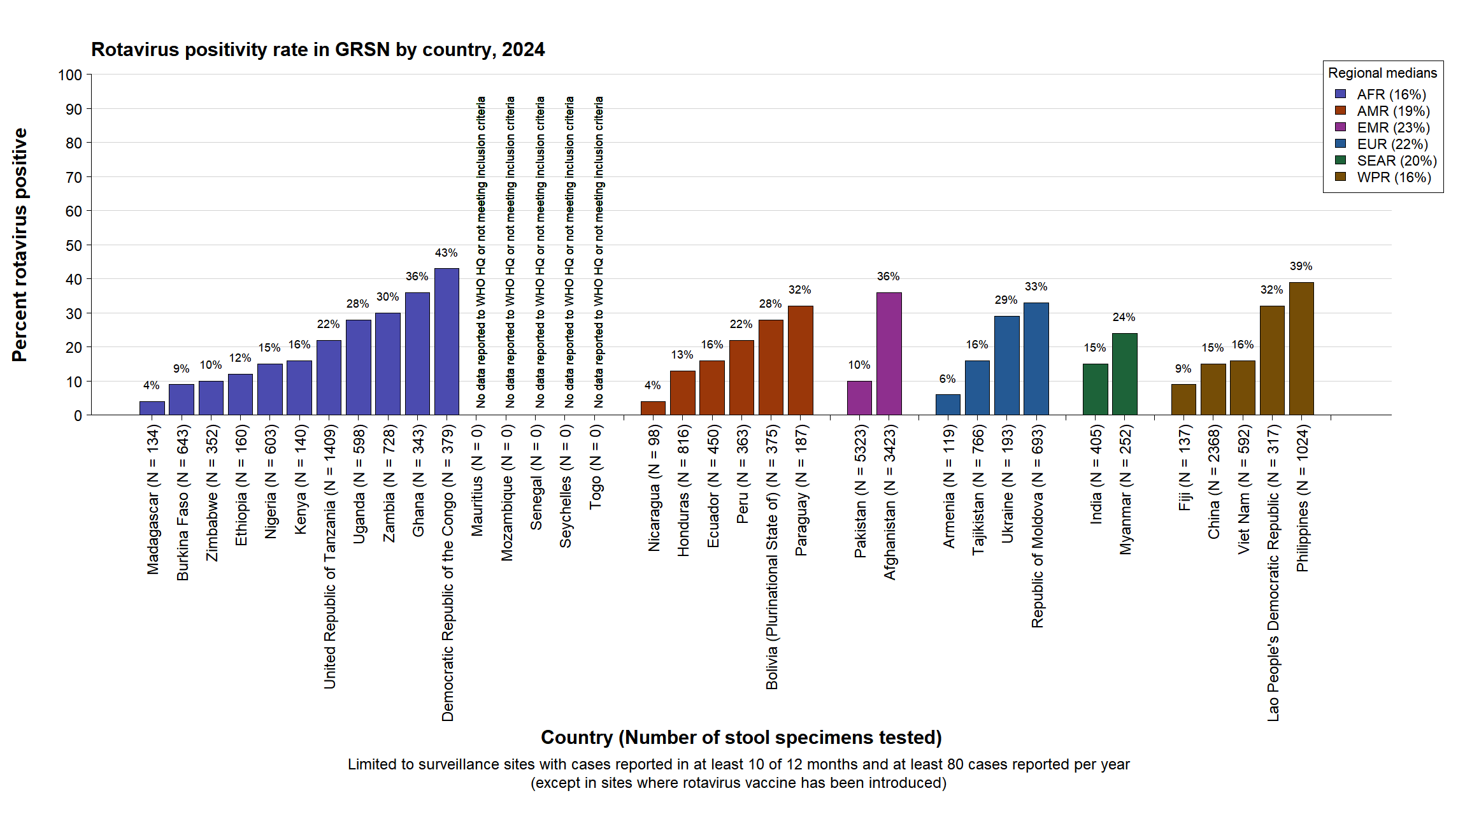
Based on data received as of 10 November 2025

Slide 35
GRSN rotavirus positivity conclusions
The proportion of countries participating in GRSN that have already introduced rotavirus vaccine has increased over time
Globally, rotavirus positivity among children hospitalized with diarrhoea remains consistently lower in countries with rotavirus vaccine

Slide 36
GRSN rotavirus genotype data

Slide 37
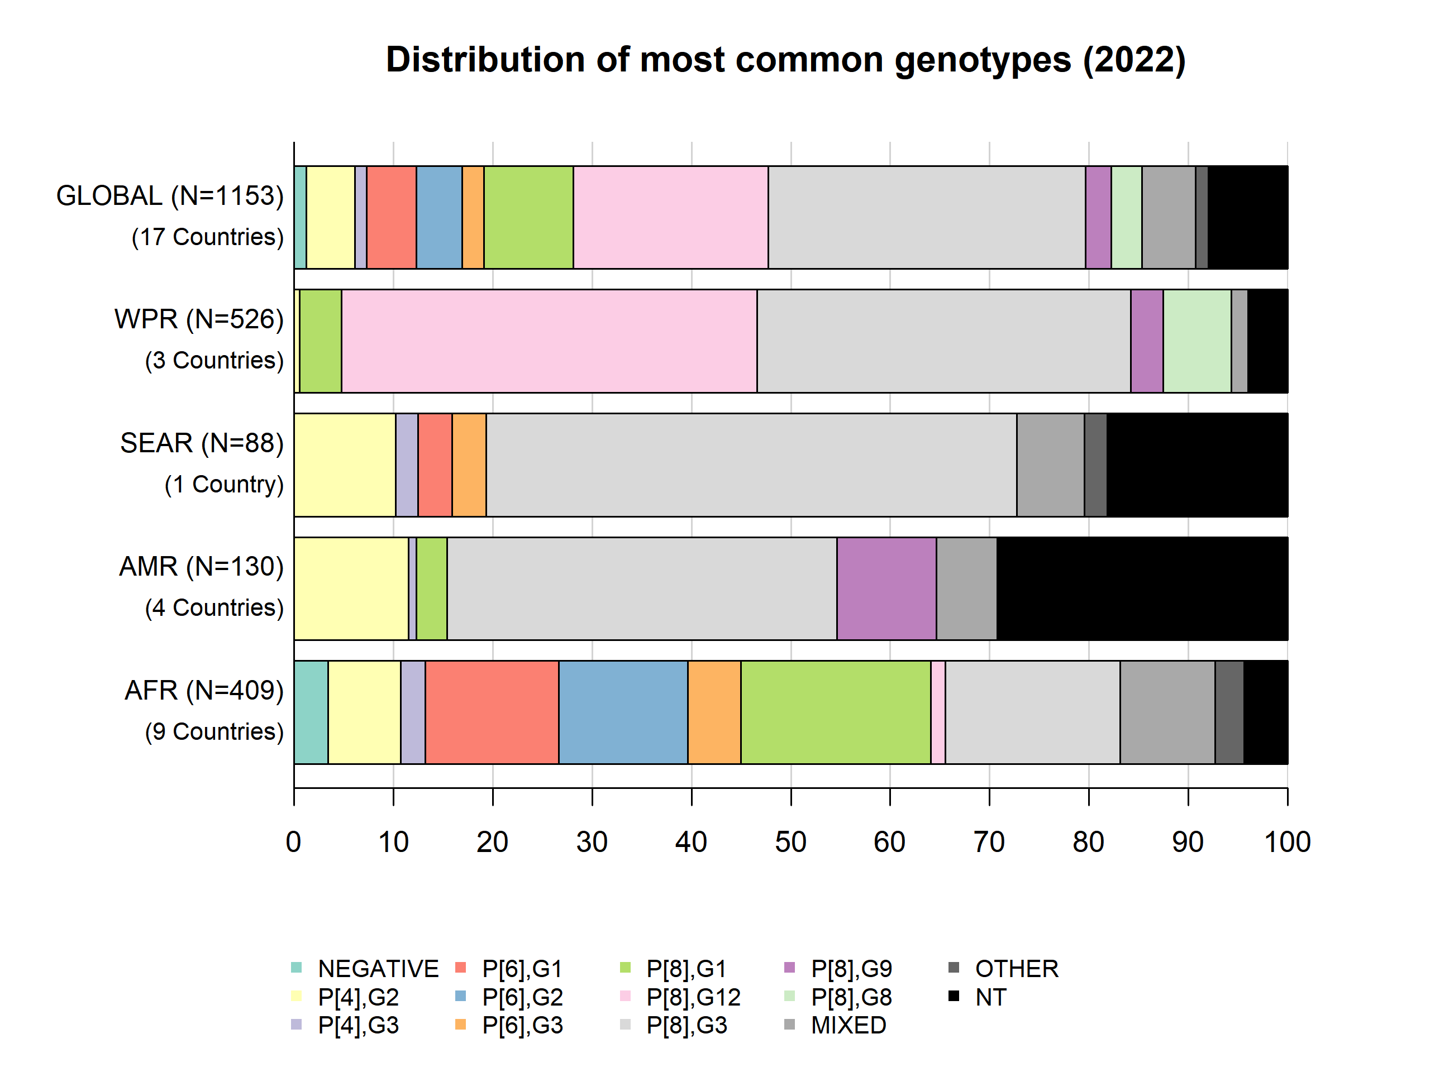
Rotavirus genotype distribution in GRSN, 2022

Slide 38
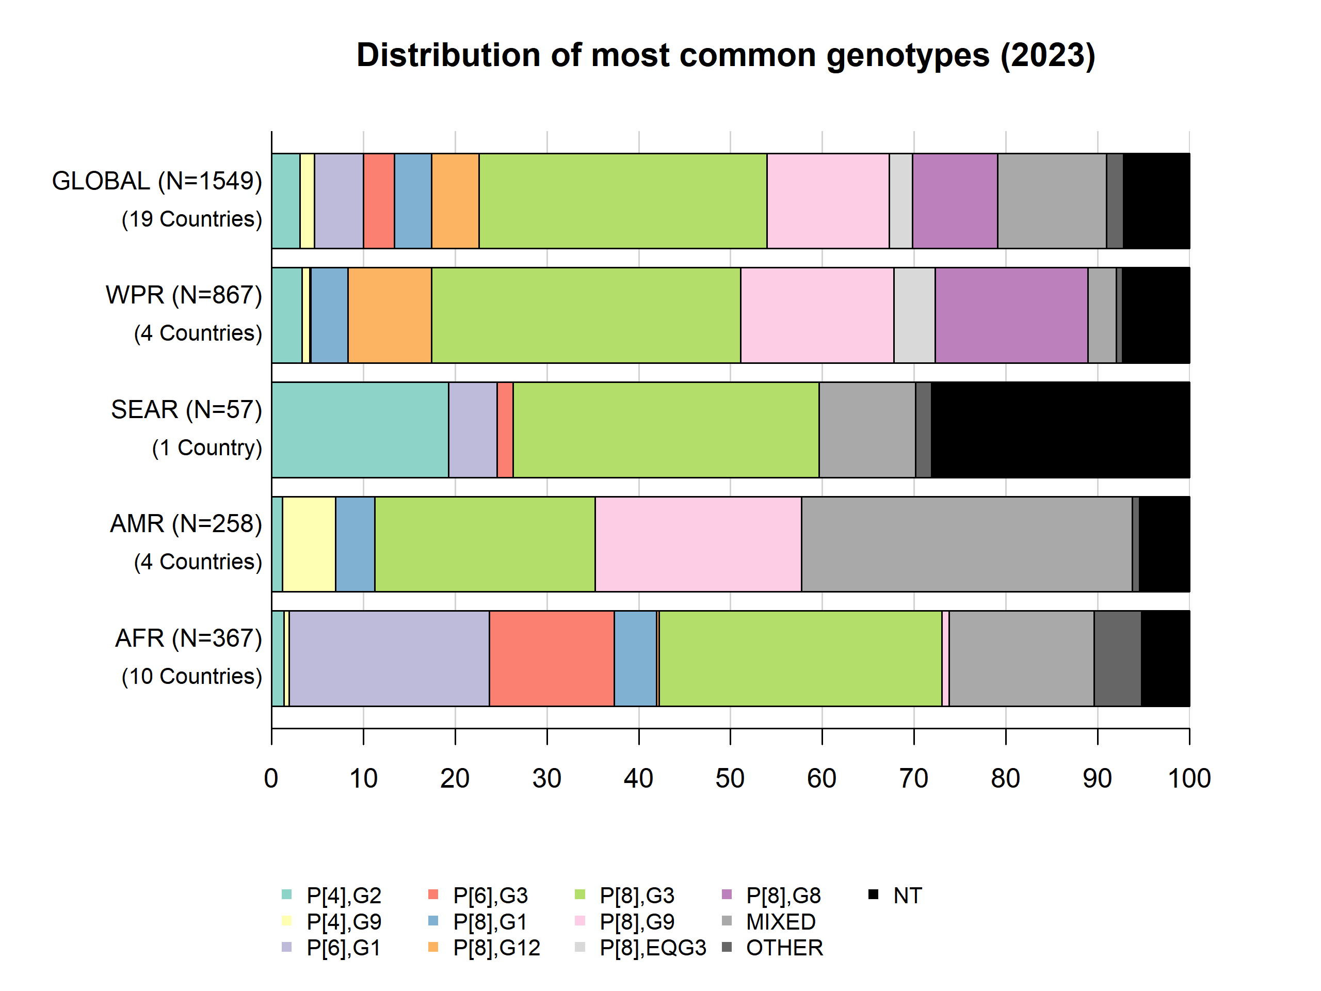
Rotavirus genotype distribution in GRSN, 2023

Slide 39
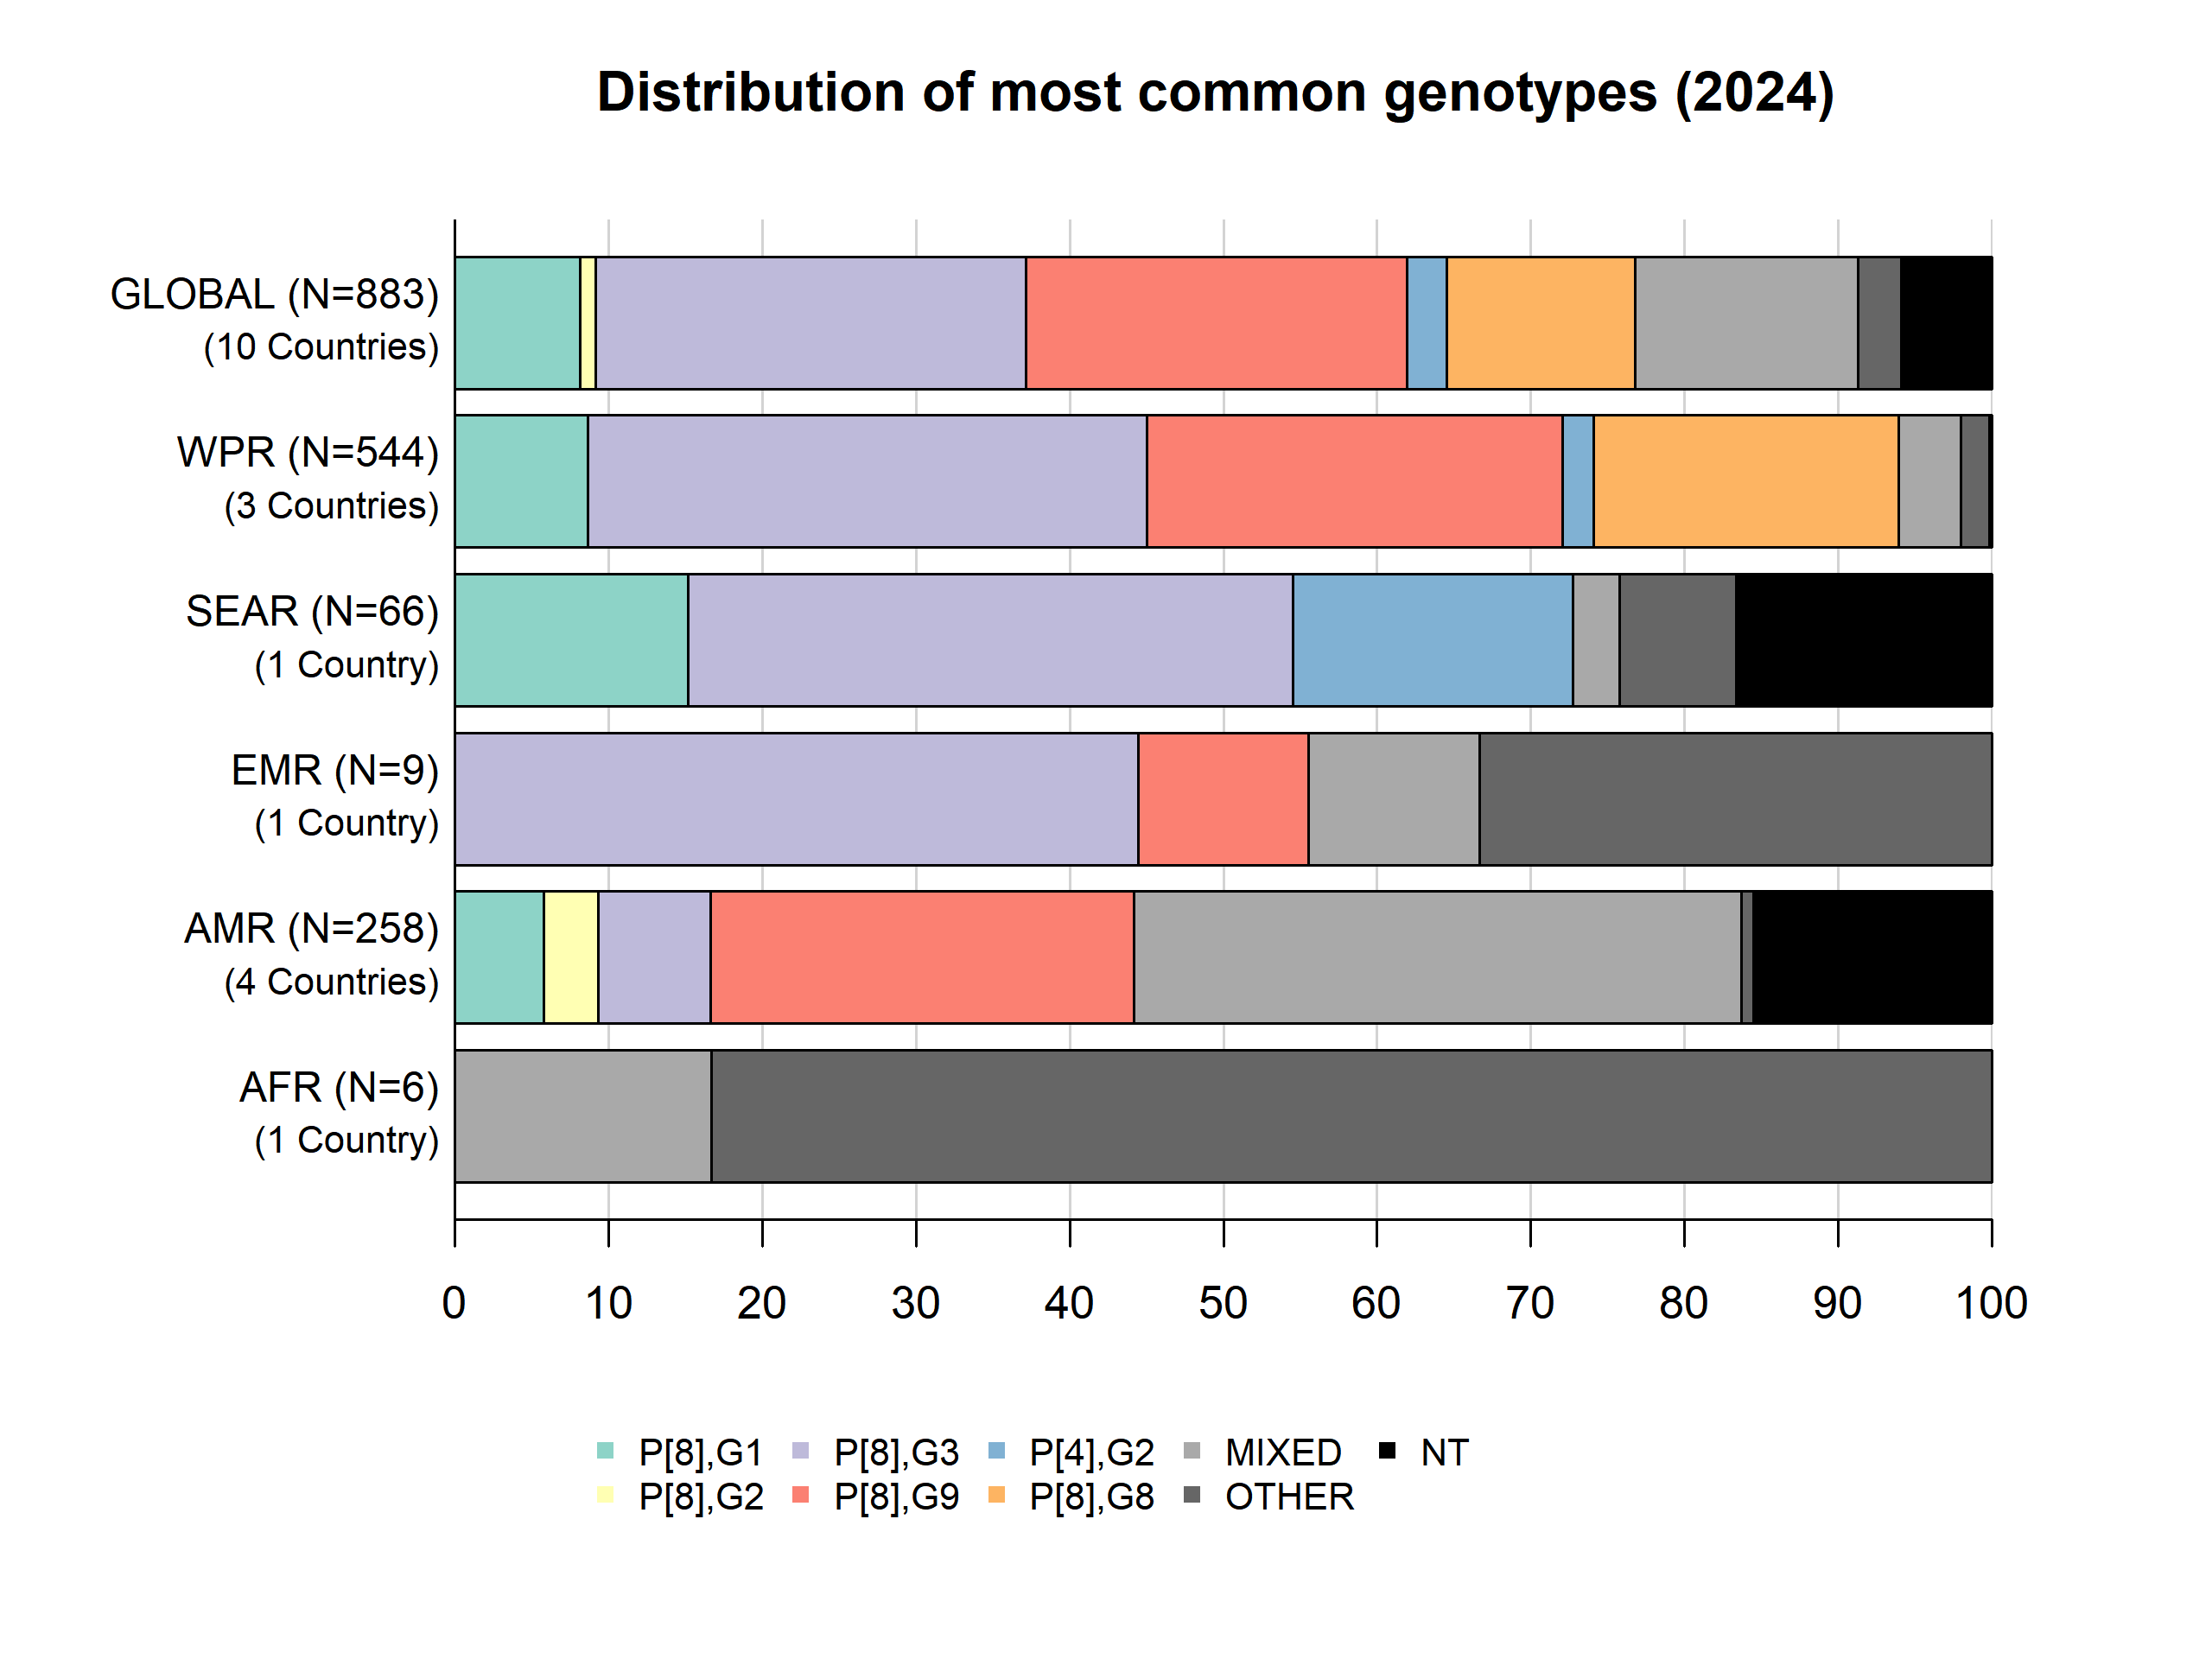
Rotavirus genotype distribution in GRSN, 2024

Slide 40
GRSN laboratory updates

Slide 41
In 2024, the GRSN laboratory network consisted of:
1
Global Reference Laboratory (U.S. CDC)
8
Regional Reference Laboratories
34
National or provincial laboratories
51
Surveillance site laboratories
Some countries have an RRL in addition to multiple provincial laboratories, these are indicated with a single icon on the subsequent maps

Slide 42
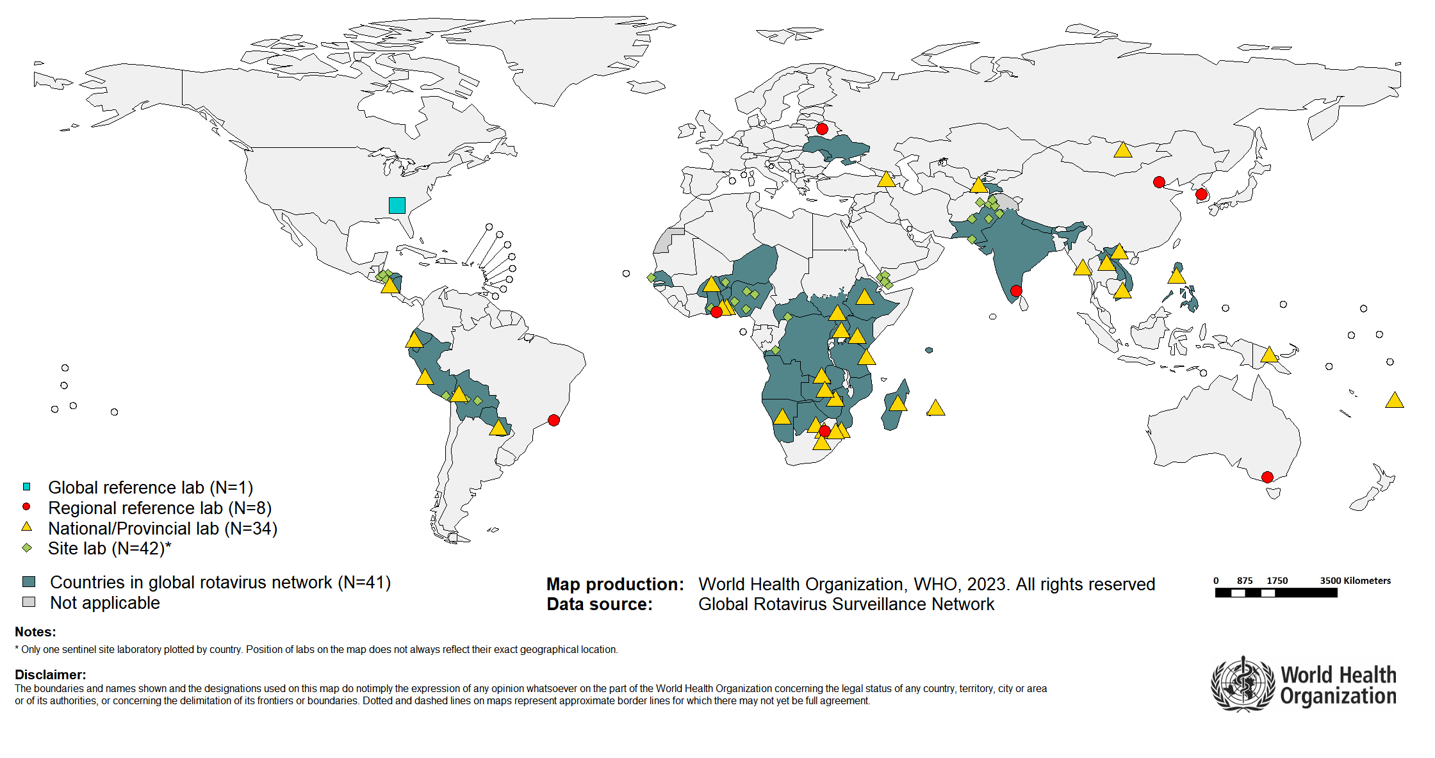
Global Rotavirus Surveillance Laboratory Network

Slide 43
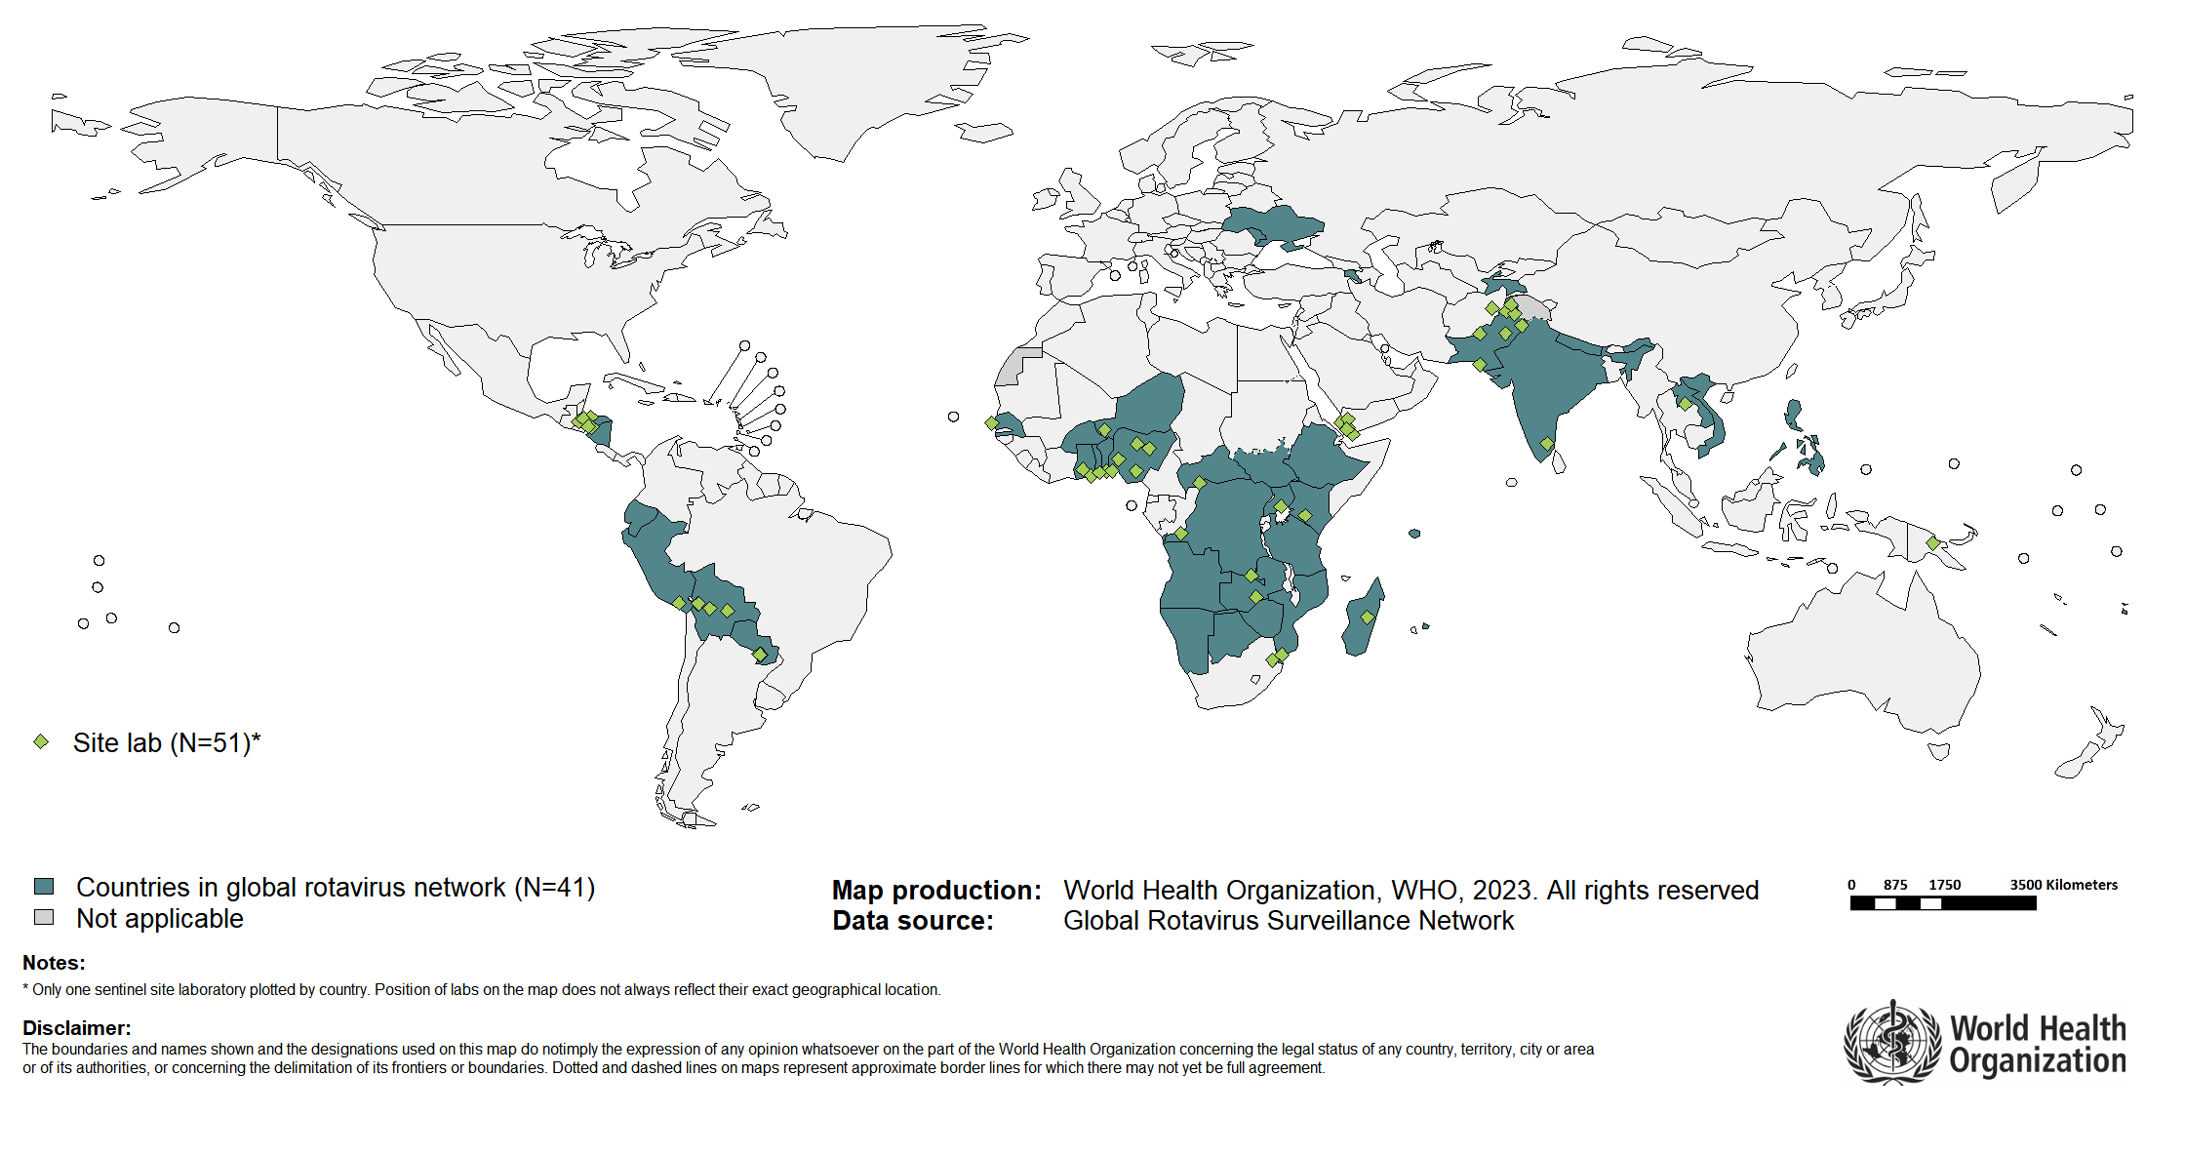
Global Rotavirus Surveillance Network – Surveillance Site Laboratories
51 site-level laboratories conduct EIA testing
Encourage SSLs to participate in the next EQA round

Slide 44
GRSN Laboratory Network: Summary of Lab Capacities (2024)
WHO Region | Labs with EIA capacity | Labs with genotyping capacity
AFR | 37 | 12
AMR | 22 | 10
EMR | 19 | 1
EUR | 4 | 1
SEAR | 6 | 3
WPR | 49 | 41
Total | 137 | 68

Slide 45
Rotavirus External Quality Assessment
In 2023, rotavirus external quality assessment (EQA) was conducted with support from U.S. CDC. This round took nearly 12 months to complete, as a result a 2024 round of EQA was not conducted.
The EQA exercise included both enzyme immunoassay (EIA) to detect rotavirus, and genotyping for strain characterization for laboratories with genotyping capacities
The rotavirus proficiency testing panels consisted of 10 lyophilized, non-infectious samples prepared and shipped by the International Reagent Resource (IRR) in coordination with the U.S. CDC
Results from the 2023 rotavirus EQA program are presented on the following slides
Additionally, the 2025 rotavirus EQA program is currently underway

Slide 46
GRSN laboratory participation in 2023 Rotavirus EQA
Region | GRSN labs with EIA Capacity | Labs participating in 2023 EIA EQA | GRSN labs with GT Capacity | Labs participating in 2023 GT EQA
AFR | 37 | 35 (95%) | 12 | 9 (75%)
AMR | 22 | 12 (55%) | 10 | 10 (100%)
EMR | 19 | 12 (63%) | 1 | 1 (100%)
EUR | 4 | 3 (75%) | 1 | 0 (0%)
SEAR | 6 | 6 (100%) | 3 | 3 (100%)
WPR | 49 | 49 (100%) | 41 | 41 (100%)
Total | 137 | 117(85%) | 68 | 64 (94%)
All GRSN labs are encouraged to participate in future rounds of Rotavirus EQA

Slide 47
2023 Rotavirus EQA Program Response Times
Response times were calculated as the time between shipment of EQA panels and reporting of EQA results to CDC. Reporting within 22 business days was the criteria to receive full scores.
Main reasons for delayed result reporting:
Logistical challenges with EQA panel distribution & import
Lack of testing reagents to perform EIA/genotype testing
Moving forward, EQA organizers are simplify the processes.
All GRSN labs are encouraged to ensure that appropriate staff is aware of panel shipment and timelines, and that non-expired reagents are present in the lab for testing EQA panels.
Region | Response time, Mean (days) | Response time, Range (days)
AFR | 54 | 1-229
AMR | 60 | 8-192
EMR | 46 | 6-145
EUR | 8 | 7-10
SEAR | 31 | 9-88
WPR | 15 | 1-133

Slide 48
2023 Rotavirus EQA Laboratory Performance
Rotavirus EQA Lab Score | Enzyme Immunoassay (n=117 participating labs) | Genotyping (n=64 participating labs)
100 points | 95% (n=111) | 73% (n=47)
90-99 points | 2% (n=2) | 19% (n=12)
80-89 points | 1% (n=1) | 2% (n=1)
<80 points | 3%(n=3) | % (n=4)

Slide 49
Rotavirus enzyme immunoassay kits used by labs participating in the 2023 rotavirus EQA program
EIA Kit Name | Vendor | Proportion of Labs Using EIA Kits | Average EIA Score (%)
ProSpecT™ | Oxoid, Ltd. | 78% | 99
RIDASCREEN® | R-biopharm AG | 9% | 95
Premier™ Rotaclone® | Meridian Bioscience, Inc. | 9% | 100
Tianjin Yizhi Rotavirus Test kit | Tianjin Yizhi | 2% | 100
Serazym® Rotavirus | GBG-MLD SRL. | 2% | 100

Slide 50
Other Laboratory Updates
In 2024, WHO added Premier™ Rotaclone® rotavirus enzyme immuno assay diagnostic kits to the catalog, replacing ProSpecT™ for logistical and resource reasons. This transition was supported by multiple laboratory training workshops at regional and country levels to build capacity to transition to the new diagnostic kit. Results from the workshops and subsequent quality control demonstrated comparable results for samples tested by both diagnostic kits.
The ongoing 2025 rotavirus EQA program is a hybrid program with panels developed by US CDC and distributed by the Royal College of Pathologists of Australasia Quality Assurance Programs (RCPAQAP). Going forward the entire rotavirus EQA program will be run by a single provider.

Slide 51
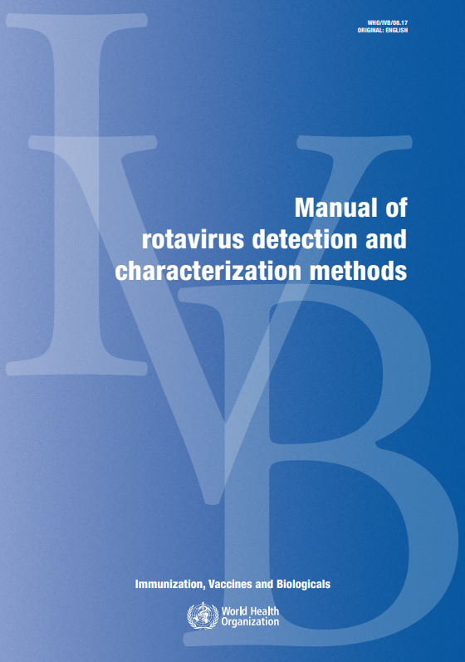
Rotavirus Lab Manual revision
The WHO Manual of rotavirus detection and characterization methods (last published in 2009) is being updated
Updates will include:
    Methodology (including updated genotyping methods)
    Laboratory quality assurance procedures
    Considerations for lab testing of other etiologies of pediatric diarrhoea
A writing team of rotavirus laboratory experts was assembled, and draft chapters have been prepared. However, due to the interruption of US CDC technical support to this project, the finalization of chapters has been paused for now, with a goal to restart in 2026.
In the interim, updated protocols and reagent lists will be published on the TechNet website in Q1 2026.
WHO_IVB_08.17_eng.pdf

Slide 52
Global Pediatric Diarrhoea Surveillance (GPDS)

Slide 53
Global Pediatric Diarrhoea Surveillance (GPDS)
WHO, Member States and main technical partners, the U.S. Centers for Disease Control and Prevention (CDC) and the University of Virginia (UVA), have leveraged the Global Rotavirus Surveillance Network to establish the Global Pediatric Diarrhoea Surveillance (GPDS) network to further study the etiology of diarrhoea among hospitalized children under 5 years of age by using a molecular diagnostic technology called TaqMan Array Card (TAC) singleplex real-time PCR that simultaneously detects more than 20 enteric pathogens.
Selected sentinel sites with high performing surveillance are part of GPDS and contribute to gathering important data that will provide global, regional, and country-level estimates of pathogen specific diarrhoea related to hospitalizations among children under 5 years. These data contribute to a better estimation of pathogen-specific disease burden among young children with severe diarrhoea and improve our understanding of the main causes of diarrhoea among this age group. These data on the burden of pediatric diarrhoea are not only important to monitor the success of rotavirus vaccination but also to provide evidence for the role of additional enteric vaccines that are currently in development, such as ETEC, Shigella and norovirus.
GRSN is the platform for GPDS; GRSN sites that are additionally participating in GPDS expand their case definition to include all pediatric diarrhoea regardless of duration or presence of blood in stool. In these sites, 100 samples per year are randomly selected from the cumulative samples at the end of the year for TAC testing. GPDS data is used to estimate pathogen-specific attributable burdens of diarrhoeal hospitalizations at the site, country, regional, and global levels.

Slide 54
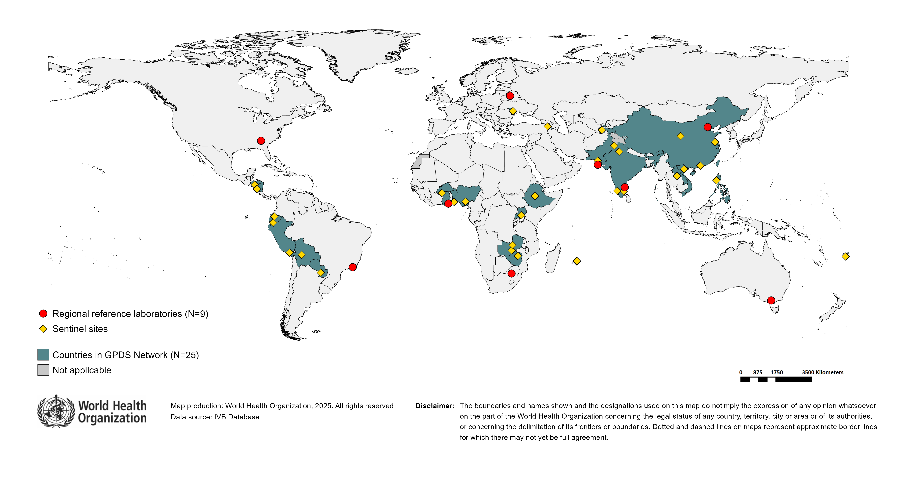
Countries participating in the Global Pediatric diarrhoea Surveillance network (GPDS), 2023
Countries participating: ARM, BEN, BFA, BOL, CHN, ECU, ETH, FJI, GHA, HND, IND, LAO, MDA, MUS, NGA, NIC, PAK, PER, PHL, PRY, TJK, UGA, VNM, ZMB, ZWE

Slide 55
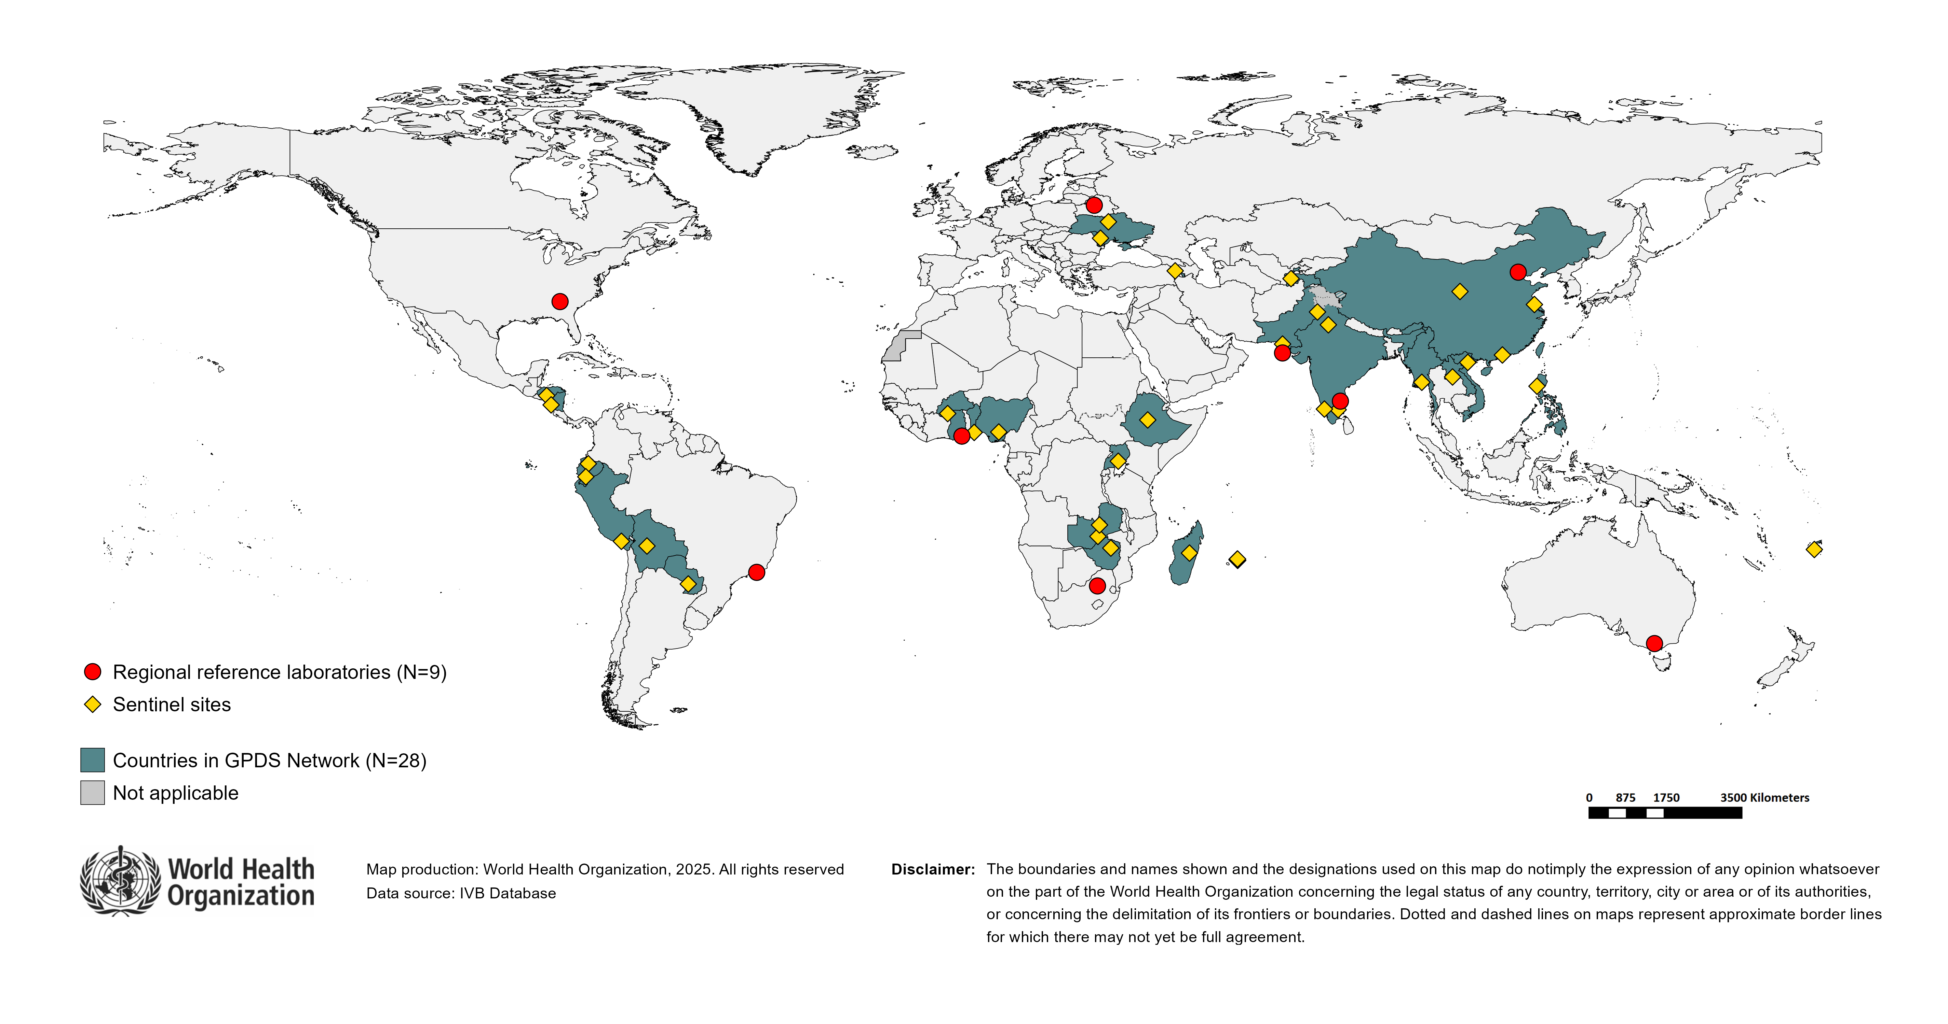
Countries participating in the Global Pediatric diarrhoea Surveillance network (GPDS), 2024
Countries participating: ARM, BEN, BFA, BOL, CHN, ECU, ETH, FJI, GHA, HND, IND, LAO, MDA, MDG, MMR, MUS, NGA, NIC, PAK, PER, PHL, PRY, TJK, UGA, UKR, VNM, ZMB, ZWE

Slide 56
Global Pediatric diarrhoea Surveillance - updates
Analysis of 2017-2018 data has been published:
  Aetiology and incidence of diarrhoea requiring hospitalisation in children under 5 years of age in 28 low-income and middle-income countries: findings from the Global Pediatric diarrhoea Surveillance network | BMJ Global Health
Analysis of 2019-2023 data is complete (see following slides)
Testing of 2024 specimens is ongoing; preliminary analysis is underway

Slide 57
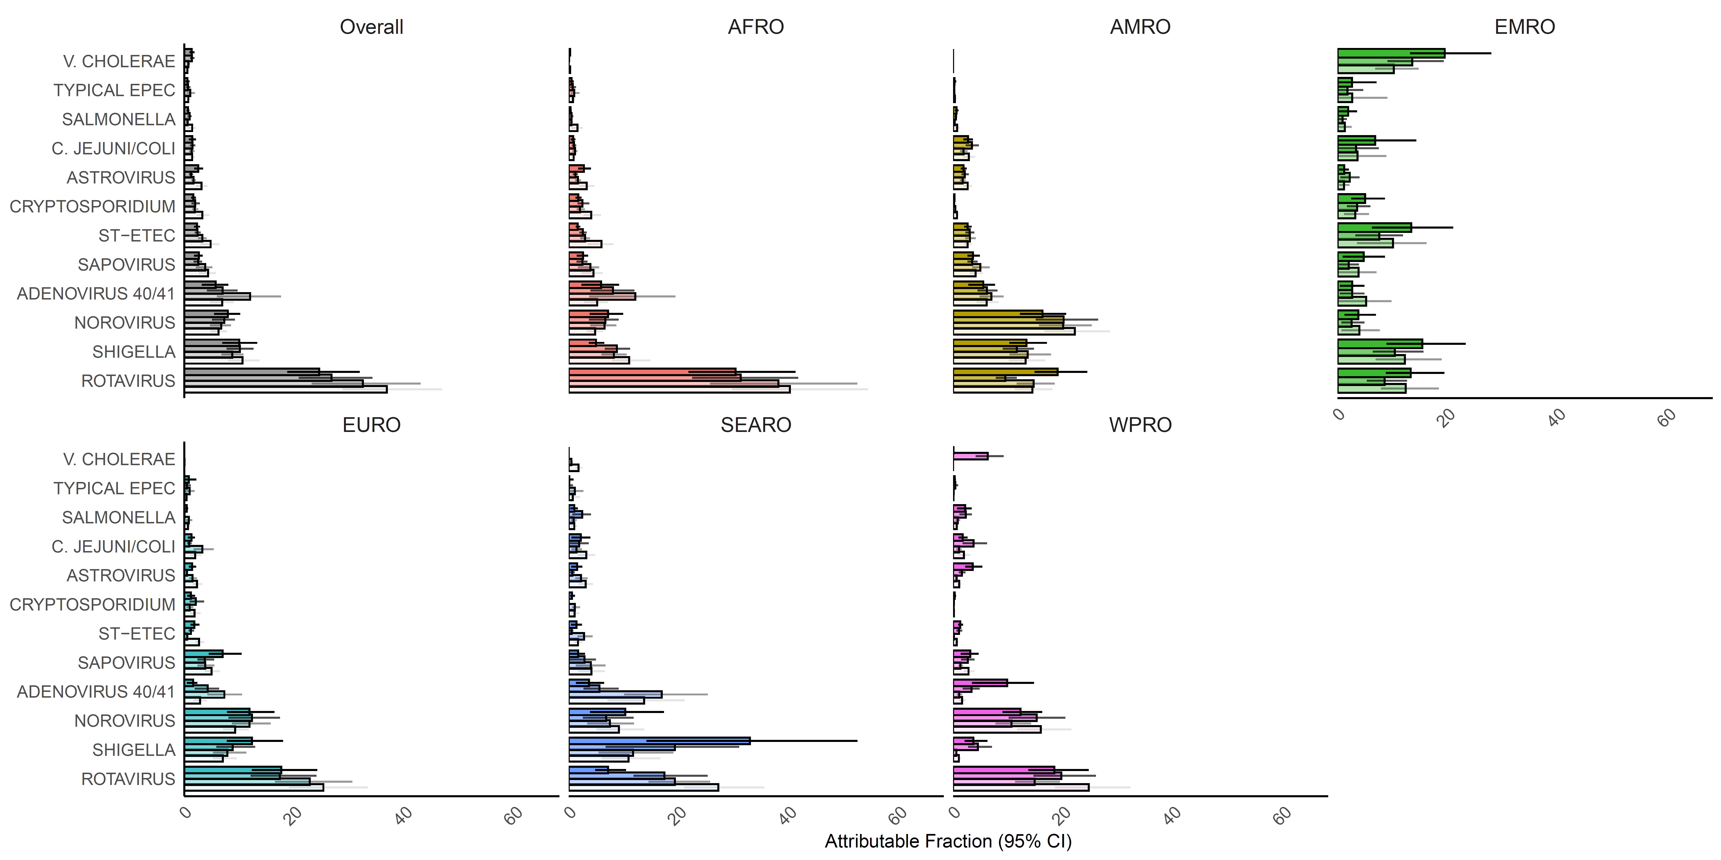
Pathogen-specific attributable fractions of hospitalized diarrhoea in children aged <5 years in Global Pediatric diarrhoea Surveillance both globally and by WHO Region, 2017–2023
AFR
AMR
EMR
EUR
SEAR
WPR
In accordance with resolution WHA78.25 (2025), Indonesia was reassigned to the WHO Western Pacific Region as of 27 May 2025. Data pertaining to Indonesia are therefore included in the Western Pacific regional aggregates for the entire time series presented in this report
Based on data analyzed as of 1 December 2025
57

Slide 58
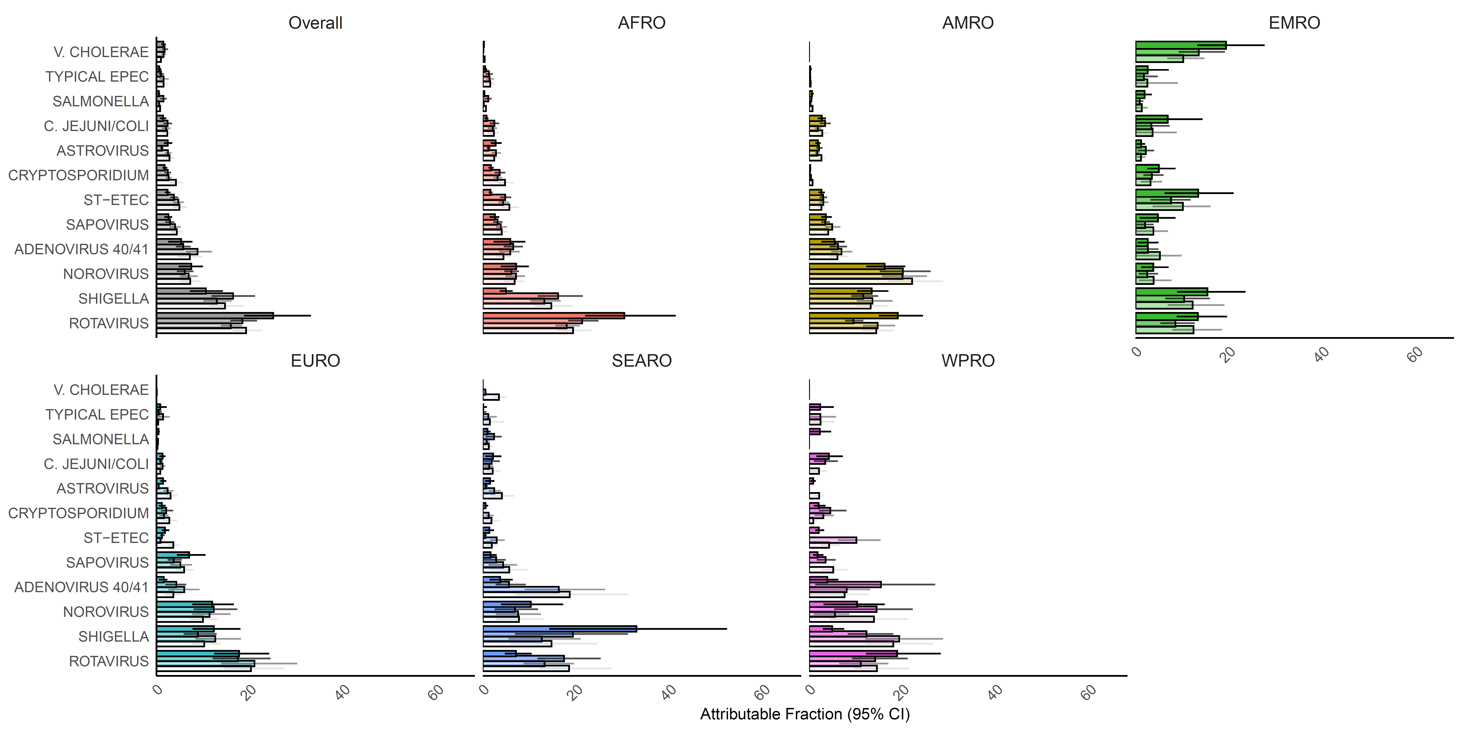
Pathogen-specific attributable fractions of hospitalized diarrhoea in children aged <5 years in countries that have introduced rotavirus vaccine only, GPDS 2017-2023
AFR
AMR
EMR
EUR
SEAR
WPR
In accordance with resolution WHA78.25 (2025), Indonesia was reassigned to the WHO Western Pacific Region as of 27 May 2025. Data pertaining to Indonesia are therefore included in the Western Pacific regional aggregates for the entire time series presented in this report
Based on data analyzed as of 1 December 2025
58

Slide 59
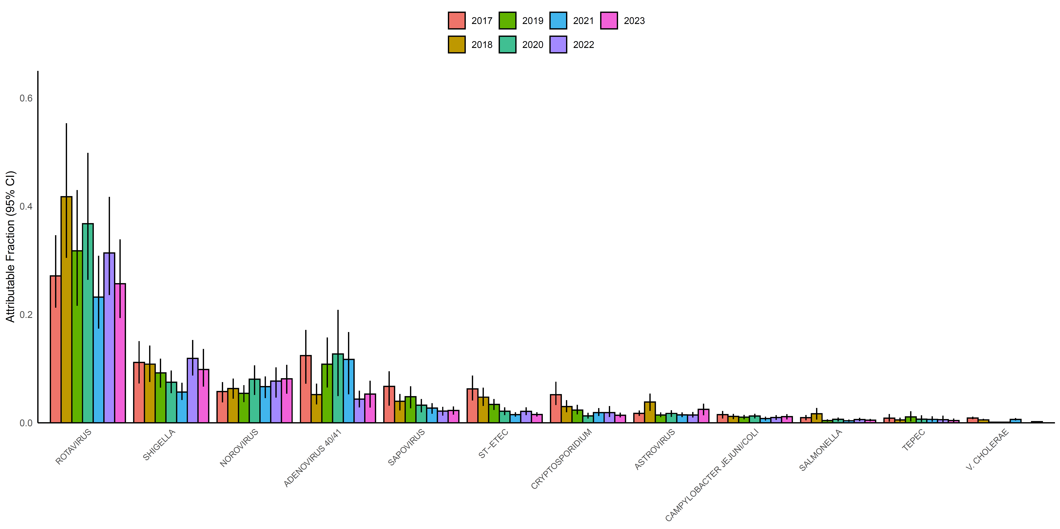
GPDS 2017-2023: Overall trends in pathogen-specific attributable fractions for countries included in all 7 years of surveillance
Based on data analyzed as of 1st Dec 2025
59

Slide 60
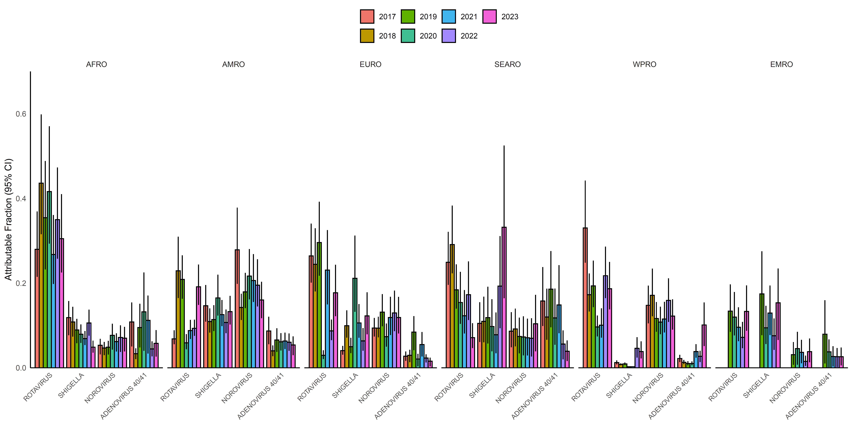
GPDS 2017-2023: Overall trends in pathogen-specific attributable fractions for countries included in all 7 years of surveillance, stratified by WHO Region
AFR
AMR
EUR
SEAR
WPR
EMR
Based on data analyzed as of 1st Dec 2025
60

Slide 61
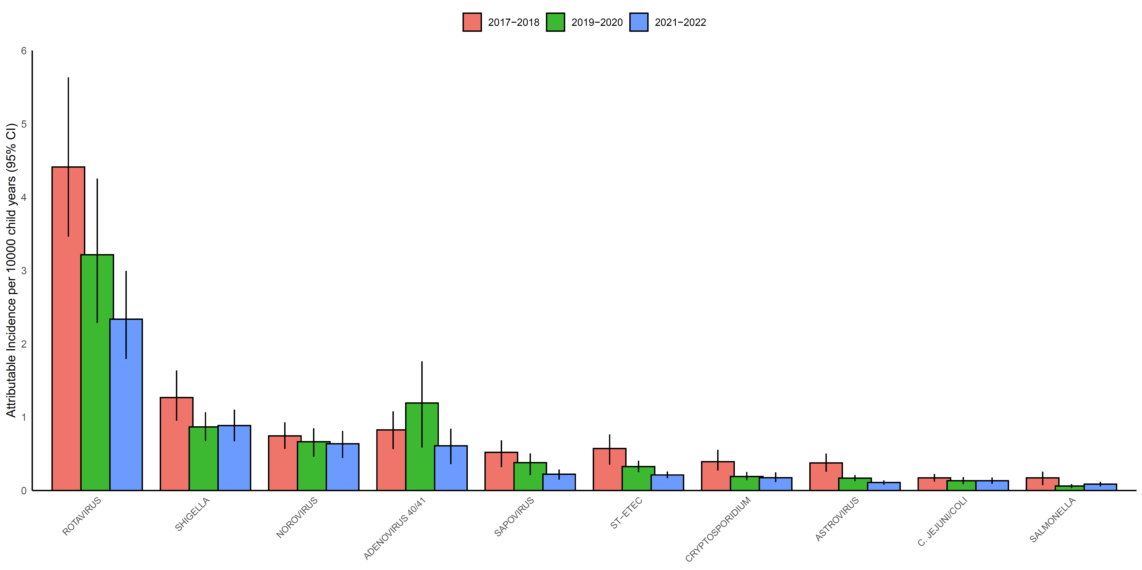
GPDS 2017-2022: Pathogen-specific attributable incidence of diarrhoea hospitalizations
Based on data analyzed as of 1 December 2025. To estimate incidence, we applied GPDS pathogen-specific attributable fractions to national-level estimates of the number of diarrhoea hospitalizations and under 5 populations from the Global Burden of Disease study. 2023 data is not included in this incidence graph as the GPDS incidences are calculated in 2-year increments; 2023-2024 incidence will be added once 2024 results are available.
61

Slide 62
GPDS conclusions
Despite the substantial impact of rotavirus vaccine introduction, rotavirus remained the leading cause of pediatric diarrhoea hospitalizations in 2017-2023
  However, the gap between rotavirus and other leading pathogens has closed substantially in countries that have introduced rotavirus vaccine
Shigella (with a burden of diarrhoea similar to rotavirus in countries that have introduced rotavirus vaccine), norovirus, and adenovirus 40/41 are other important causes of diarrhoea requiring hospitalization in these settings

Slide 63
GRSN/GPDS case definitions and procedures

Slide 64
WHO case definitions & methodology for
rotavirus and pediatric diarrhoea surveillance
Global Rotavirus Surveillance Network (GRSN)
Acute (<14 days) watery diarrhoea, defined as three or more loose stools in a 24-hour period in a child <5 years of age who is admitted for treatment of diarrhoea to a hospital ward of emergency unit at a participating surveillance facility.
Stool specimens collected within 48 hours of admission
Lab confirmation of rotavirus: Enzyme immunoassay (ELISA)
Global Pediatric Diarrhoea Surveillance (GPDS)
Layered upon GRSN surveillance platform
All pediatric diarrhoea regardless of duration or presence of blood in stool are enrolled
Lab testing: 100 samples per site/year; quantitative PCR via TaqMan Array Card for 16 enteric pathogens

Slide 65
Recent GRSN/GPDS publications

Slide 66
GPDS: Planned PLOS Collection
The Global Pediatric diarrhoea Surveillance (GPDS) network has produced an incredible amount of useful data since 2017 and includes collaborators at the global, regional, and country level.
To maximize the rapid analysis and dissemination of data from the network, we are developing a set of manuscripts describing the trends in burden estimates for diarrhoeal pathogens since the start of the network.
With a goal to disseminate these findings in an open-source format, and encourage authorship from within the network, we plan to submit these manuscripts to journals within the Public Library of Science (PLOS) family of journals. Once published, these manuscripts will then be collated as part of a GPDS-focused PLOS collection.
Work towards this manuscript collection has already begun, with a goal to submit the first two manuscripts in Q1 of 2026.

Slide 67
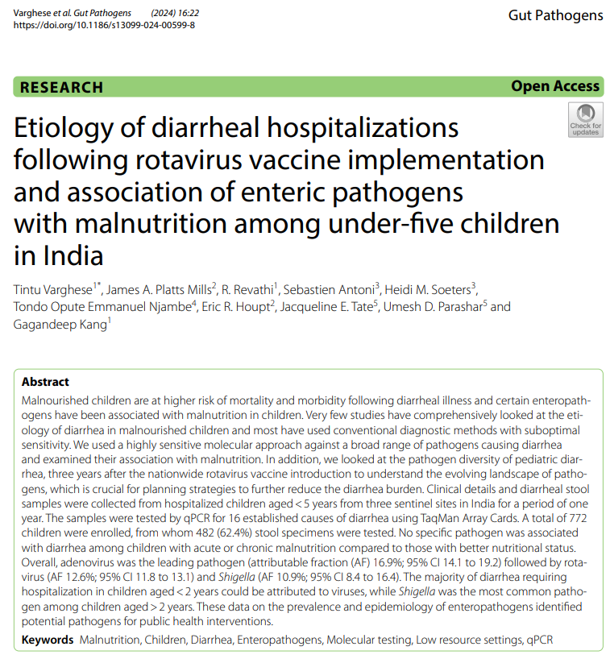
GPDS in India
Diarrhoeal burden still remains high, especially among children <2 years old
Acutely malnourished children are more likely to develop severe diarrhoea
There was no association between any specific pathogen and malnutrition status
The rotavirus burden is substantial despite nationwide vaccination
  Need to focus on strategies to improve the performance of rotavirus vaccines
Interventions addressing malnutrition, adenovirus 40/41 and Shigella are important to address diarrhoeal related morbidity and mortality
https://gutpathogens.biomedcentral.com/articles/10.1186/s13099-024-00599-8

Slide 68
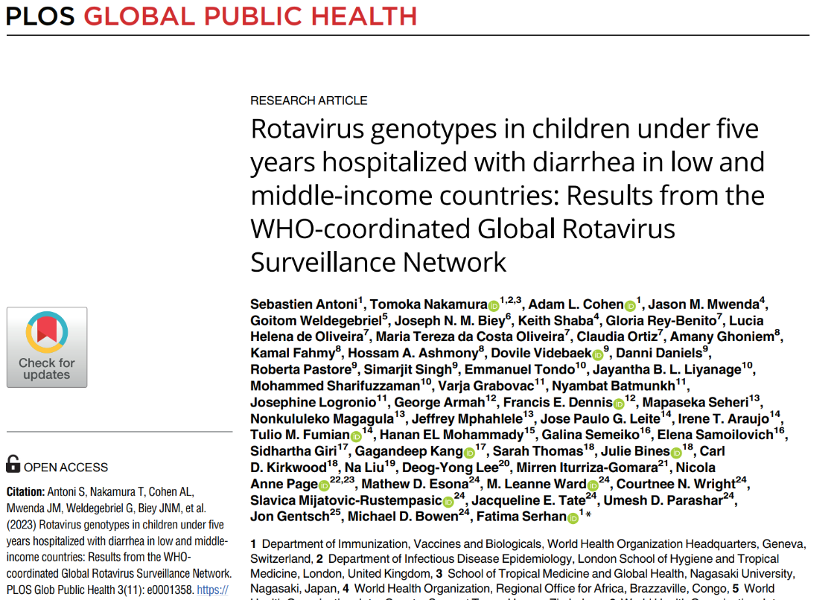
Rotavirus genotypes
Genotype data of >16,000 rotavirus isolates from 40 countries participating in GRSN
Globally, the most frequent genotypes were G1P[8] (31%), G1P[6] (8%) and G3P[8] (8%)
G1P[8] was less frequent in countries that had introduced the rotavirus vaccine while different strains are emerging or re-emerging in different regions
https://journals.plos.org/globalpublichealth/article?id=10.1371/journal.pgph.0001358

Slide 69
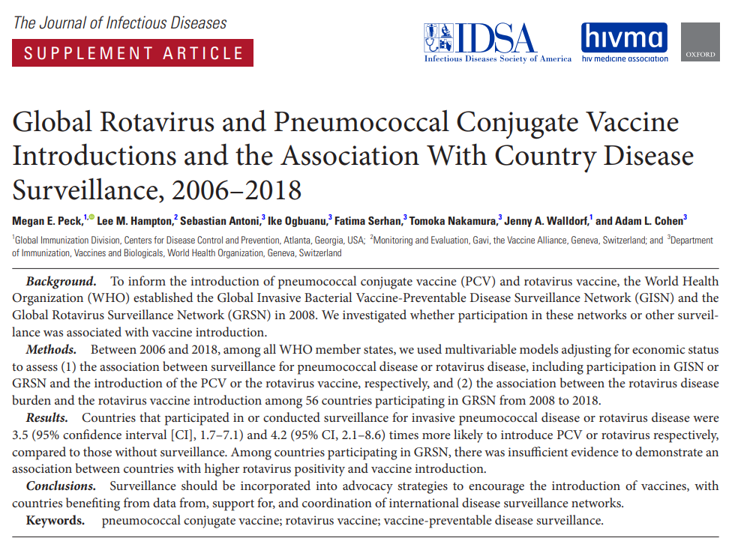
Association between rotavirus surveillance & vaccine introduction
Countries that participated in or conducted surveillance for rotavirus disease were 4.2 times more likely to introduce rotavirus vaccine, compared to countries without surveillance
https://academic.oup.com/jid/article/224/Supplement_3/S184/6361075

Slide 70
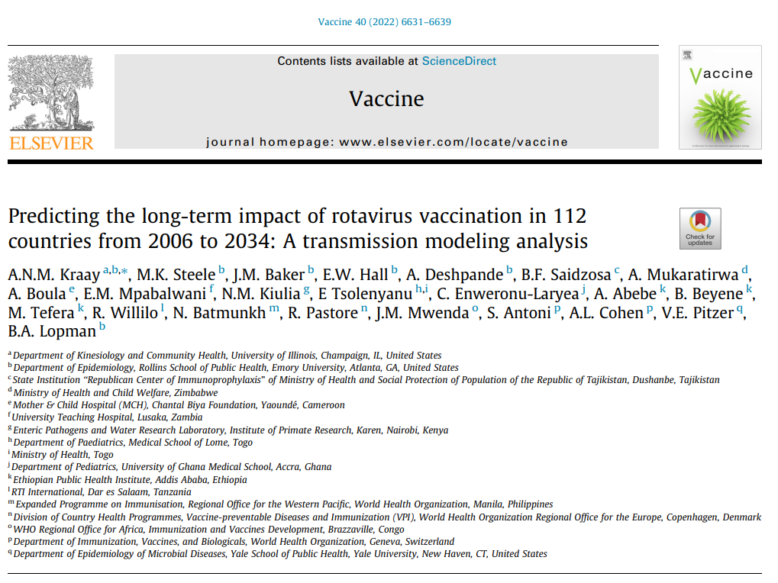
Long-term global impact of rotavirus vaccination
Transmission model to estimate the long-term impact of rotavirus vaccination on deaths and disability adjusted life years (DALYs) from 2006 to 2034 for 112 low- and middle-income countries
Estimated that vaccination would reduce deaths from rotavirus by 49.1 % by 2034
69-97% of this benefit is due to direct benefit to vaccinated individuals
https://www.sciencedirect.com/science/article/abs/pii/S0264410X22011938

Slide 71
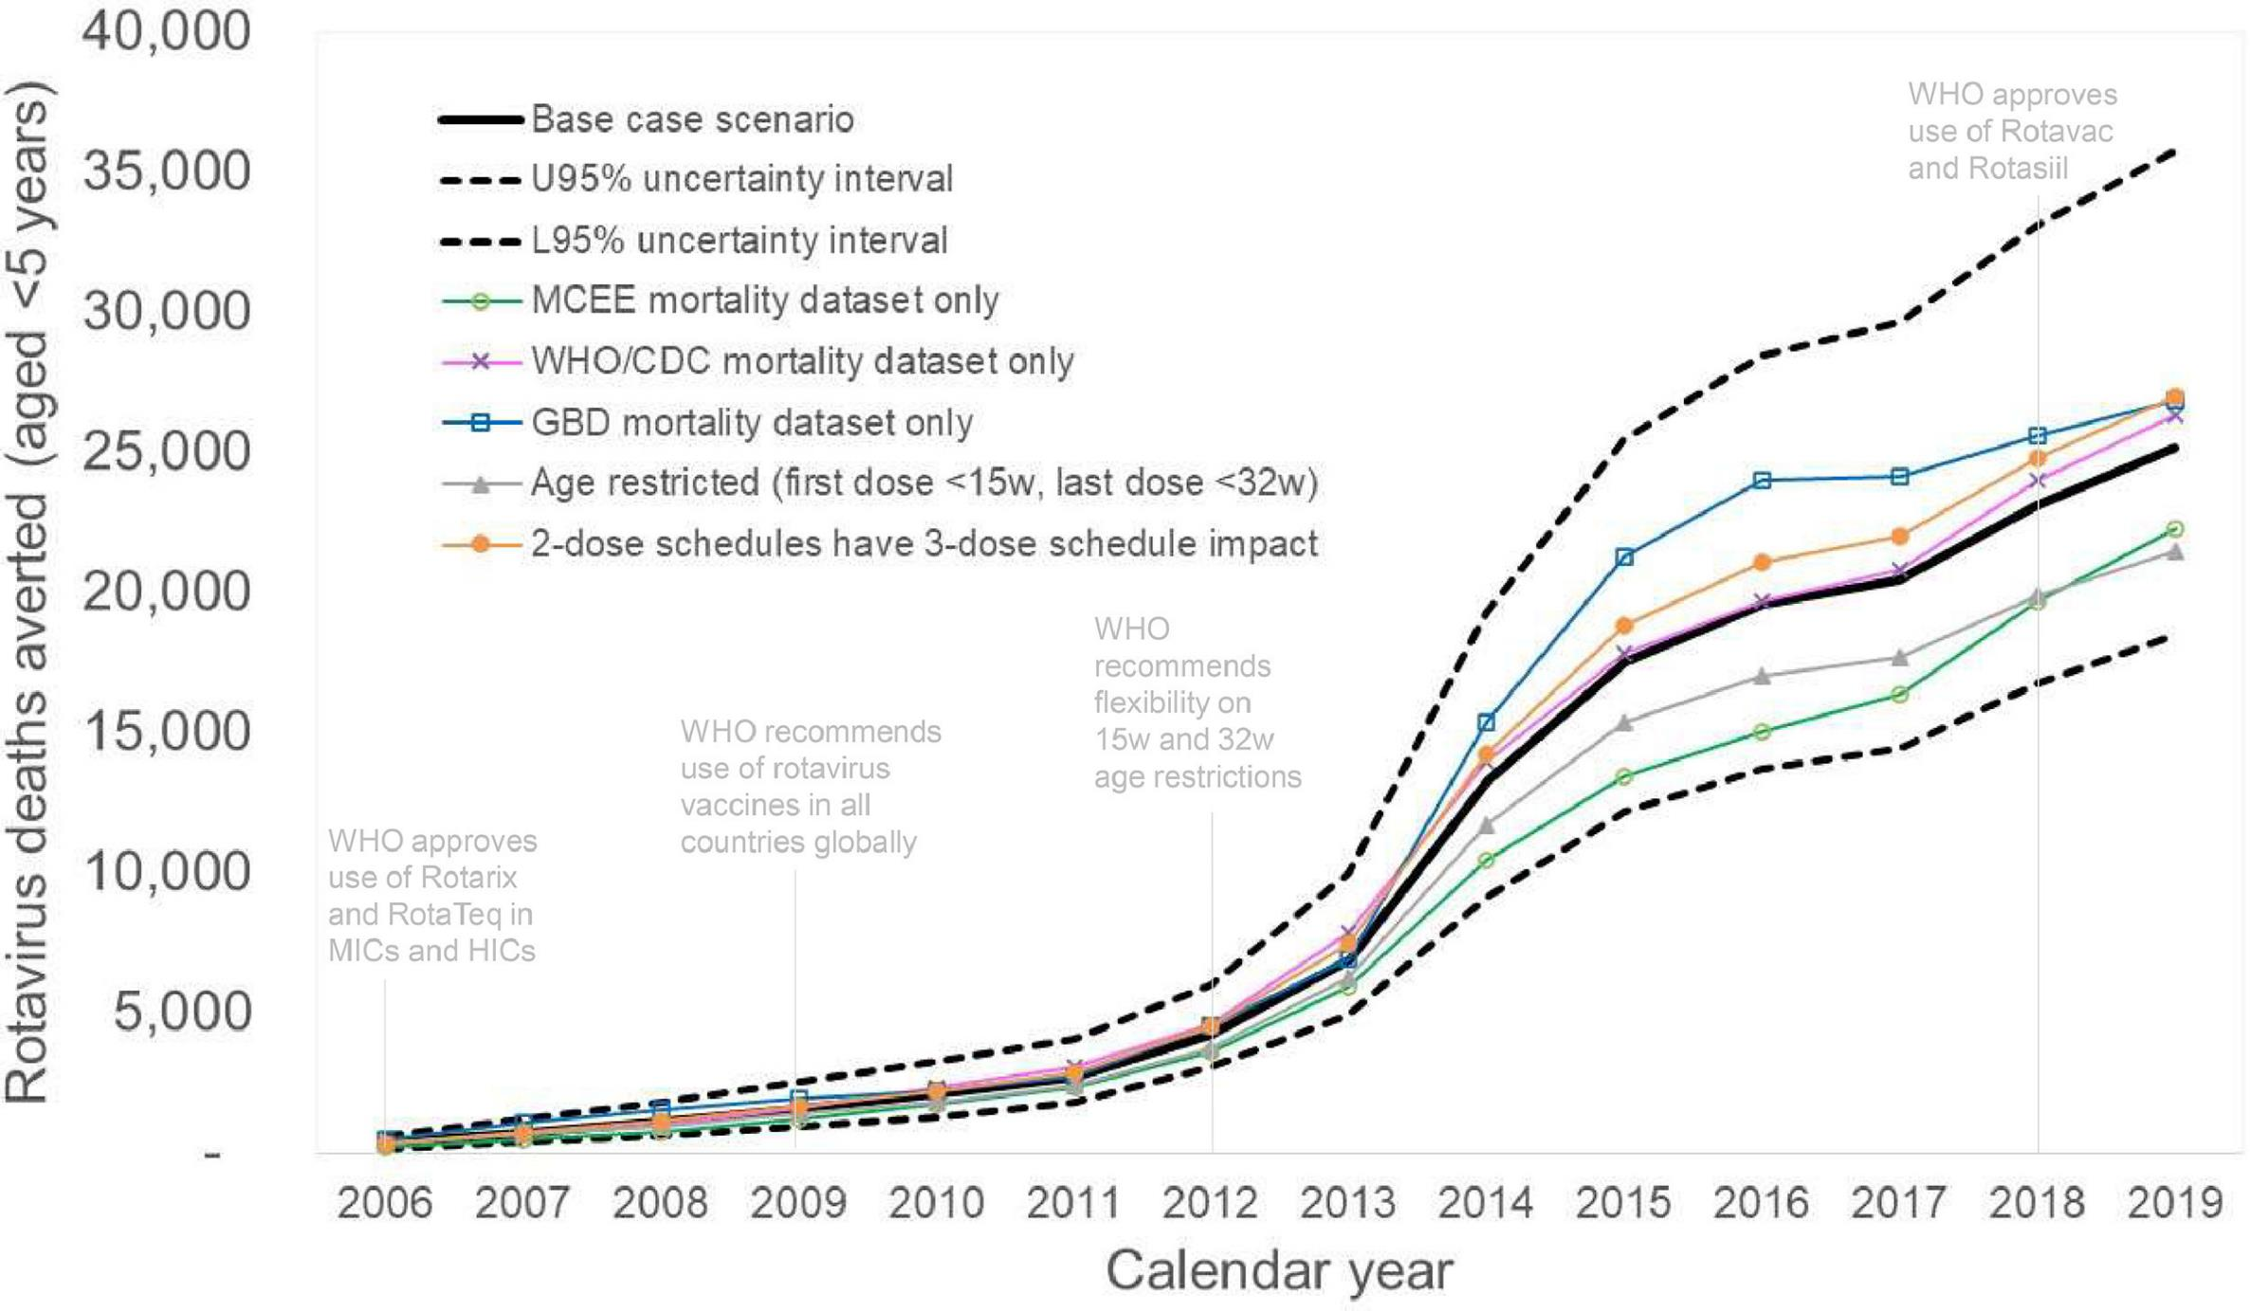
Rotavirus vaccines prevented ~139,000 child deaths in 2006-2019
139,000
https://www.ijidonline.com/article/S1201-9712(23)00742-7/fulltext

Slide 72
Other Recent Publications from GRSN/GPDS
  Cohen, Platts-Mills et al. Aetiology and incidence of diarrhoea requiring hospitalization in children under 5 years of age in 28 low-income and middle-income countries: findings from the Global Pediatric diarrhoea Surveillance network. BMJ Global Health. 2022; 7:e009548.
  Hartman et al. Risk factors for mortality among children under 5 years of age with severe diarrhoea in low- and middle-income countries: Findings from the WHO-coordinated Global Rotavirus and Pediatric diarrhoea Surveillance Networks. Clin Infect Dis. 2022;ciac561.
  Murray et al. Multicountry Analysis of Spectrum of Clinical Manifestations of Children <5 Years of Age Hospitalized with diarrhoea. Emerg Infect Dis. 2019; 25(12):2253-2256.
  Aliabadi et al. Global impact of rotavirus vaccine introduction on rotavirus hospitalisations among children under 5 years of age, 2008-16: findings from the Global Rotavirus Surveillance Network. Lancet Glob Health. 2019; 7(7):e893-e903.
  Hasso-Agopsowicz et al. Global Review of the Age Distribution of Rotavirus Disease in Children Aged <5 Years Before the Introduction of Rotavirus Vaccination. Clin Infect Dis. 2019; 69(6):1071-1078.
  Hasan et al. Using pneumococcal and rotavirus surveillance in vaccine decision-making: A series of case studies in Bangladesh, Armenia and the Gambia. Vaccine. 2018; 36(32 Pt B):4939-4943.
  Operario et al. Etiology of Severe Acute Watery diarrhoea in Children in the Global Rotavirus Surveillance Network Using Quantitative Polymerase Chain Reaction. J Infect Dis. 2017; 216(2):220-227.

Slide 73
Additional information

Slide 74
Acknowledgements
All collaborators in the GRSN/GPDS networks
Participating Ministries of Health
Sentinel surveillance hospitals & staff
WHO regional office and country office colleagues
National, Regional, and Global reference laboratories
Partners (U.S. Centers for Disease Control and Prevention, University of Virginia)
Global Burden of Disease Study – Institute for Health Metrics and Evaluation
Financial support from the Bill & Melinda Gates Foundation and the U.S. Centers for Disease Control and Prevention
WHO HQ Global monitoring and surveillance team

Slide 75
Useful links
WHO Vaccine-Preventable Disease Surveillance Standards
Rotavirus Laboratory Network
WHO Immunization Data
WHO Department of Immunization, Vaccines and Biologicals

Slide 76
Contact us
Surveillance Focal Point Carolina Danovaro danovaroc@who.int
Data Focal Point Sébastien Antoni antonis@who.int
Lab Focal Points Mick Mulders muldersm@who.int
Shilpa Iyer iyers@who.int
Our mailing address is:
World Health Organization
Avenue Appia 20
Geneve 1211
Switzerland

Slide 77
How to subscribe
To subscribe to this global rotavirus and pediatric diarrhoea surveillance update, please contact Sébastien Antoni at antonis@who.int

