Slide 1
Global Rotavirus Surveillance Network (GRSN) &
Global Pediatric Diarrhea Surveillance (GPDS) update
May 2024
VPD Surveillance and Risk Assessment Team
Global Monitoring Team

Slide 2
Introduction
Dear Colleagues,
We are pleased to share the latest update from the World Health Organization (WHO)-coordinated Global Rotavirus Surveillance Network (GRSN) and Global Pediatric Diarrhea Surveillance (GPDS).
This slide deck reports the most up-to-date global surveillance data reported to WHO HQ as of May 2024, which includes GRSN data from recent years with a focus on 2021-2023, as well as the most recent GPDS data available from 2017-2021.
Thank you to everyone from staff at the sentinel surveillance hospitals and Member States, concerned WHO regional and country offices, and to the country, regional and global partners who make this surveillance possible. We look forward to continuing to work together to strengthen these surveillance networks!
We hope you enjoy the update! Please feel free to forward to other interested parties.
WHO HQ - VPD Surveillance and Risk Assessment Team & Global Monitoring Team
Copyright © 2024 World Health Organization, All rights reserved.

Slide 3
Disclaimers
Please note that all data contained within is provisional. If any numbers from this provisional data are quoted, they should be properly sourced with a date (i.e., "provisional data based on data reported to WHO (Geneva) as of May 2024").
All presented data is based upon data reported to WHO (Geneva); it is possible that additional data exists but has not yet been reported to all levels.
These data come from children aged <5 years hospitalized with diarrhea at sentinel surveillance hospitals, and may not be representative of non-hospitalized diarrhea or geographies beyond the catchment areas of the surveillance hospitals

Slide 4
GRSN & GPDS update: contents
Topic | Slide number
GRSN & GPDS surveillance objectives | 5
Global GRSN & GPDS surveillance meeting – December 2023 | 6
Global Rotavirus Surveillance Network (GRSN) | 9
Surveillance and laboratory performance | 14
Rotavirus positivity | 20
Genotype data | 33
Laboratory updates | 37
Global Pediatric Diarrhea Surveillance (GPDS) | 46
Recent GRSN/GPDS publications | 56
Additional information | 63

Slide 5
Surveillance objectives
GRSN GPDS
In countries that have not yet introduced rotavirus vaccine –
  Generate data to advocate for vaccine introduction
In countries that have introduced rotavirus vaccine –
  Evaluate vaccine effectiveness & impact
  Monitor changes in vaccine product or schedule
Globally –
  Monitor rotavirus burden & circulating rotavirus genotypes
Evaluate pathogens associated with hospitalized pediatric diarrhea
Monitor changing burden of pathogens over time
Monitor circulating strains
Inform global, regional, & country disease burden estimates
Inform new enteric vaccine development
Provide a platform for future vaccine evaluation

Slide 6
Global Rotavirus and Pediatric Diarrhea Surveillance Meeting – December 2023

Slide 7
Global Rotavirus and Pediatric Diarrhea and Surveillance Meeting
Held at the Western Pacific Regional Office (WPRO) campus in Manila, Philippines, 11-13 December 2023
The meeting brought together >60 colleagues from WHO HQ, Regional Offices, Country Offices, Ministries of Health, Regional Reference Laboratories and partners (U.S. CDC, University of Virginia, Bill & Melinda Gates Foundation)
Meeting conclusions:
  Recent data showed that the Global Rotavirus and Pediatric Diarrhea Surveillance networks continue to recover from COVID-19 pandemic impact on surveillance performance, and to get back on the intended schedule of specimen testing and data reporting
  The meeting highlighted the most recent country to join Global Pediatric Diarrhea Surveillance (Philippines) as well as other Western Pacific Region countries participating in the surveillance networks
  We collectively discussed priorities and future activities for rotavirus and pediatric diarrhea surveillance, as well as priorities and activities specific to each WHO Region
The final meeting report is available online: Global rotavirus and pediatric diarrhea surveillance: meeting report, WHO Regional Office for the Western Pacific, Manila, Philippines, 11-13 December 2023

Slide 8
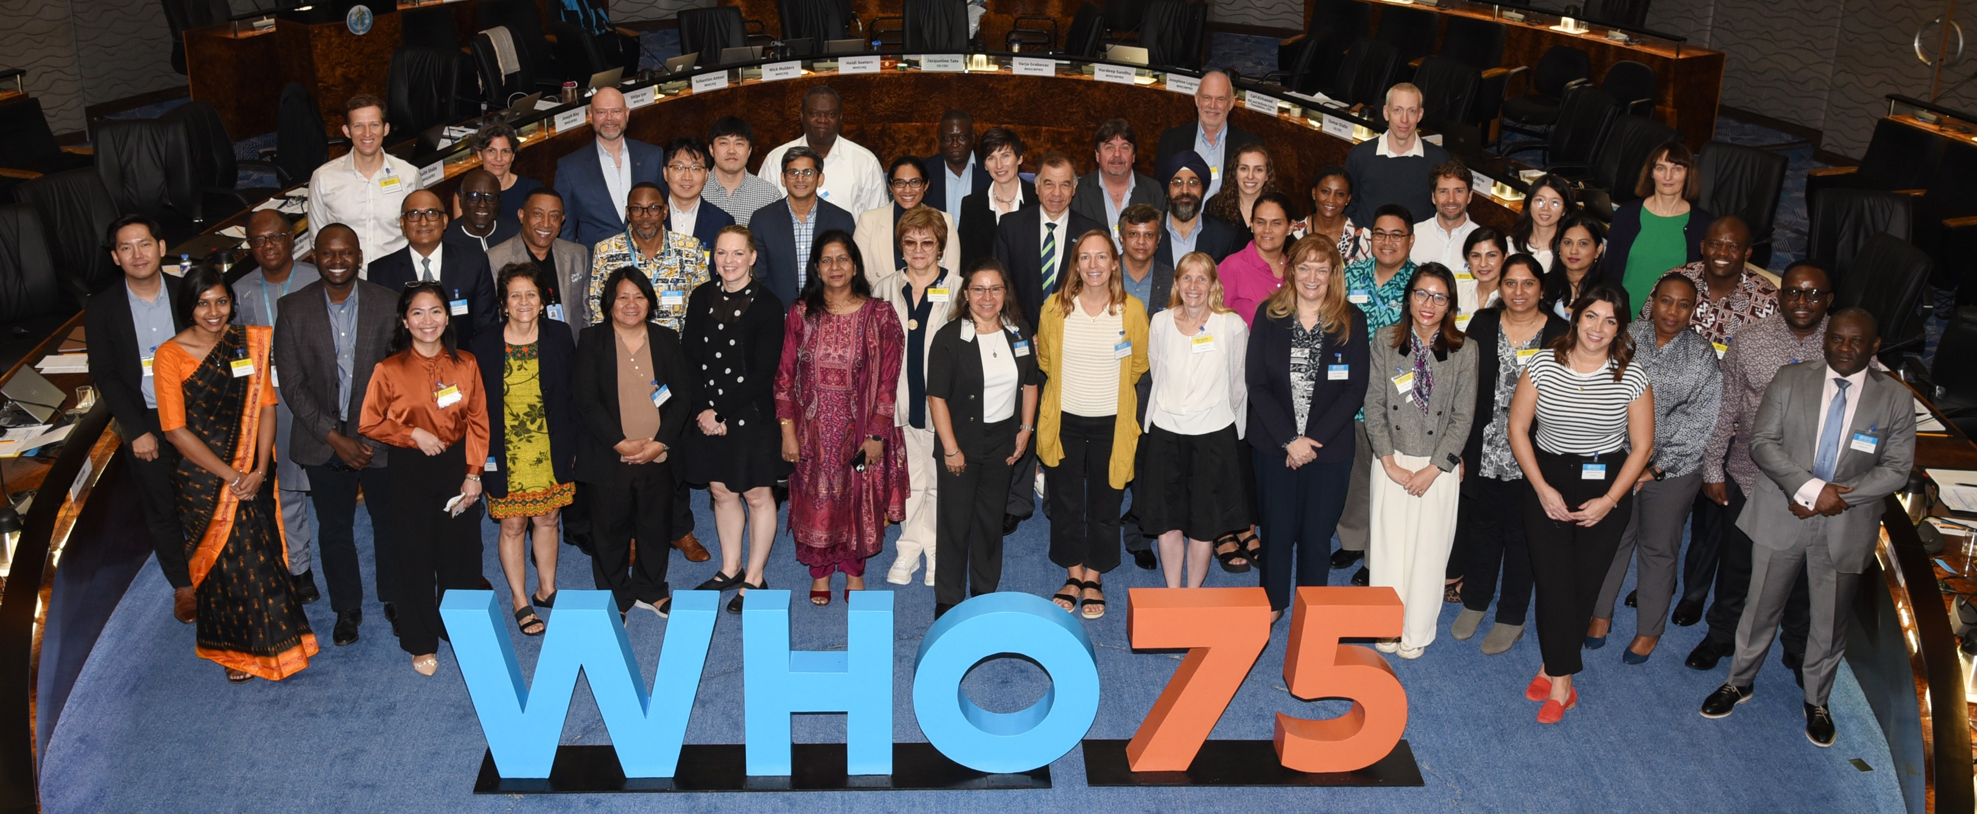
Global Rotavirus and Pediatric Diarrhea Surveillance Meeting

Slide 9
Global Rotavirus Surveillance Network
(GRSN)

Slide 10
Over a decade of rotavirus surveillance
Pre-2010 Rotavirus surveillance networks began in some regions
2010 WHO-coordinated Global Rotavirus Surveillance Network (GRSN) established: aggregate and unlinked but standardized
2013 Strategic review of GRSN and SAGE endorsement: Transition to case-based, laboratory-linked data
2014-today GRSN conducted in all 6 WHO Regions

Slide 11
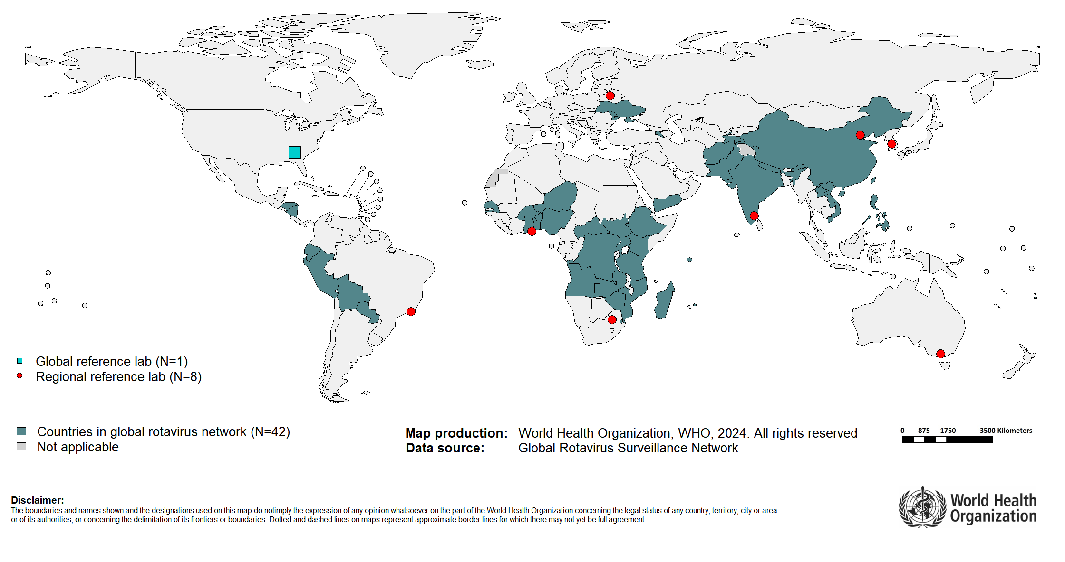
Countries reporting data to the Global Rotavirus Surveillance Network, 2021

Slide 12
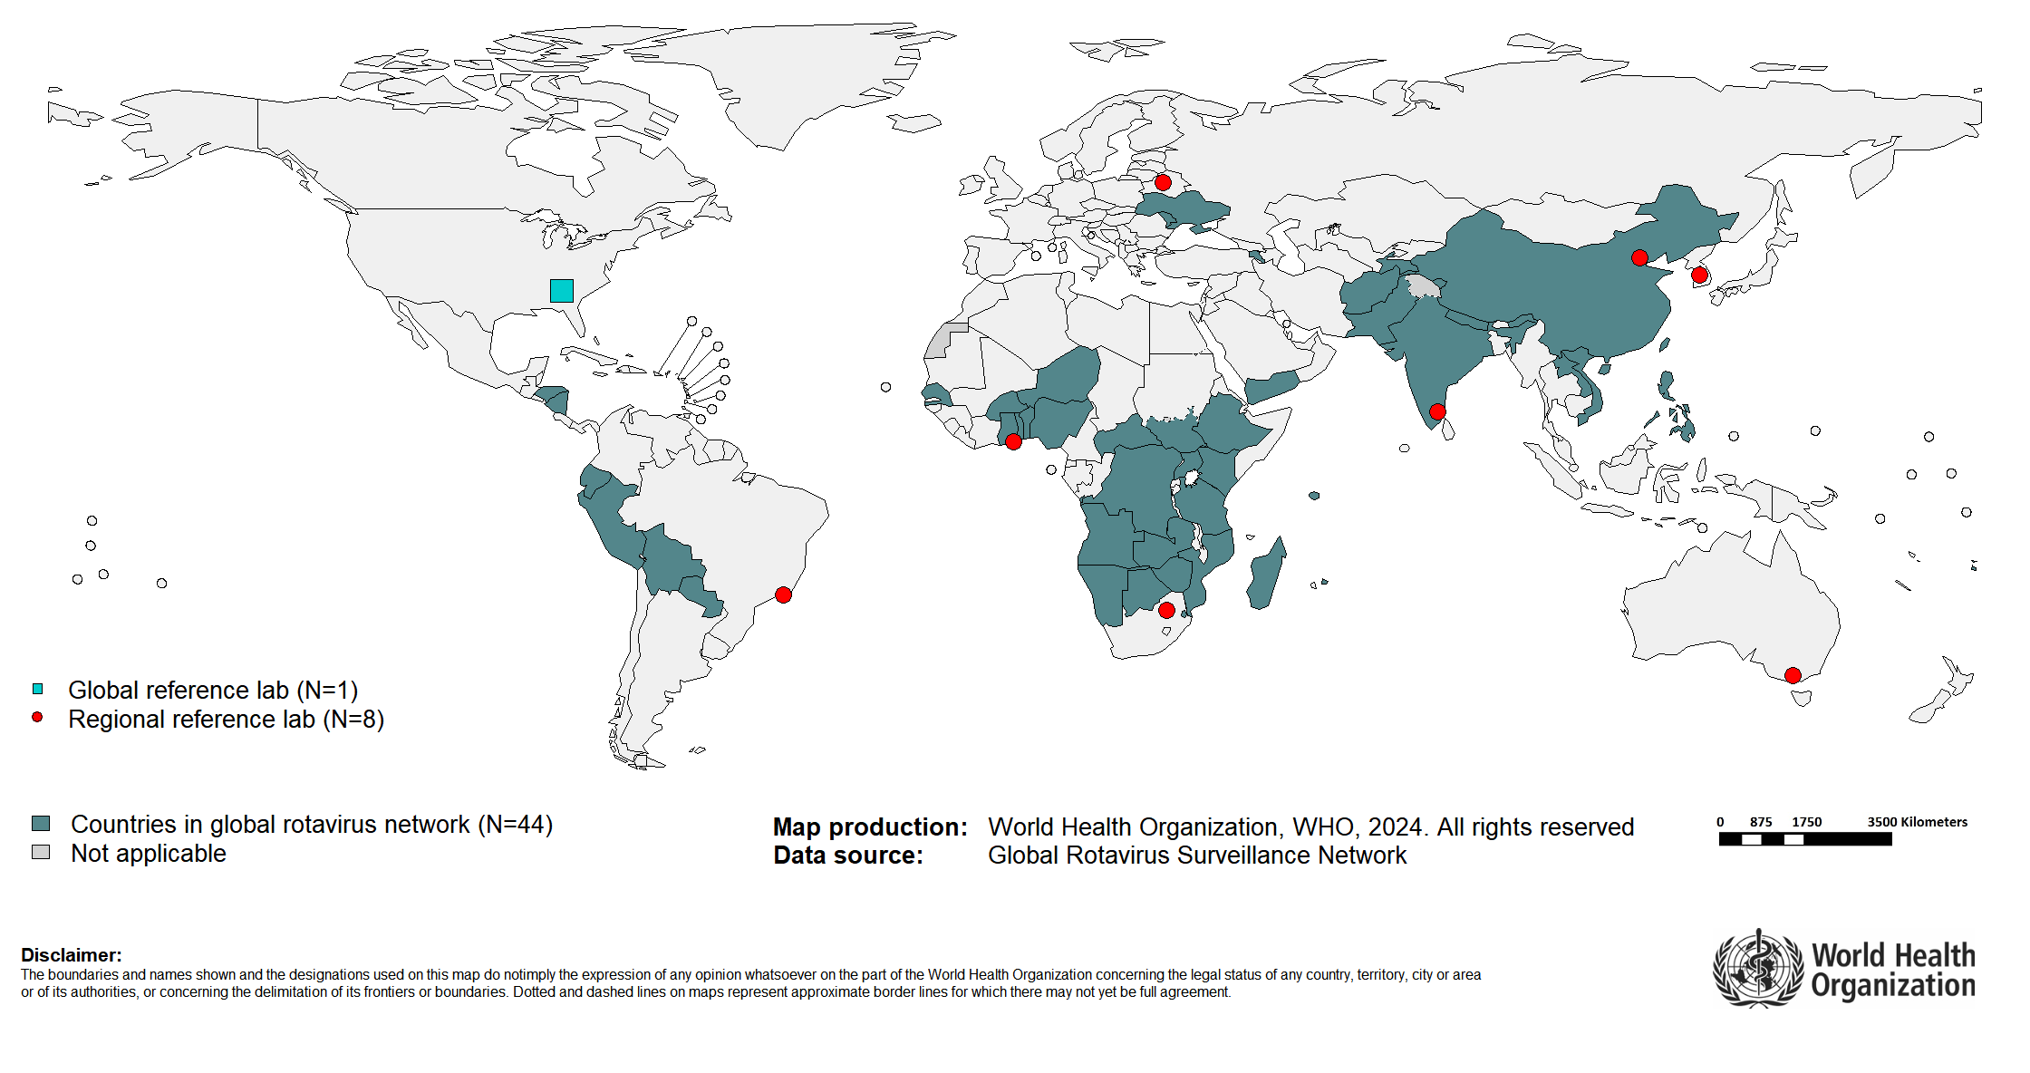
Countries reporting data to the Global Rotavirus Surveillance Network, 2022

Slide 13
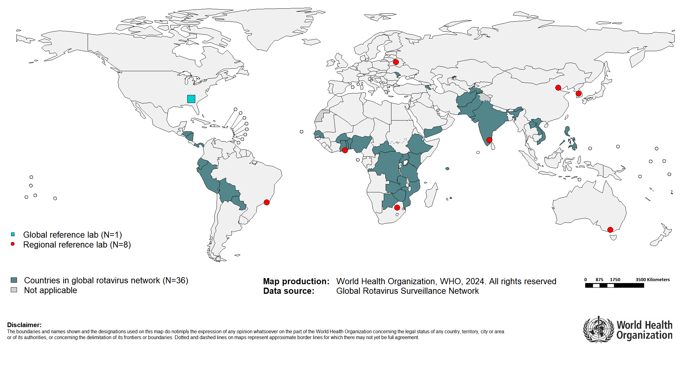
Countries reporting data to the Global Rotavirus Surveillance Network, 2023

Slide 14
GRSN surveillance and laboratory performance

Slide 15
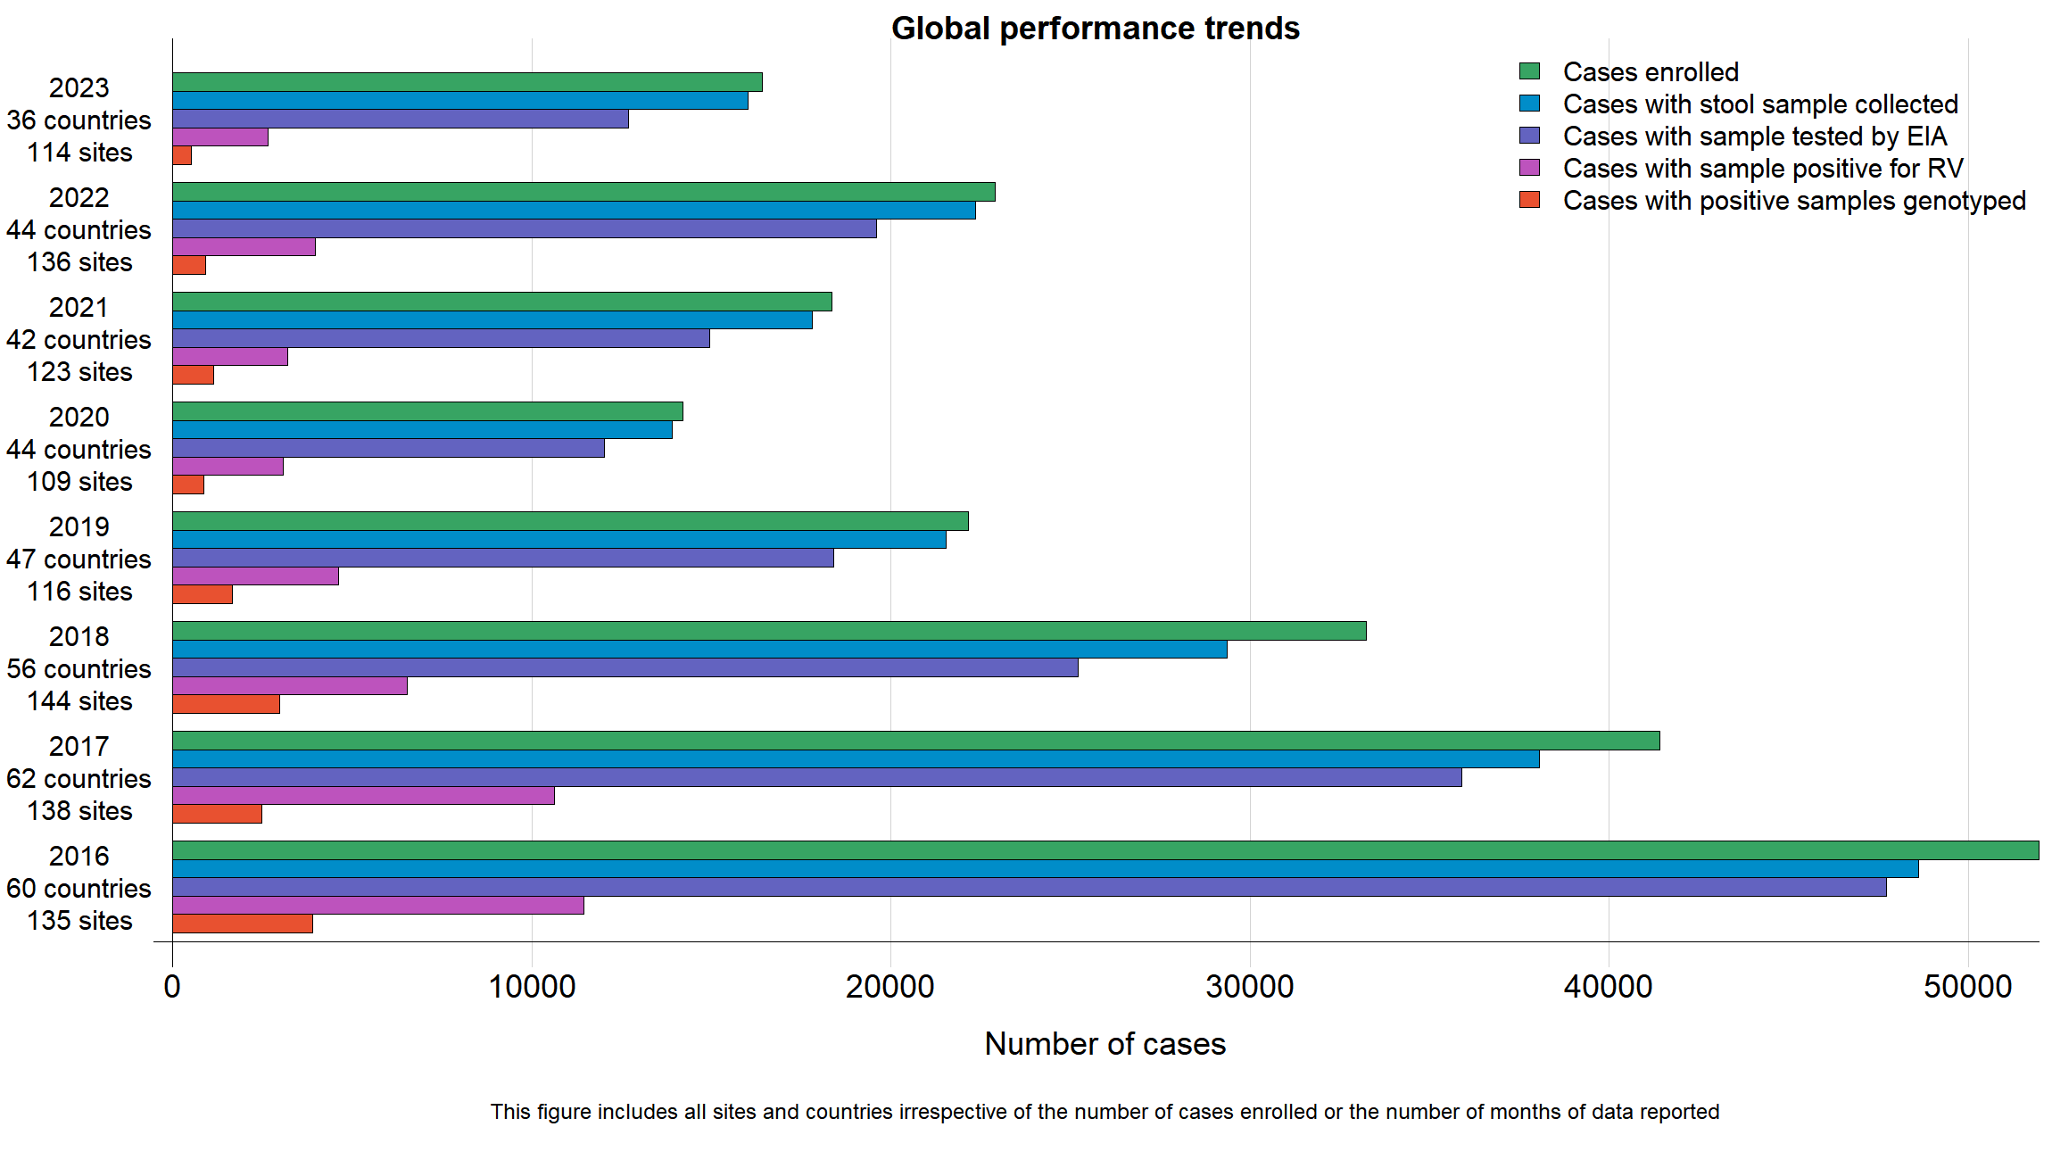
Global GRSN surveillance performance trends, 2016-2023

Slide 16
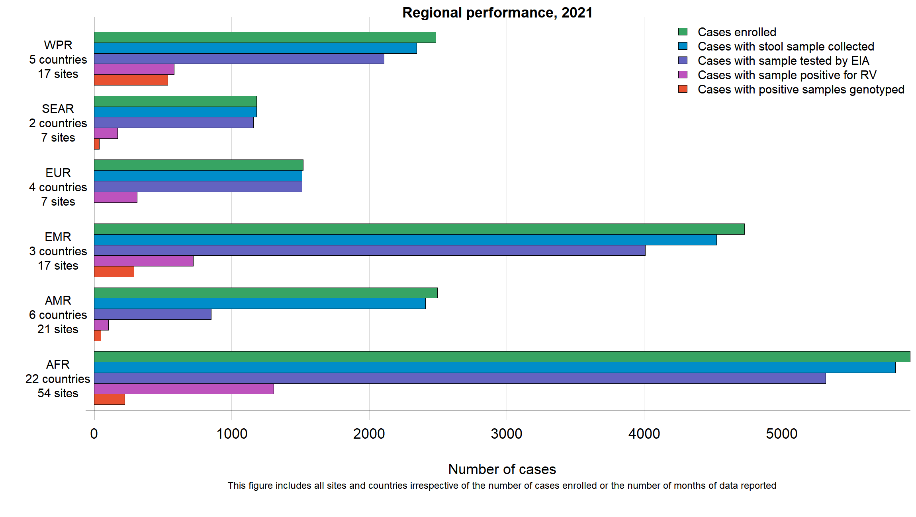
Regional GRSN surveillance performance, 2021

Slide 17
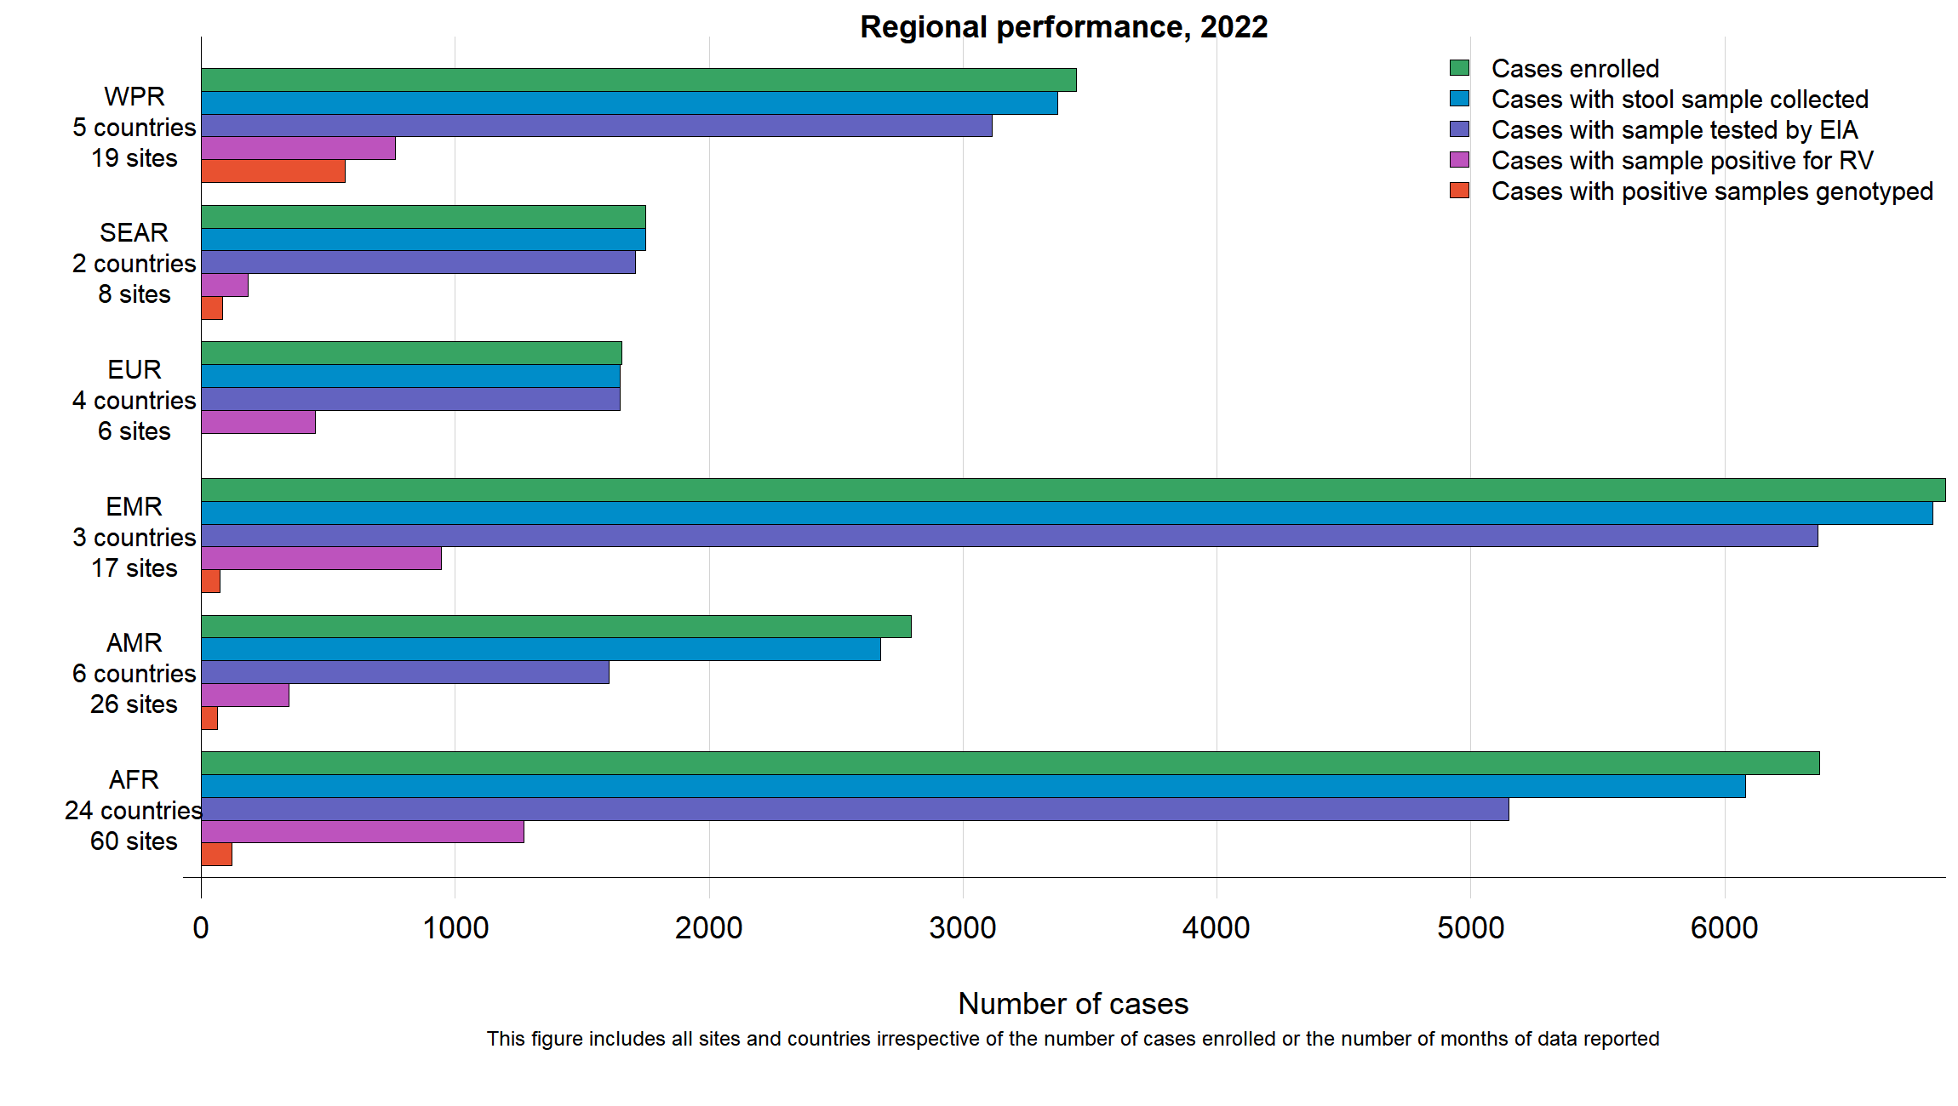
Regional GRSN surveillance performance, 2022

Slide 18
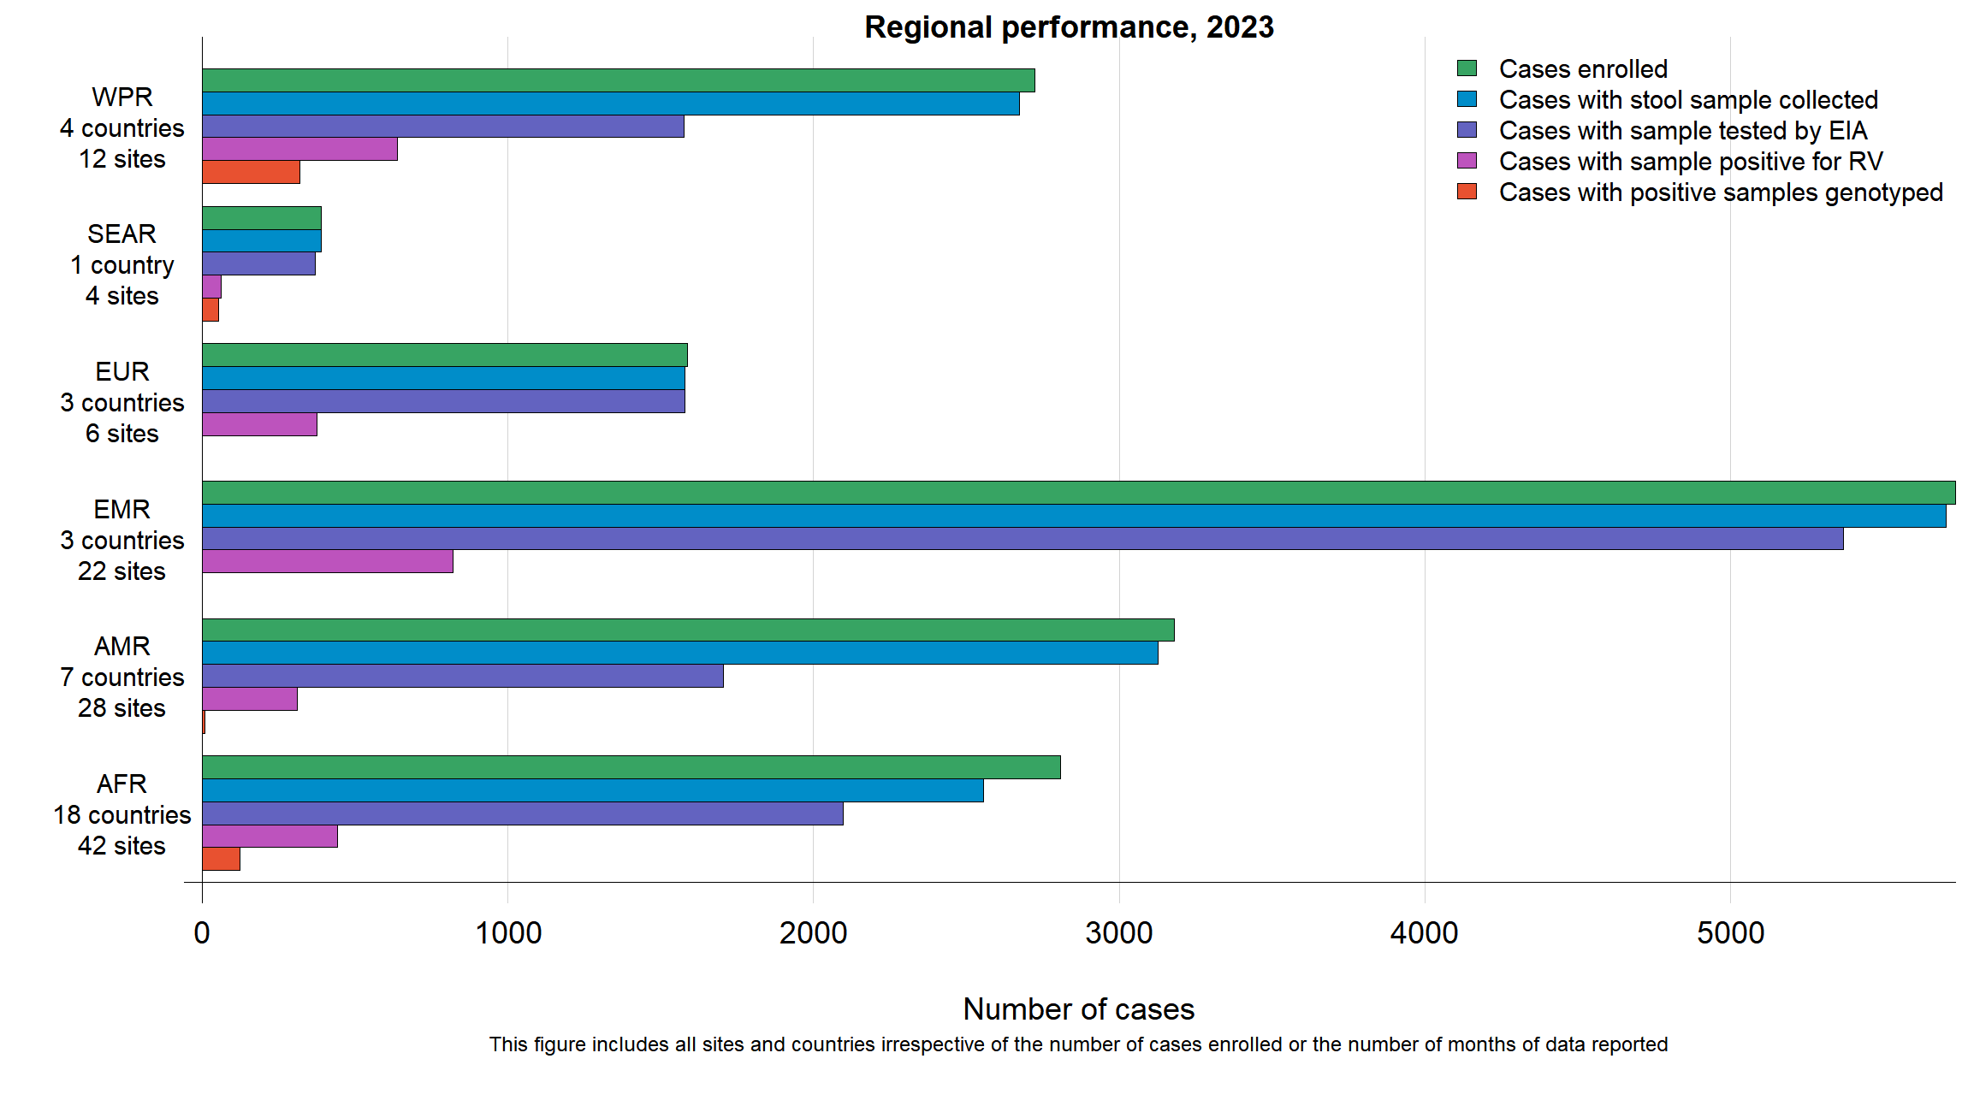
Regional GRSN surveillance performance, 2023

Slide 19
GRSN surveillance performance conclusions
Overall, surveillance performance and case enrolment has begun to recover from COVID-19 pandemic impact
  By 2022, the number of enrolled pediatric diarrhea cases rebounded above pre-pandemic levels in 2019
Work remains to improve the proportion of collected specimens tested by ELISA, and to increase the proportion of rotavirus-positive specimens with a genotype tested and reported

Slide 20
GRSN rotavirus positivity

Slide 21
The proportion of countries participating in GRSN that have introduced rotavirus vaccine has increased in recent years
2016
2022

Slide 22
Rotavirus positivity was significantly lower in GRSN countries with rotavirus vaccine, 2016-2022

Slide 23
Rotavirus positivity was consistently lower in GRSN countries with rotavirus vaccine

Slide 24
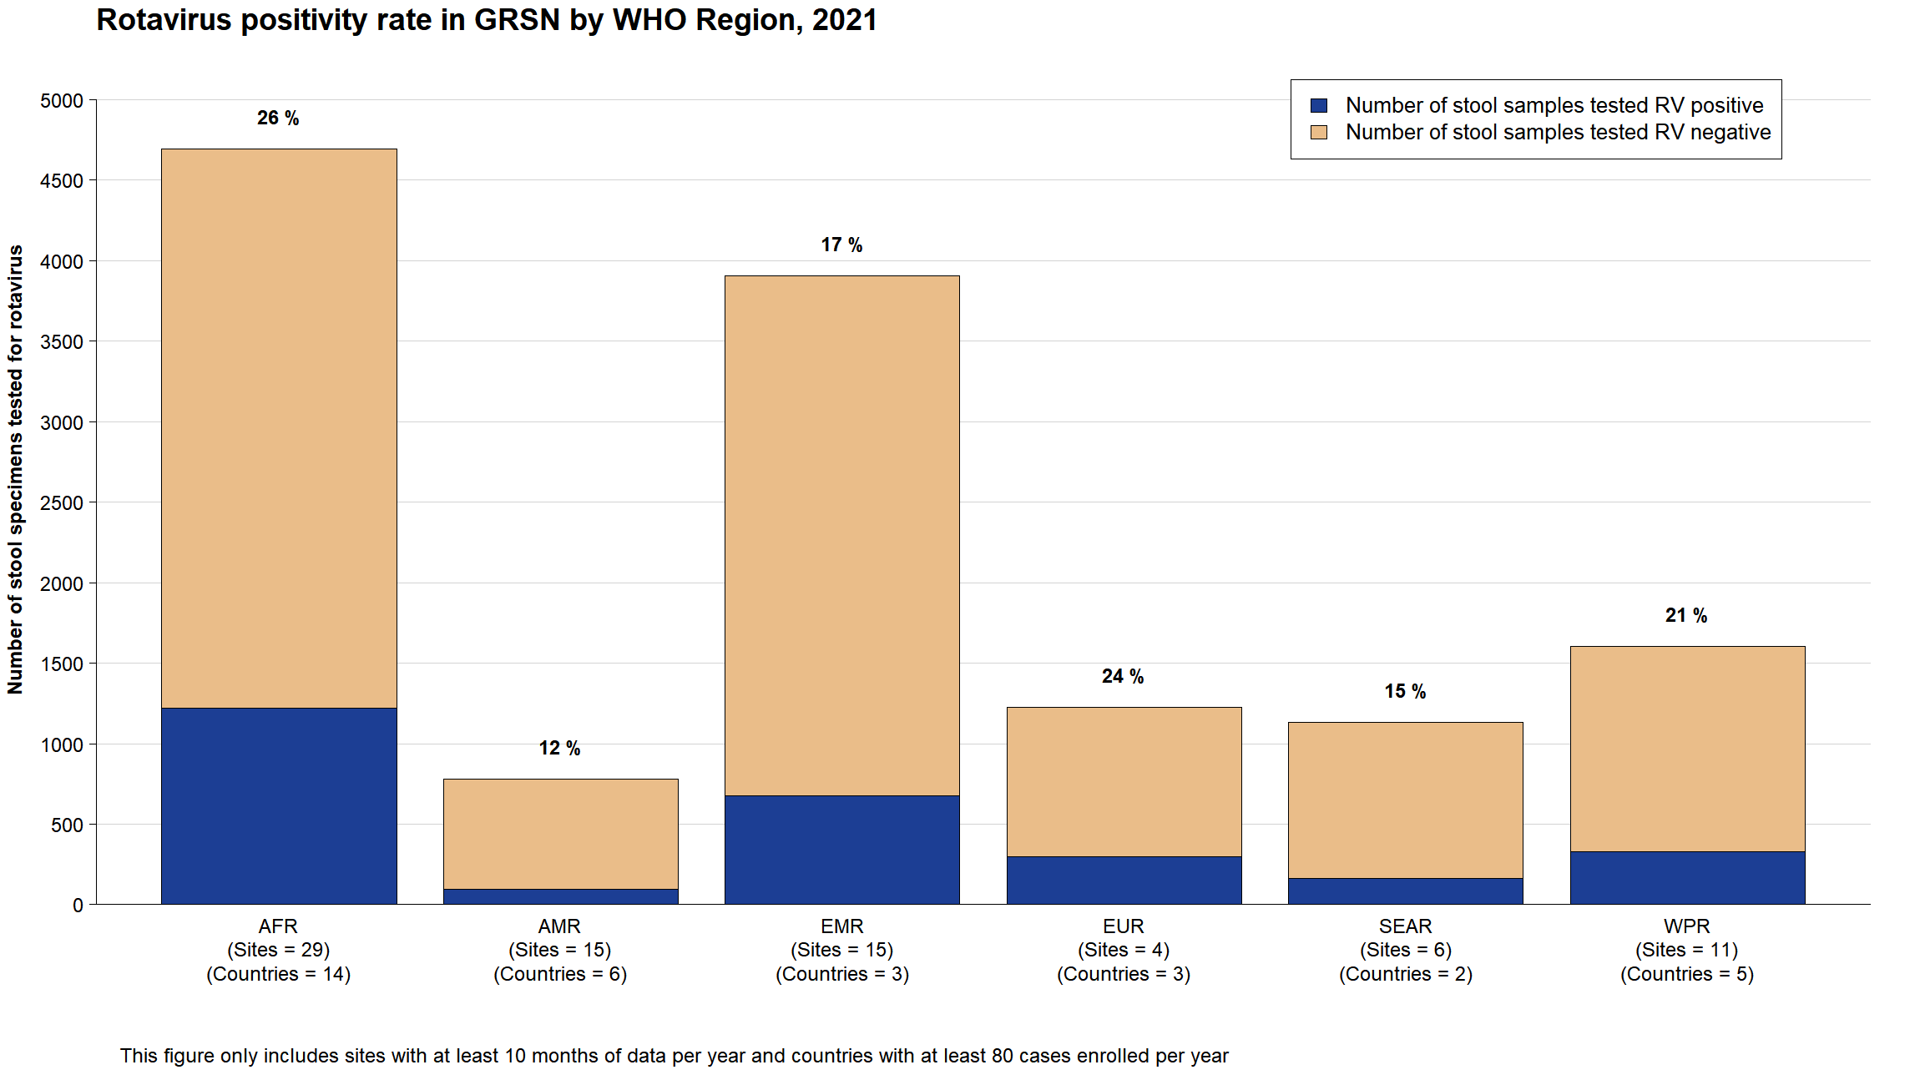

Slide 25
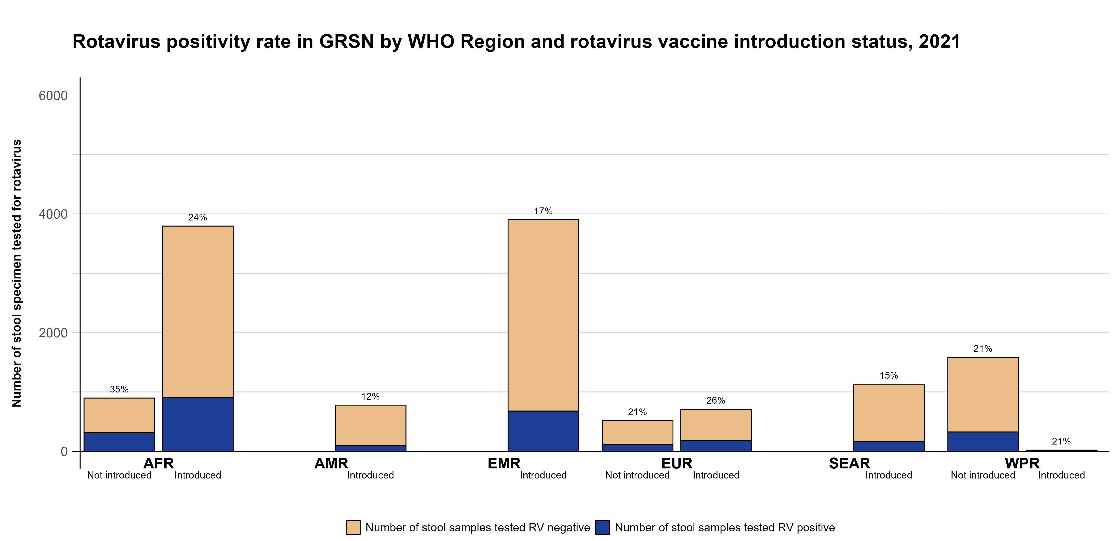

Slide 26
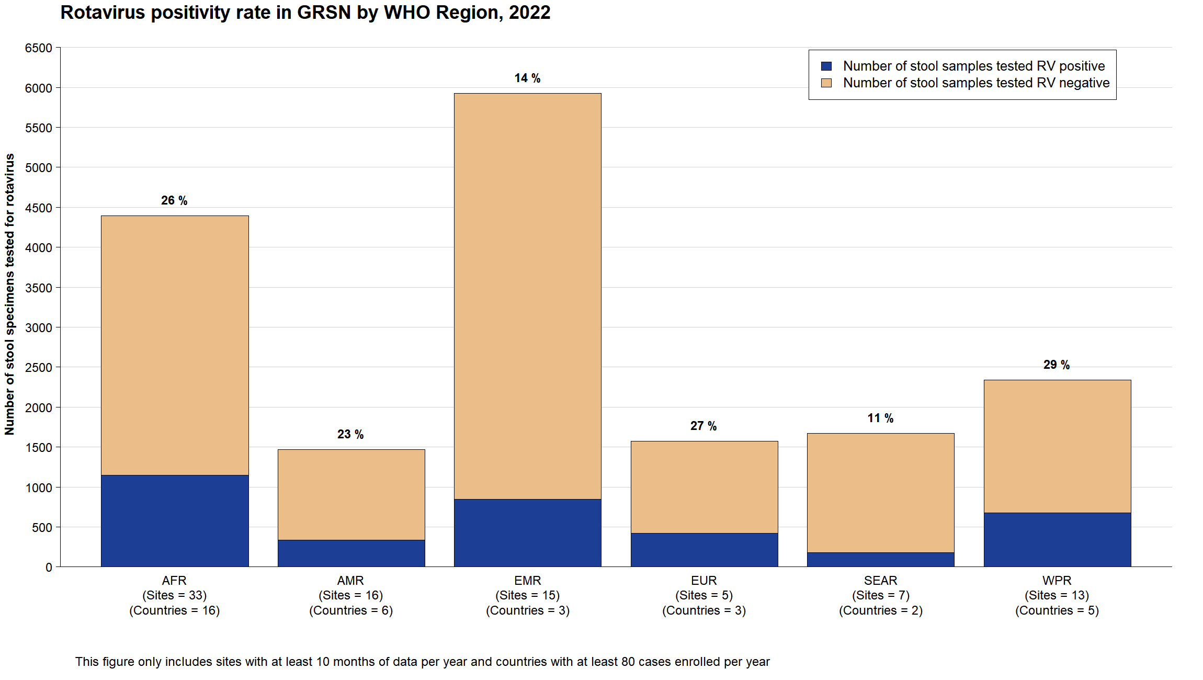
Notes:
WPRO: 30%

Slide 27
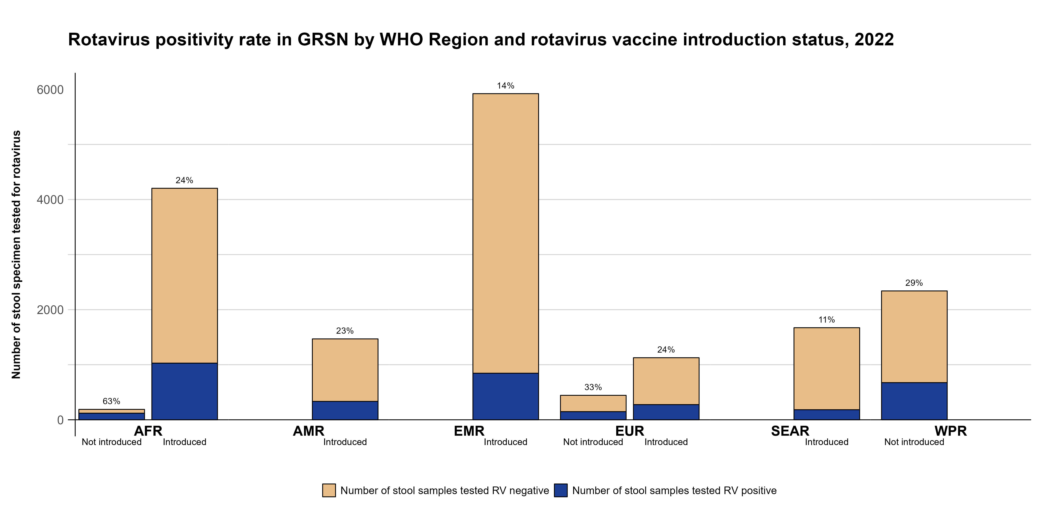

Slide 28
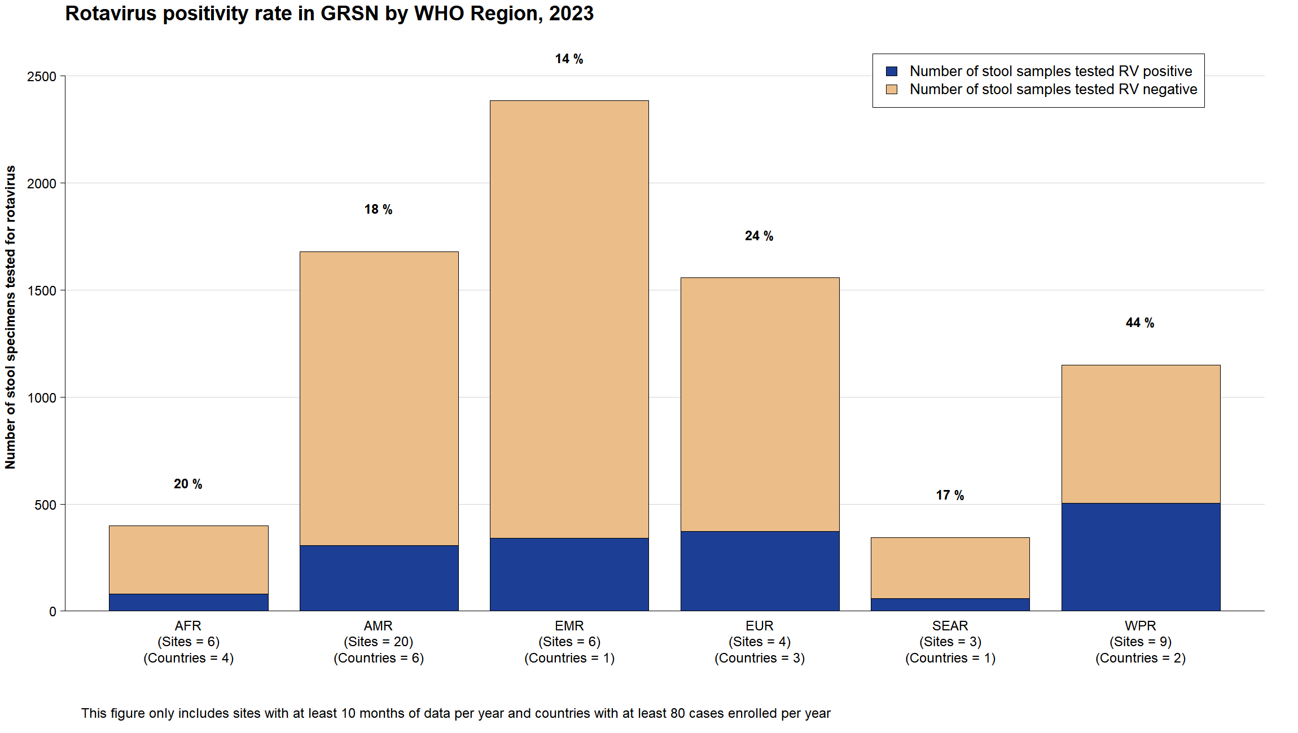

Slide 29
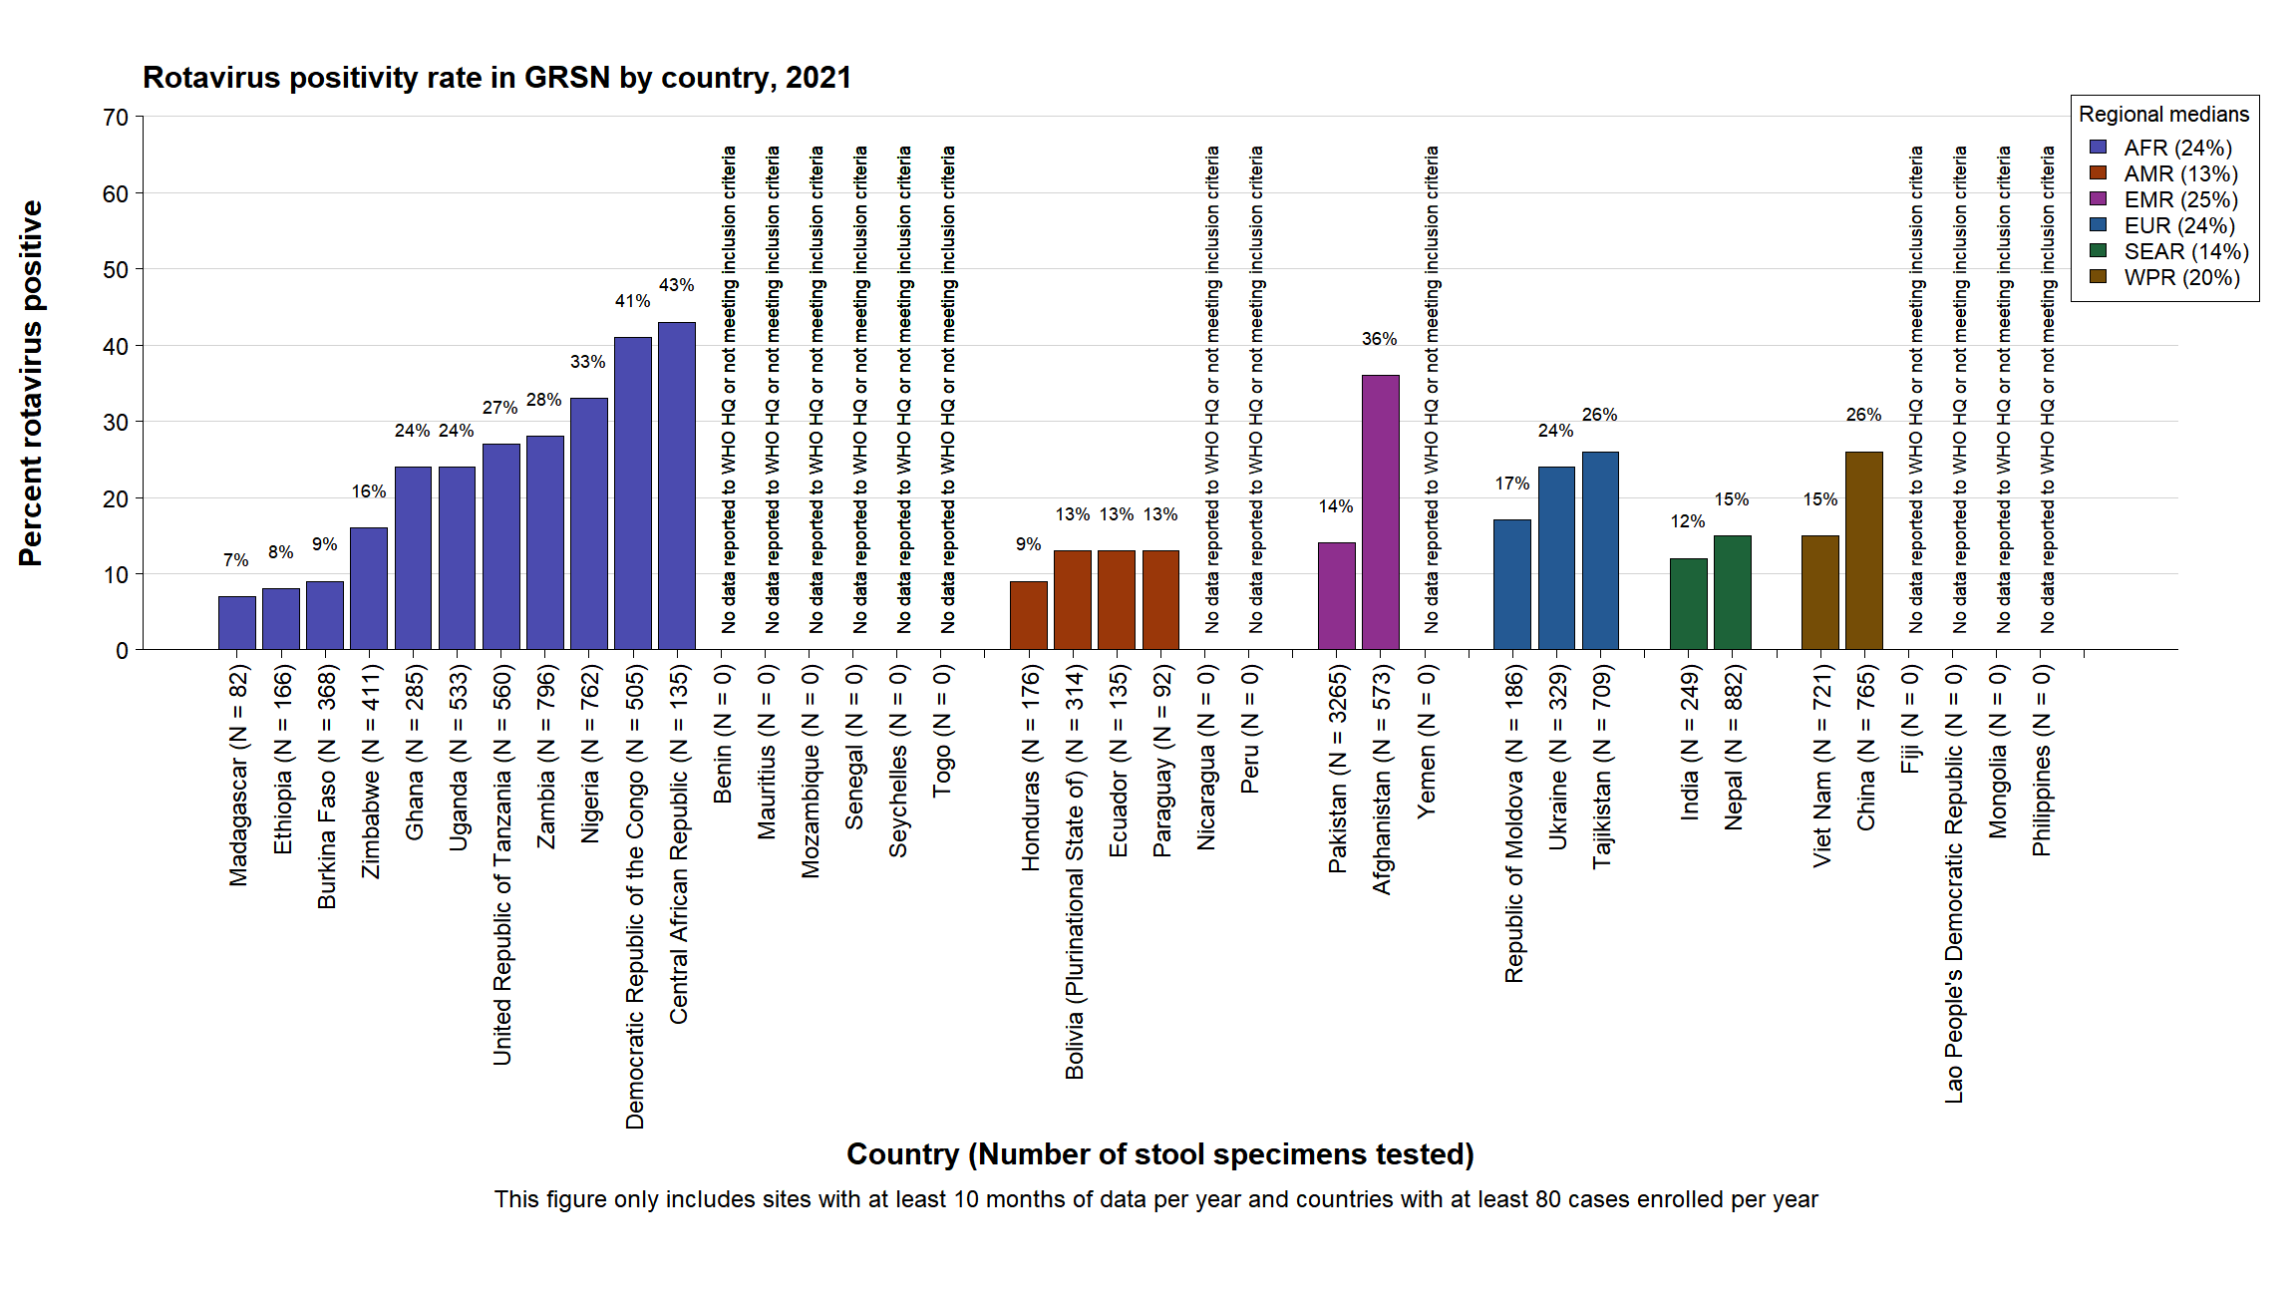

Slide 30
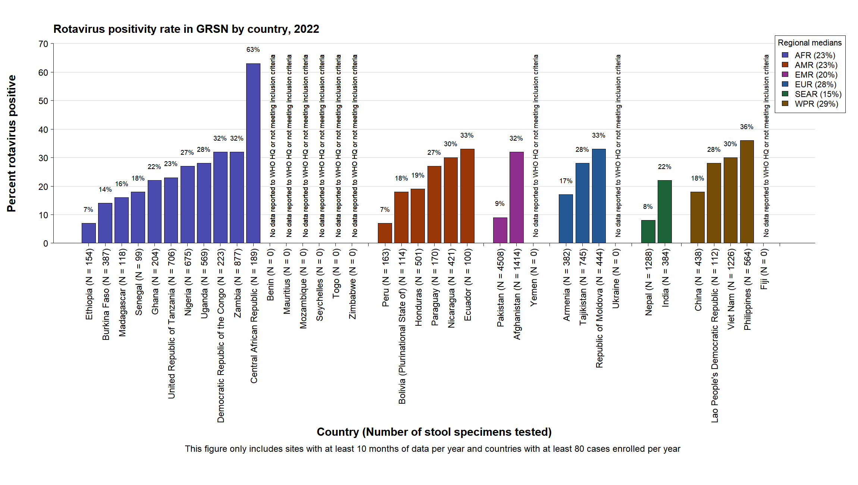

Slide 31
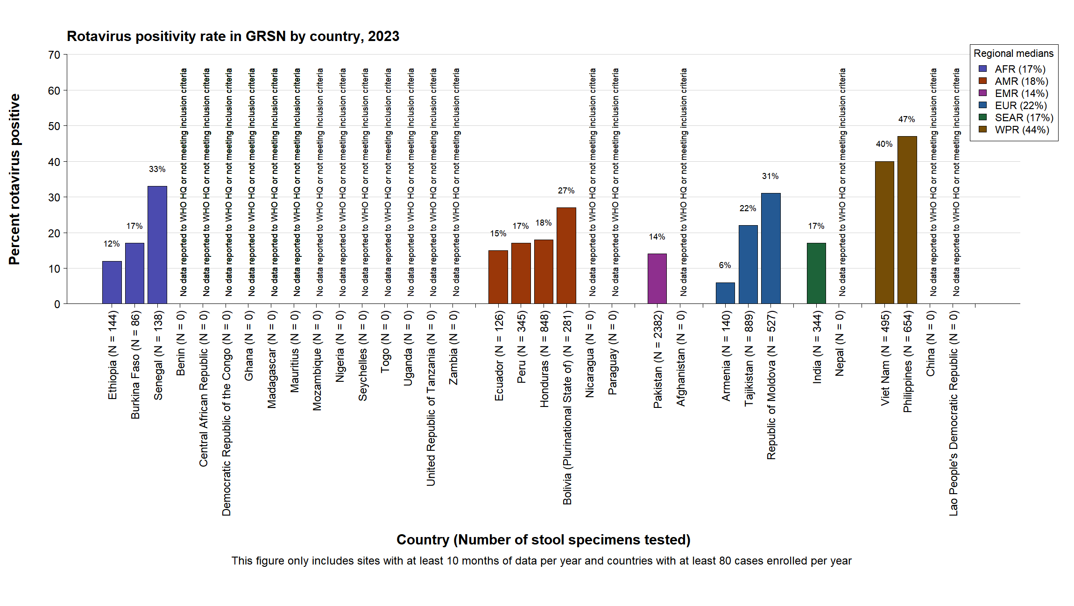

Slide 32
GRSN rotavirus positivity conclusions
The proportion of countries participating in GRSN that have already introduced rotavirus vaccine has increased over time
Globally, rotavirus positivity remains consistently lower in countries with rotavirus vaccine

Slide 33
GRSN rotavirus genotype data

Slide 34
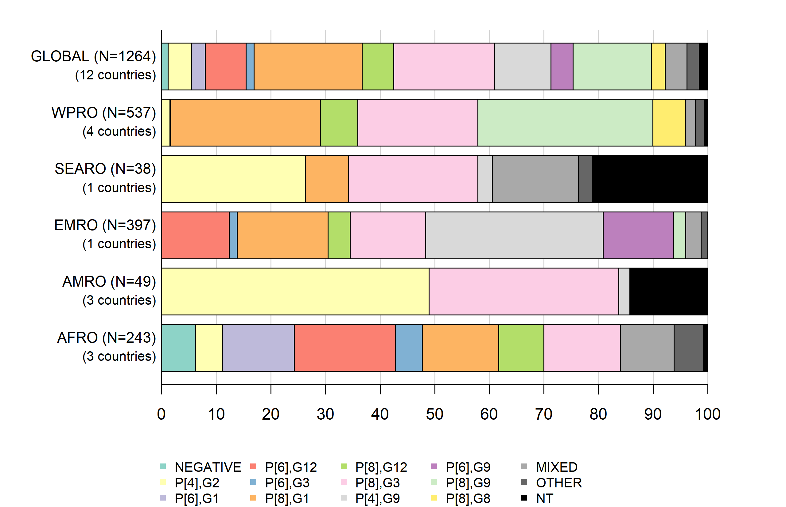
Rotavirus genotype distribution in GRSN, 2021

Slide 35
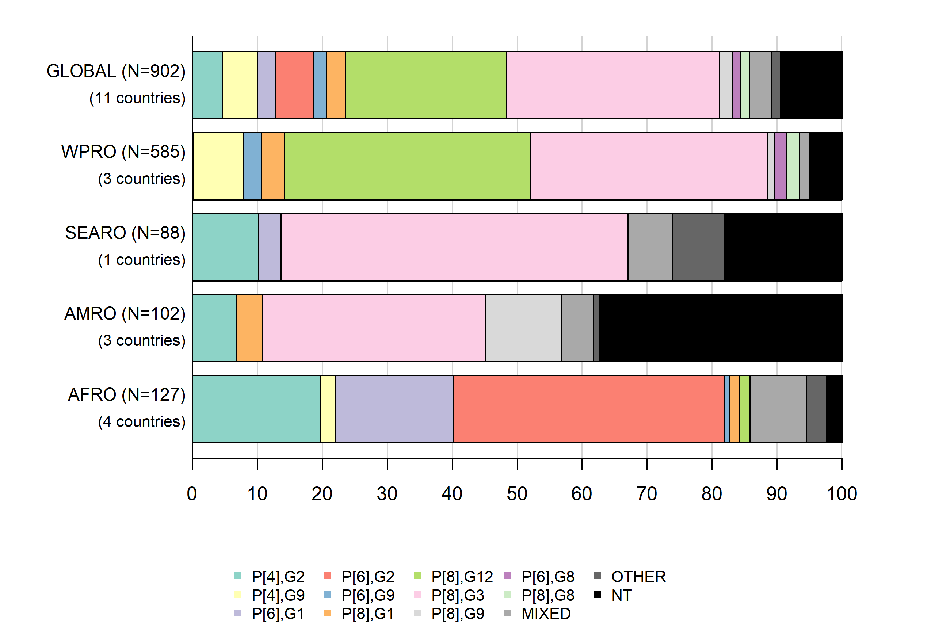
Rotavirus genotype distribution in GRSN, 2022

Slide 36
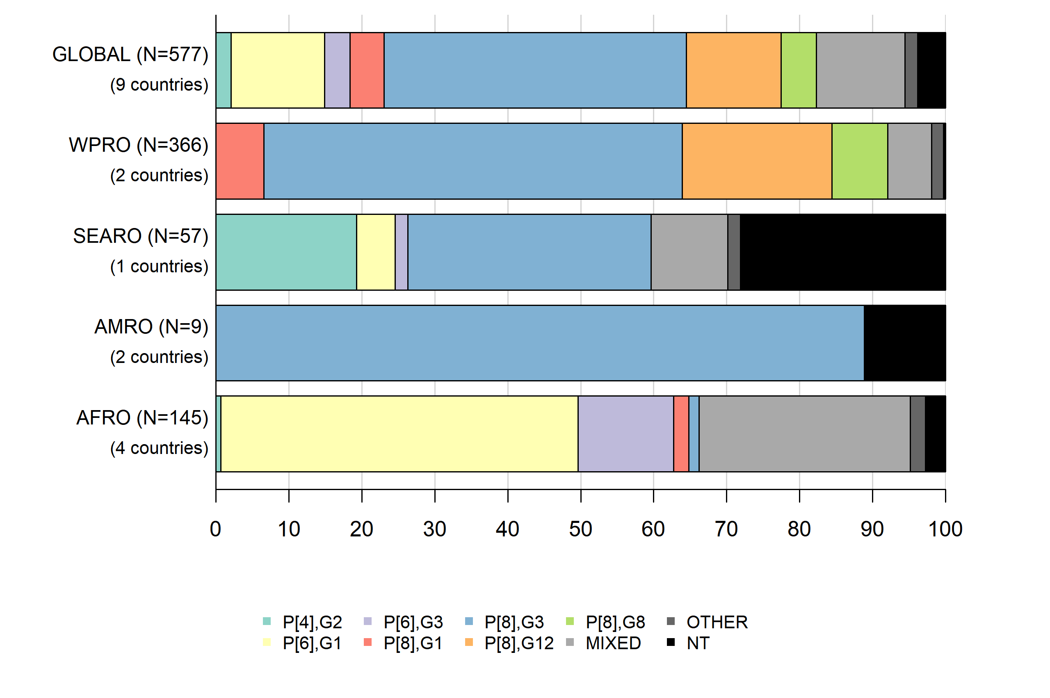
Rotavirus genotype distribution in GRSN, 2023

Slide 37
GRSN laboratory updates

Slide 38
In 2022, the GRSN laboratory network consisted of:
1
Global Reference Laboratory (U.S. CDC)
8
Regional Reference Laboratories
35
National or provincial laboratories
56
Surveillance site laboratories

Slide 39
GRSN Laboratory Network: Summary of Lab Capacities
WHO Region | Labs with EIA capacity | Labs with genotyping capacity
AFR | 37 | 12
AMR | 22 | 7
EMR | 19 | 1
EUR | 4 | 1
SEAR | 2 | 2
WPR | 16 | 10
Total | 100 | 33

Slide 40
Rotavirus External Quality Assessment
In 2022, rotavirus external quality assessment (EQA) activities resumed, with support from U.S. CDC
The EQA exercise included both enzyme immunoassay (EIA) to detect rotavirus, and genotyping for strain characterization among the subset of laboratories with genotyping capacities
The rotavirus proficiency testing panels consisted of lyophilized, non-infectious samples
Results from the 2022 rotavirus EQA program are presented on the following slides
Additionally, the 2023 rotavirus EQA program is currently underway

Slide 41
GRSN laboratory participation in 2022 Rotavirus EQA
Region | GRSN labs with EIA Capacity | Labs participating in 2022 EIA EQA | GRSN labs with GT Capacity | Labs participating in 2022 GT EQA
AFR | 37 | 27 (73%) | 12 | 5 (42%)
AMR | 22 | 2 (9%) | 7 | 2 (29%)
EMR | 19 | 11 (58%) | 1 | 1 (100%)
EUR | 4 | 3 (75%) | 1 | 0 (0%)
SEAR | 2 | 2 (100%) | 2 | 2 (100%)
WPR | 16 | 12 (75%) | 10 | 9 (90%)
Total | 100 | 57(57%) | 33 | 19 (58%)
All GRSN labs are encouraged to participate in future rounds of Rotavirus EQA

Slide 42
2022 Rotavirus EQA Program Response Times
Response times were calculated as the time between shipment of EQA panels and reporting of EQA results to CDC.
Main reasons for delayed result reporting:
Logistical challenges with EQA panel distribution & import
Lack of testing reagents to perform EIA/genotype testing
Moving forward, EQA organizers are working to ease some logistical challenges associated with panel distribution & import.
All GRSN labs are encouraged to ensure that appropriate staff is aware of panel shipment and timelines, and that non-expired reagents are present in the lab for testing EQA panels.
Region | Response time, Mean (days) | Response time, Range (days)
AFR | 38 | 1-232
AMR | 51 | 3-192
EMR | 24 | 2-117
EUR | 6 | 2-9
SEAR | 14 | 9-22
WPR | 12 | 5-18

Slide 43
2022 Rotavirus EQA Laboratory Performance
Rotavirus EQA Lab Score | Enzyme Immunoassay (n=57 participating labs) | Genotyping (n=19 participating labs)
100 points | 88% (n=50) | 42% (n=8)
90-99 points | 9% (n=5) | 42% (n=8)
80-89 points | 3% (n=2) | 11% (n=2)
<80 points | 0 | 5% (n=1)

Slide 44
Rotavirus enzyme immunoassay kits used by labs participating in the 2022 rotavirus EQA program
EIA Kit Name | Vendor | Proportion of Labs Using EIA Kits | Average EIA Score (%)
ProSpecT™ | Oxoid, Ltd. | 81% | 95.5
RIDASCREEN® | R-biopharm AG | 8.6% | 100
Premier™ Rotaclone® | Meridian Bioscience, Inc. | 6.7% | 100
Xpect™ Rotavirus Test | Thermo Fisher Diagnostics | 1.9% | 100
Rotavirus antigen-EIA BEST | Bioron GmbH | 0.9% | 100
Serazym® Rotavirus | GBG-MLD SRL. | 0.9% | 100

Slide 45
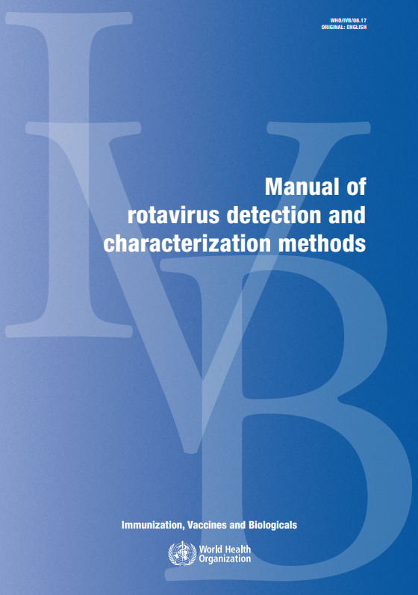
Rotavirus Lab Manual revision
The WHO Manual of rotavirus detection and characterization methods (last published in 2009) is being updated
Updates will include:
    Methodology (including updated genotyping methods)
    Laboratory quality assurance procedures
    Considerations for lab testing of other etiologies of pediatric diarrhea
A writing team of rotavirus laboratory experts has been assembled
We aim for the final product to be published by May 2025
WHO_IVB_08.17_eng.pdf

Slide 46
Global Pediatric Diarrhea Surveillance (GPDS)

Slide 47
Global Pediatric Diarrhea Surveillance (GPDS)
WHO, Member States and main technical partners, the U.S. Centers for Disease Control and Prevention (CDC) and the University of Virginia (UVA), have leveraged the Global Rotavirus Surveillance Network to establish the Global Pediatric Diarrhea Surveillance (GPDS) network to further study the etiology of diarrhea among hospitalized children under 5 years of age by using a molecular diagnostic technology called TaqMan Array Card (TAC) singleplex real-time PCR that simultaneously detects more than 20 enteric pathogens.
Selected sentinel sites with high performing surveillance are part of GPDS and contribute to gathering important data that will provide global, regional, and country-level estimates of pathogen specific diarrhea related to hospitalizations among children under 5 years. These data contribute to a better estimation of pathogen-specific disease burden among young children with severe diarrhea and improve our understanding of the main causes of diarrhea among this age group. These data on the burden of pediatric diarrhea are not only important to monitor the success of rotavirus vaccination but also to provide evidence for the role of additional enteric vaccines that are currently in development, such as ETEC, Shigella and norovirus.
GRSN is the platform for GPDS; GRSN sites that are additionally participating in GPDS expand their case definition to include all pediatric diarrhea regardless of duration or presence of blood in stool. In these sites, 100 samples per year are randomly selected from the cumulative samples at the end of the year for TAC testing. GPDS data is used to estimate pathogen-specific attributable burdens of diarrheal hospitalizations at the site, country, regional, and global levels.

Slide 48
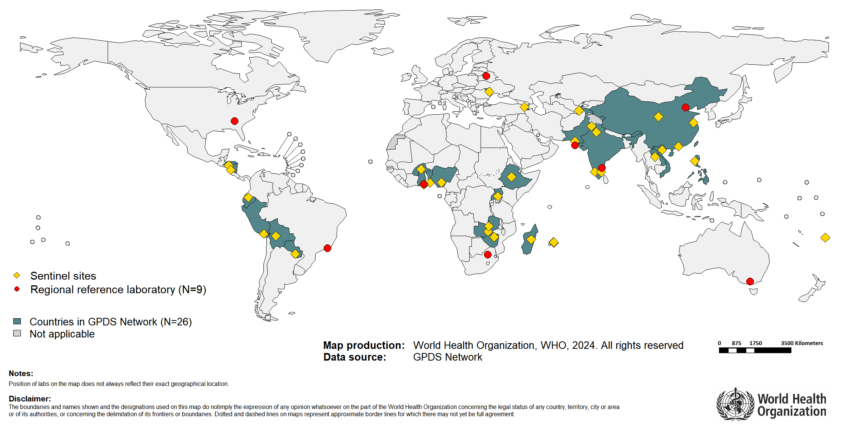
Countries participating in the Global Pediatric Diarrhea Surveillance network (GPDS), 2022

Slide 49
Global Pediatric Diarrhea Surveillance - updates
Analysis of 2017-2018 data has been published:
  Aetiology and incidence of diarrhoea requiring hospitalisation in children under 5 years of age in 28 low-income and middle-income countries: findings from the Global Pediatric Diarrhea Surveillance network | BMJ Global Health
Analysis of 2019-2020 data is complete (see following slides)
Testing of 2021 specimens is nearly complete (preliminary analysis is presented in following slides)
Testing of 2022 specimens is ongoing; preliminary analysis is underway
Testing of 2023 specimens will begin soon

Slide 50
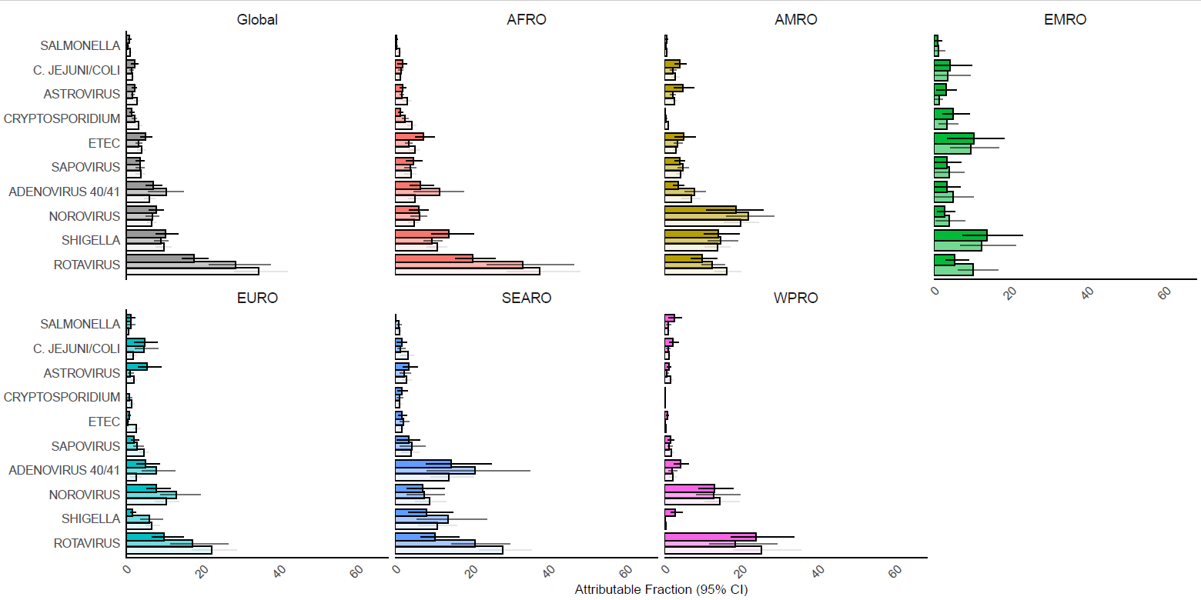

Pathogen-specific attributable fractions of hospitalized diarrhea in children aged <5 years in Global Pediatric Diarrhea Surveillance both globally and by WHO Region, 2017–2021
Based on data analyzed as of 24 May 2024
50

Slide 51
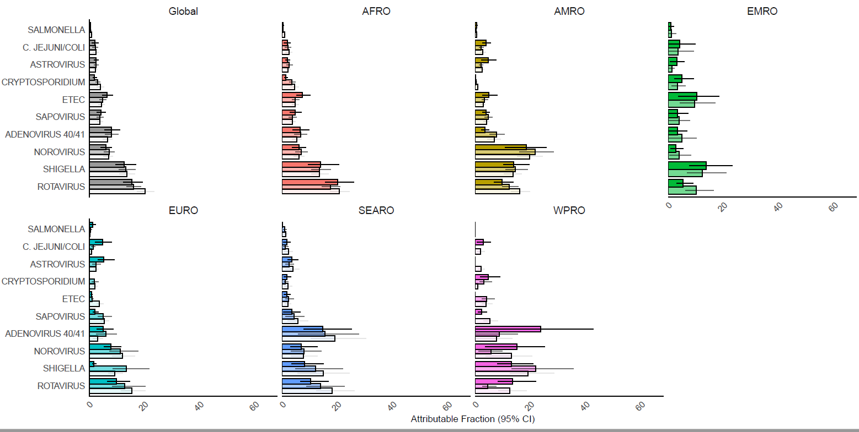
Pathogen-specific attributable fractions of hospitalized diarrhea in children aged <5 years in countries that have introduced rotavirus vaccine only, GPDS 2017-2021
Based on data analyzed as of 24 May 2024
51

Slide 52
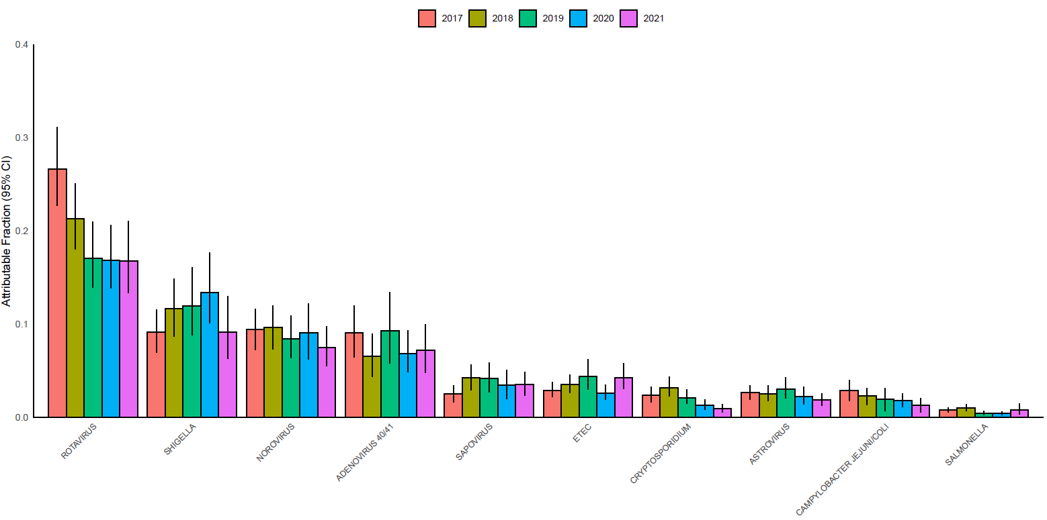
GPDS 2017-2021: Overall trends in pathogen-specific attributable fractions for countries included in all 5 years of surveillance
Based on data analyzed as of 24 May 2024
52

Slide 53
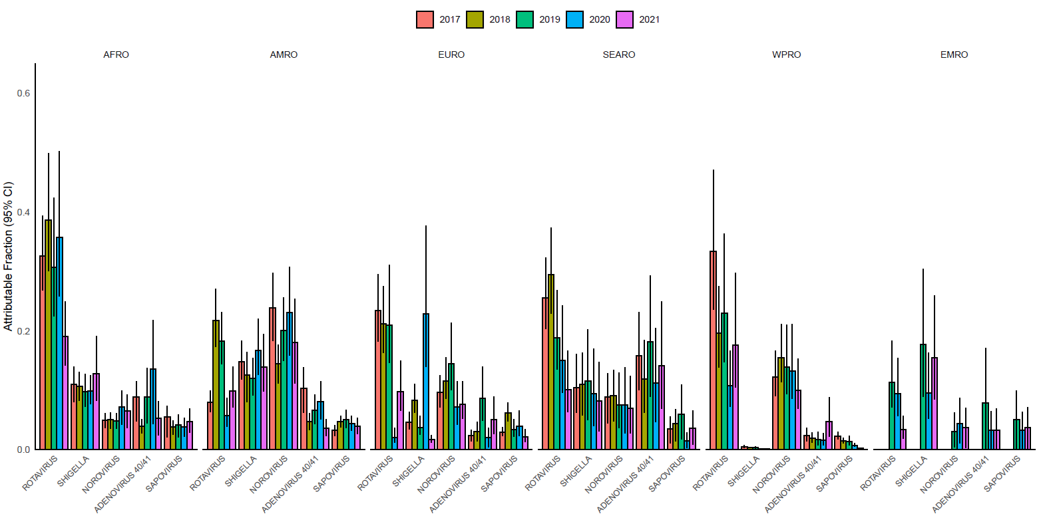
GPDS 2017-2021: Overall trends in pathogen-specific attributable fractions for countries included in all 5 years of surveillance, stratified by WHO Region
Based on data analyzed as of 24 May 2024
53

Slide 54
GPDS 2017-2020: Pathogen-specific attributable incidence of diarrhea hospitalizations
Based on data analyzed as of 24 May 2024. To estimate incidence, we applied GPDS pathogen-specific attributable fractions to national-level estimates of the number of diarrhea hospitalizations and under 5 populations from the Global Burden of Disease study. 2021 data is not included in this incidence graph as the GPDS incidences are calculated in 2-year increments; 2021-2022 incidence will be added once 2022 results are available.
54

Slide 55
GPDS conclusions
Despite the substantial impact of rotavirus vaccine introduction, rotavirus remained the leading cause of pediatric diarrhea hospitalizations in 2017-2021
  However, the gap between rotavirus and other leading pathogens has closed substantially in countries that have introduced rotavirus vaccine
Shigella (with a burden of diarrhea similar to rotavirus in countries that have introduced rotavirus vaccine), norovirus, and adenovirus 40/41 are other important causes of diarrhea requiring hospitalization in these settings

Slide 56
Recent GRSN/GPDS publications

Slide 57
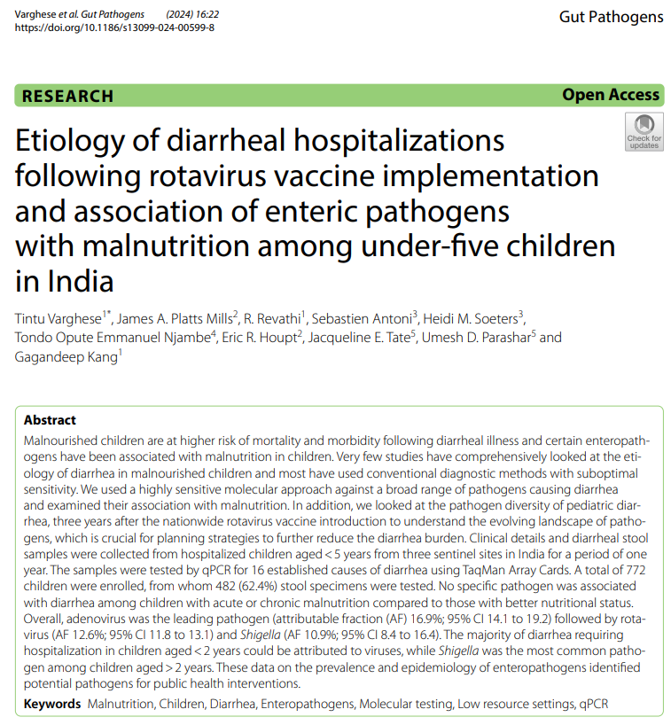
GPDS in India
Diarrheal burden still remains high, especially among children <2 years old
Acutely malnourished children are more likely to develop severe diarrhea
There was no association between any specific pathogen and malnutrition status
The rotavirus burden is substantial despite nationwide vaccination
  Need to focus on strategies to improve the performance of rotavirus vaccines
Interventions addressing malnutrition, adenovirus 40/41 and Shigella are important to address diarrheal related morbidity and mortality
https://gutpathogens.biomedcentral.com/articles/10.1186/s13099-024-00599-8

Slide 58
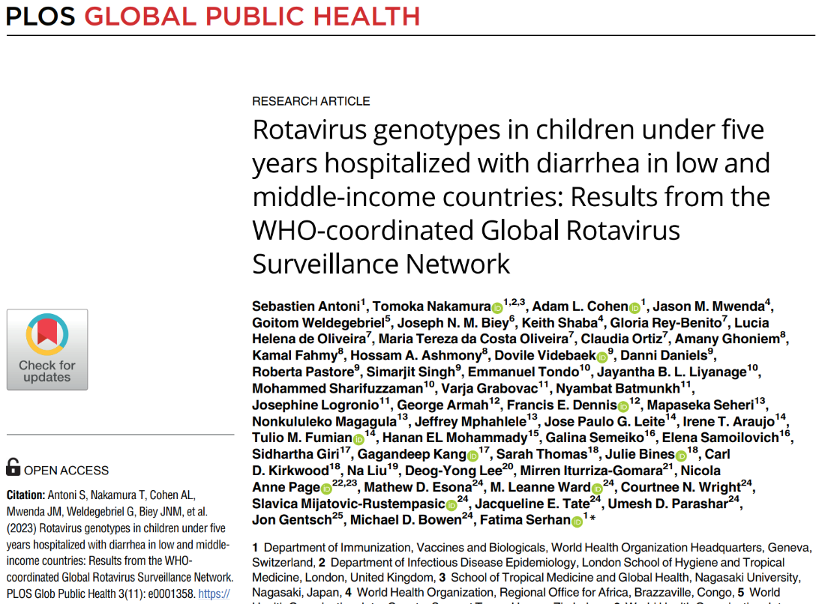
Rotavirus genotypes
Genotype data of >16,000 rotavirus isolates from 40 countries participating in GRSN
Globally, the most frequent genotypes were G1P[8] (31%), G1P[6] (8%) and G3P[8] (8%)
G1P[8] was less frequent in countries that had introduced the rotavirus vaccine while different strains are emerging or re-emerging in different regions
https://journals.plos.org/globalpublichealth/article?id=10.1371/journal.pgph.0001358

Slide 59
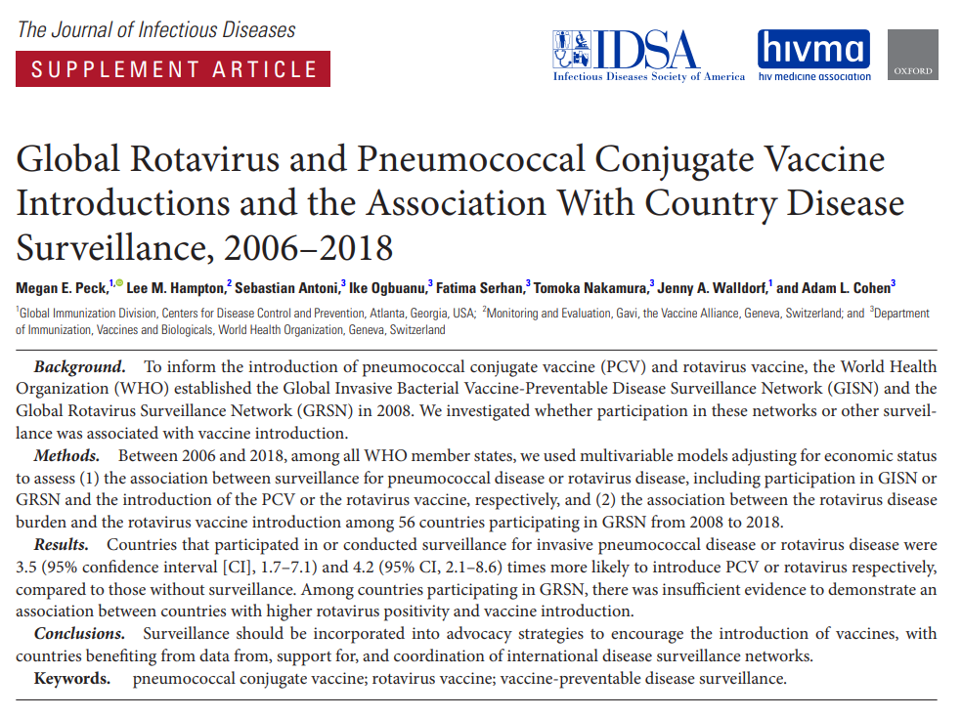
Association between rotavirus surveillance & vaccine introduction
Countries that participated in or conducted surveillance for rotavirus disease were 4.2 times more likely to introduce rotavirus vaccine, compared to countries without surveillance
https://academic.oup.com/jid/article/224/Supplement_3/S184/6361075

Slide 60
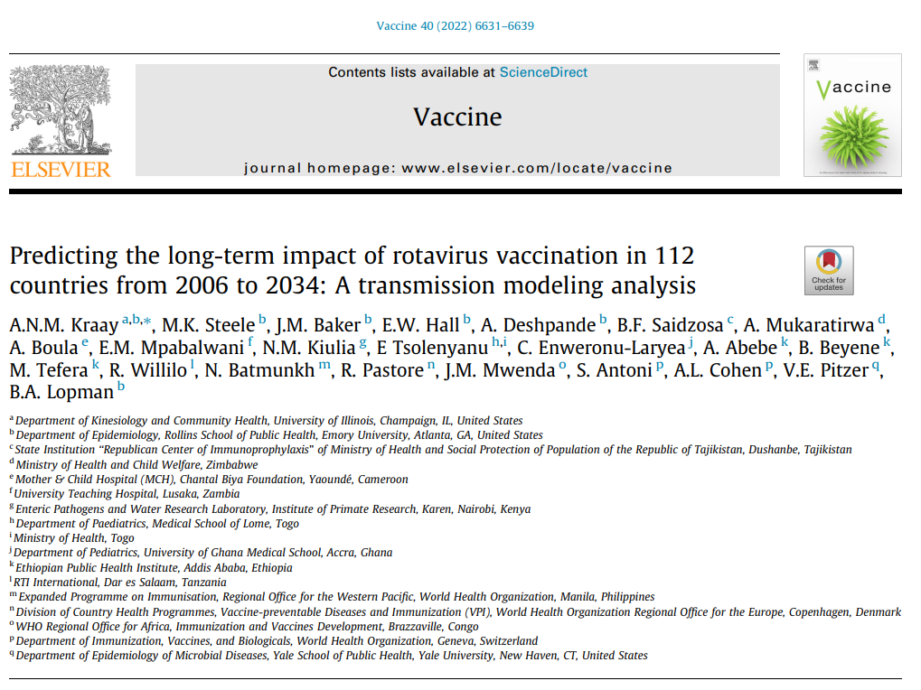
Long-term global impact of rotavirus vaccination
Transmission model to estimate the long-term impact of rotavirus vaccination on deaths and disability adjusted life years (DALYs) from 2006 to 2034 for 112 low- and middle-income countries
Estimated that vaccination would reduce deaths from rotavirus by 49.1 % by 2034
69-97% of this benefit is due to direct benefit to vaccinated individuals
https://www.sciencedirect.com/science/article/abs/pii/S0264410X22011938

Slide 61
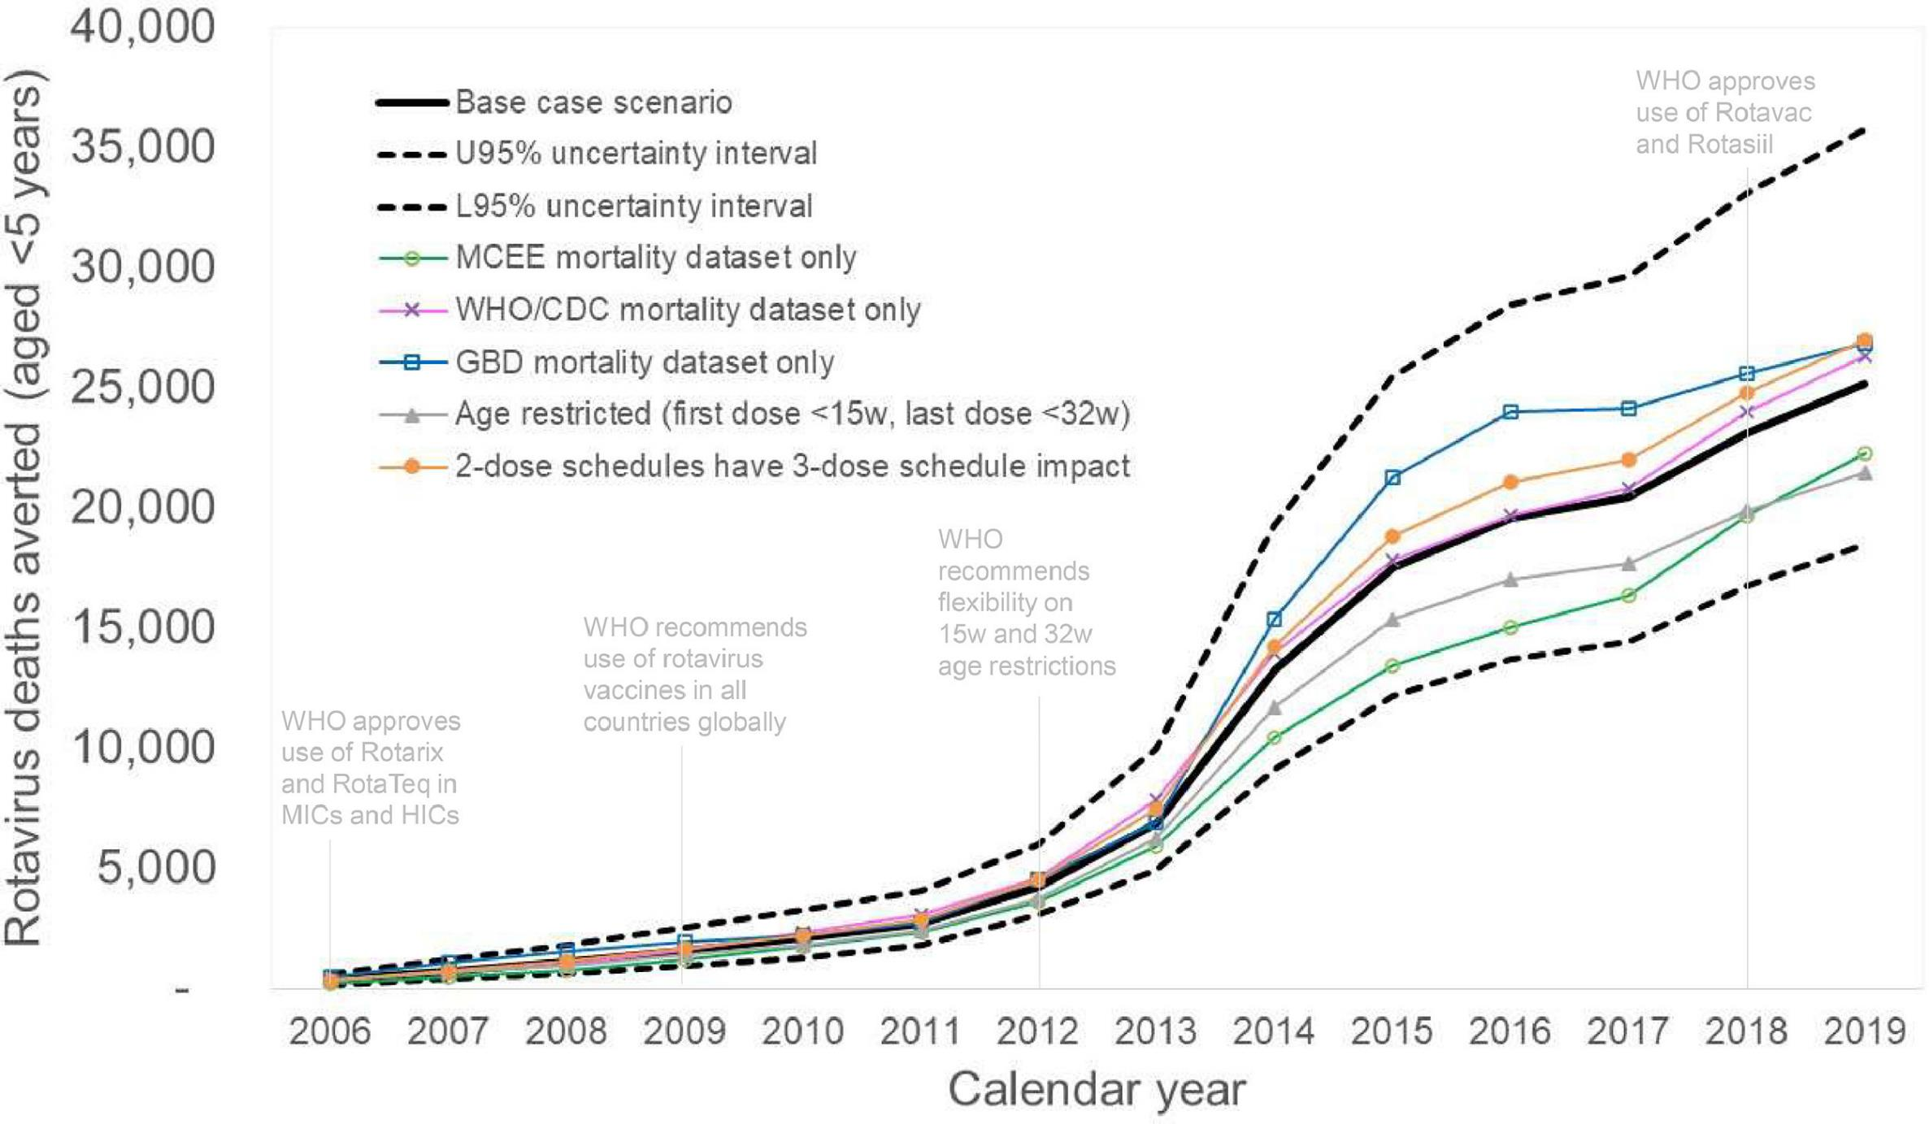
Rotavirus vaccines prevented 139,000 child deaths in 2006-2019
139,000
https://www.ijidonline.com/article/S1201-9712(23)00742-7/fulltext

Slide 62
Other Recent Publications from GRSN/GPDS
  Cohen, Platts-Mills et al. Aetiology and incidence of diarrhoea requiring hospitalization in children under 5 years of age in 28 low-income and middle-income countries: findings from the Global Pediatric Diarrhea Surveillance network. BMJ Global Health. 2022; 7:e009548.
  Hartman et al. Risk factors for mortality among children under 5 years of age with severe diarrhea in low- and middle-income countries: Findings from the WHO-coordinated Global Rotavirus and Pediatric Diarrhea Surveillance Networks. Clin Infect Dis. 2022;ciac561.
  Murray et al. Multicountry Analysis of Spectrum of Clinical Manifestations of Children <5 Years of Age Hospitalized with Diarrhea. Emerg Infect Dis. 2019; 25(12):2253-2256.
  Aliabadi et al. Global impact of rotavirus vaccine introduction on rotavirus hospitalisations among children under 5 years of age, 2008-16: findings from the Global Rotavirus Surveillance Network. Lancet Glob Health. 2019; 7(7):e893-e903.
  Hasso-Agopsowicz et al. Global Review of the Age Distribution of Rotavirus Disease in Children Aged <5 Years Before the Introduction of Rotavirus Vaccination. Clin Infect Dis. 2019; 69(6):1071-1078.
  Hasan et al. Using pneumococcal and rotavirus surveillance in vaccine decision-making: A series of case studies in Bangladesh, Armenia and the Gambia. Vaccine. 2018; 36(32 Pt B):4939-4943.
  Operario et al. Etiology of Severe Acute Watery Diarrhea in Children in the Global Rotavirus Surveillance Network Using Quantitative Polymerase Chain Reaction. J Infect Dis. 2017; 216(2):220-227.

Slide 63
Additional information

Slide 64
Acknowledgements
All collaborators in the GRSN/GPDS networks
Participating Ministries of Health
Sentinel surveillance hospitals & staff
WHO regional office and country office colleagues
National, Regional, and Global reference laboratories
Partners (U.S. Centers for Disease Control and Prevention, University of Virginia)
Global Burden of Disease Study – Institute for Health Metrics and Evaluation
Financial support from and the Bill & Melinda Gates Foundation and the U.S. Centers for Disease Control and Prevention
WHO HQ VPD surveillance and risk assessment team, and Global monitoring team

Slide 65
Useful links
WHO Vaccine-Preventable Disease Surveillance Standards
Rotavirus Laboratory Network
WHO Immunization Data
WHO Department of Immunization, Vaccines and Biologicals

Slide 66
Contact us
Epidemiology Focal Point Heidi Soeters soetersh@who.int
Data Focal Point Sébastien Antoni antonis@who.int
Lab Focal Points Mick Mulders muldersm@who.int
Shilpa Iyer iyers@who.int
Our mailing address is:
World Health Organization
Avenue Appia 20
Geneve 1211
Switzerland

Slide 67
How to subscribe
To subscribe to this global rotavirus and pediatric diarrhea surveillance update, please contact Sébastien Antoni at antonis@who.int

